Slide 1
Meet Wonder Workshop™ Dash with Geometry Challenges TI-Nspire CXII Python
Texas Instruments
@ticalculators

Slide 2
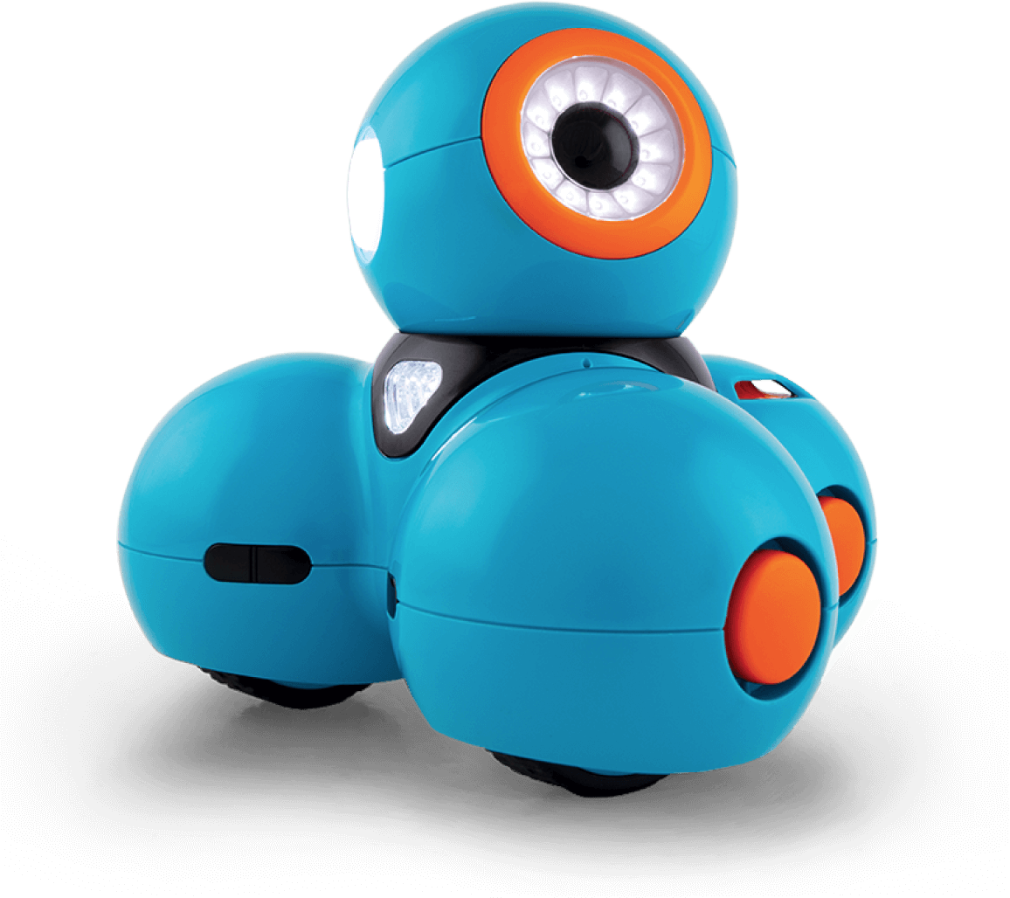
Meet the Wonder Workshop™ Dash

Slide 3
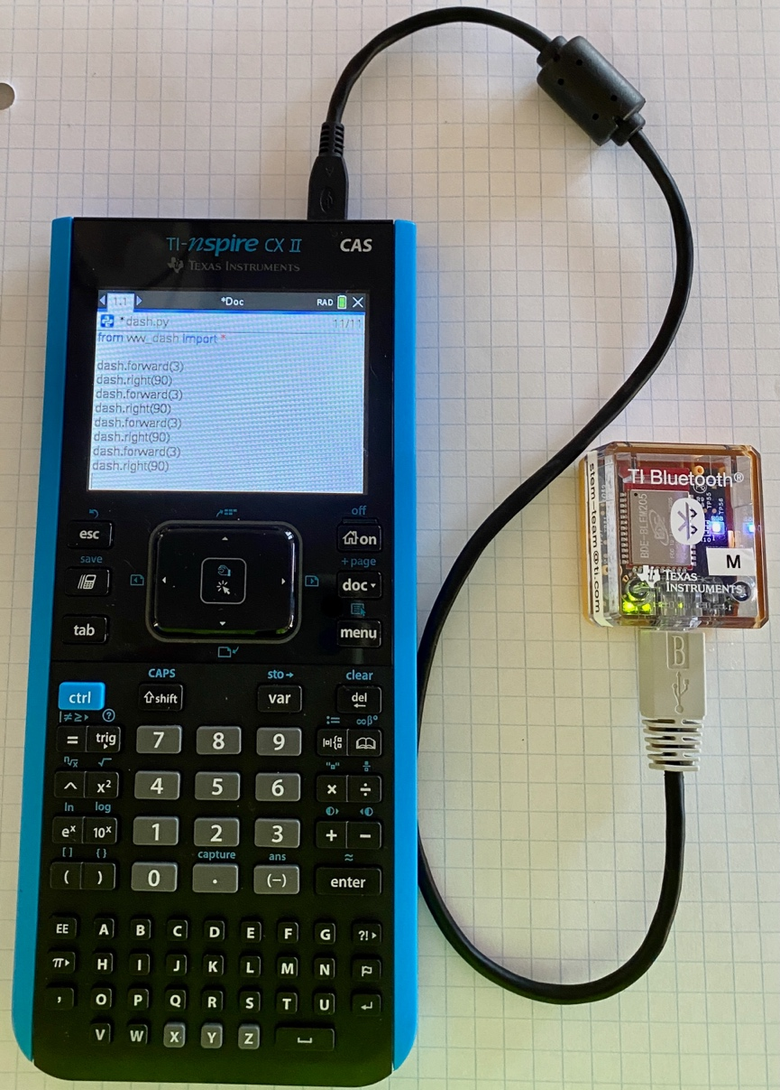
Control the Dash using Python from the TI-Nspire CXII over Bluetooth Wireless
TI Bluetooth Adapter
Wonder Workshop™ Dash
TI-Nspire CXII

Slide 4
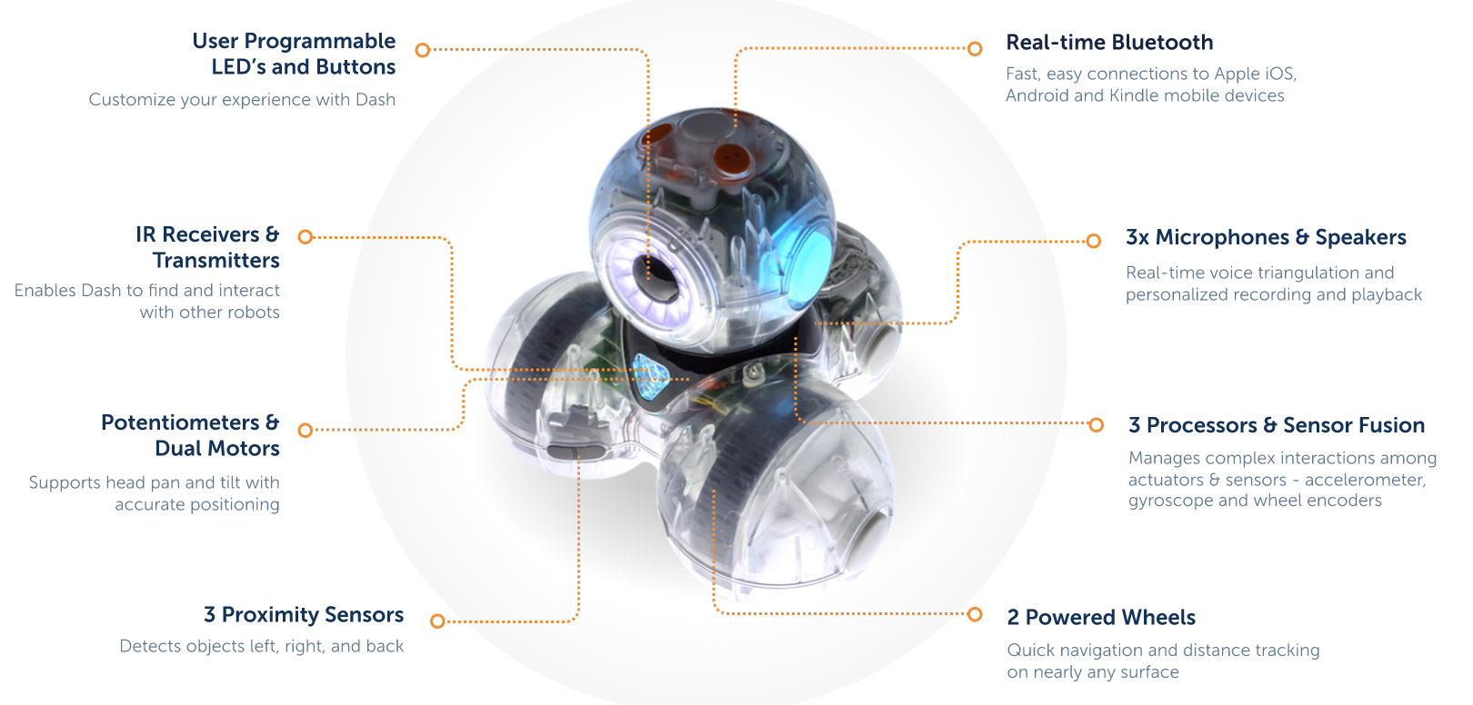
Meet the Wonder Workshop™ Dash

Slide 5
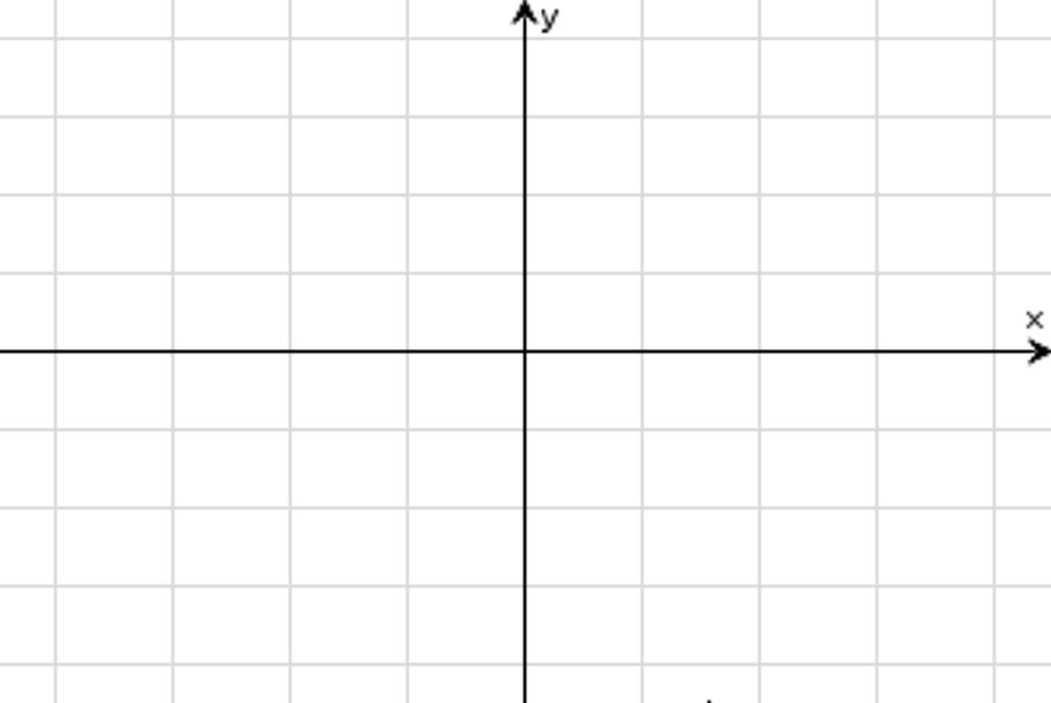
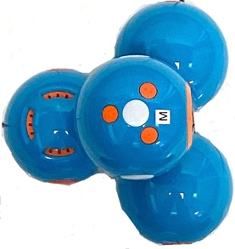
Dash orientation and virtual grid
90º
0º
180º
270º
Dash programs set the initial position as the origin and the heading as 0 degrees measured from the x-axis.
Note: The Dash tracks its position on a virtual coordinate grid with a unit value of 10 cm. The coordinate grid position applies to the to_xy(x,y), to_polar(r,theta_degrees) and to_angle(heading angle, “unit”) functions on the Dash Drive menu. The virtual grid also applies to Path menu functions.

Slide 6
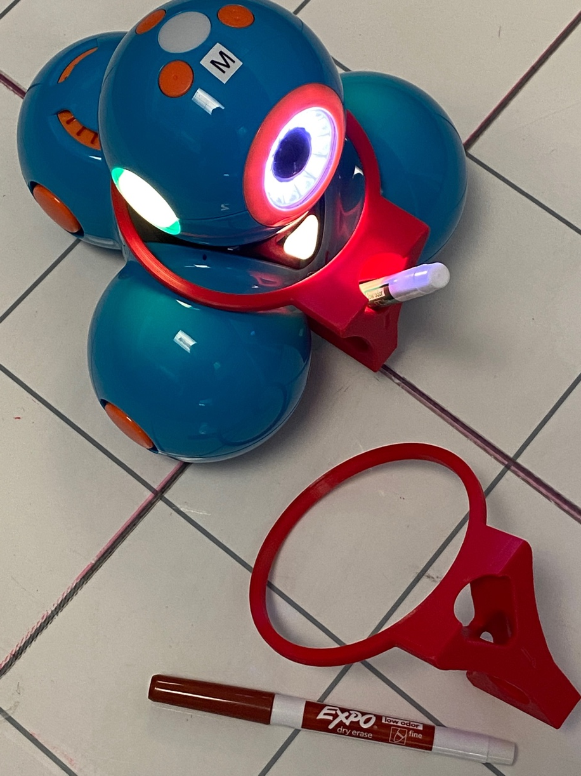
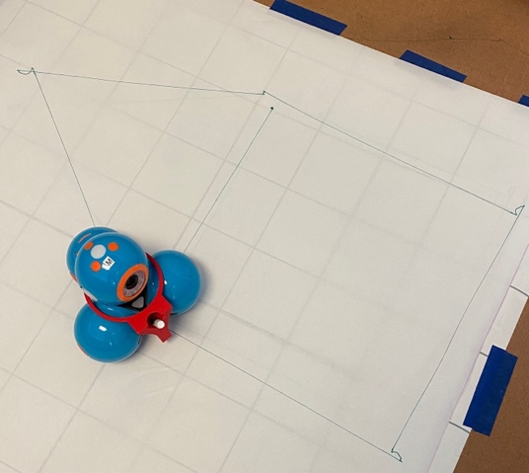
Draw with your Dash
Optional
3D Print a snap-on attachment to hold Expo Fine dry erase markers for your Dash.
Step 1: Download .stl file at this link.
Step 2: 3D print following these recommendations.
Material PLA
Supports not recommended.
20% infill
3 to 4 shells
0.2mm layer height

Slide 7
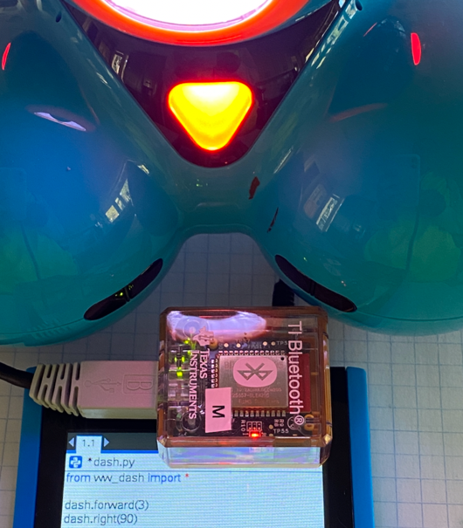
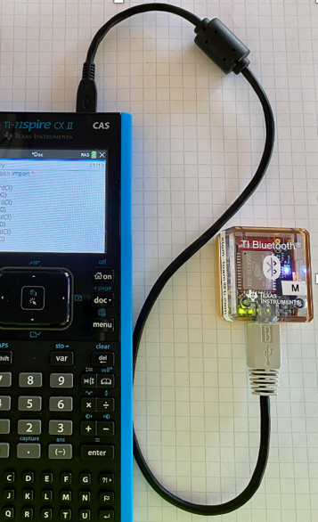
Setting up your calculator and TI Bluetooth adapter to run Dash Find step-by-step directions in the Getting Started Guide at education.ti.com/dash
Follow the steps below to put the necessary files onto your calculator and to pair your TI Bluetooth Adapter with a Dash.
4
Turn on a Dash.
Open the SetDash.tns file and follow the directions to search for and select a Dash to pair with the TI Bluetooth Adapter.
The Adapter “remembers” the Dash that it is paired with until you use the SetDash.tns file to make a change.
Students can share a Dash by passing a paired Adapter to plug into their calculator.
Use stick-on letters or names to identify Dash/Adapter pairs. (”M” is used in the photo.)
Note: The color of the adapter LED and the paired Dash LED’s match (Red in the Photo). Use the SetDash setup program to control the Dash color.
1
Download the ww_dash.tns Python module file and the SetDash.tns file to your calculator using your TI-Nspire computer software or by going to https://nspireconnect.ti.com/ on your Chrome browser.
Open the ww_dash.tns file and follow the directions to install the module into the PyLib folder.
2
3
Plug the TI Bluetooth Adapter into your calculator.
5
Quit the SetDash setup program.
You are now ready to write and run Python programs to control the Dash.

Slide 8
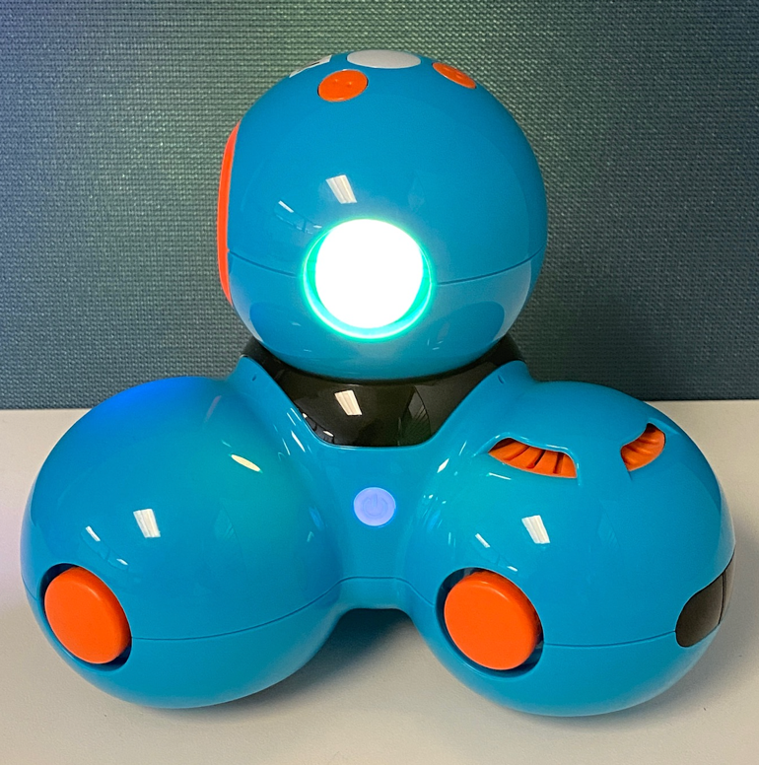
Getting ready to run a Dash program
1
Make sure that your Dash is switched on.
2
Plug the Bluetooth Adapter that is paired with the Dash into the calculator.
You are now ready to run Python programs that control the Dash.

Slide 9
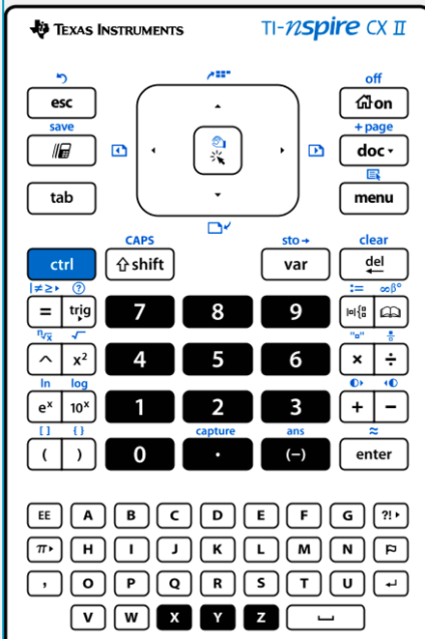
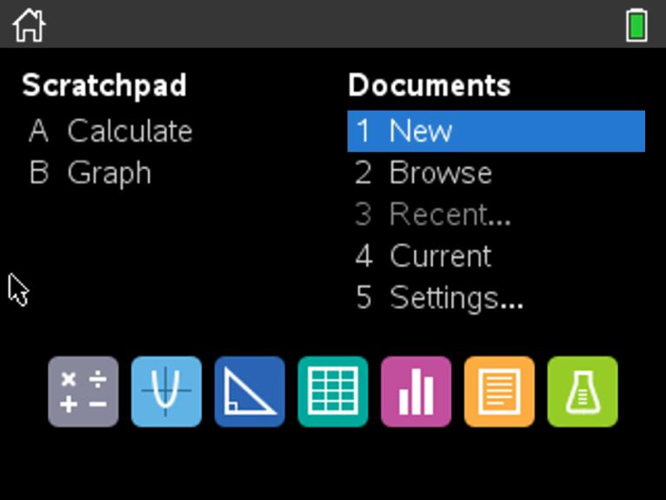
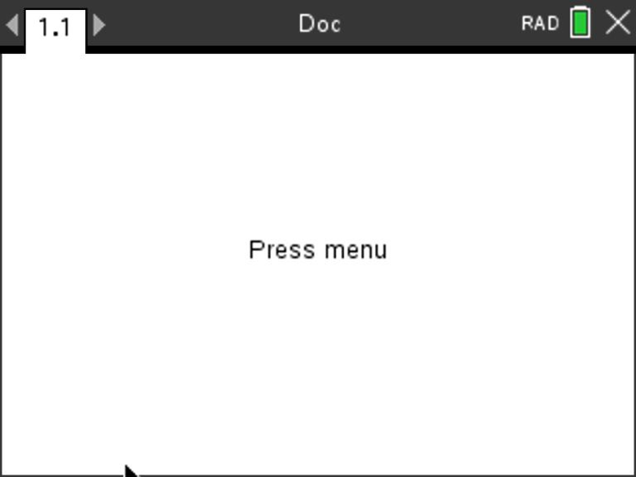
Creating a new TI-Nspire document
1
2
3
Use arrow keys and [enter] or
Press [1] to select 1 New document.
See next slide for steps to add
a program.
Press the [home/on] key to
display the home screen.
Note: If you have a document open, pressing the [home/on] key repeatedly toggles between the home screen and the document.

Slide 10
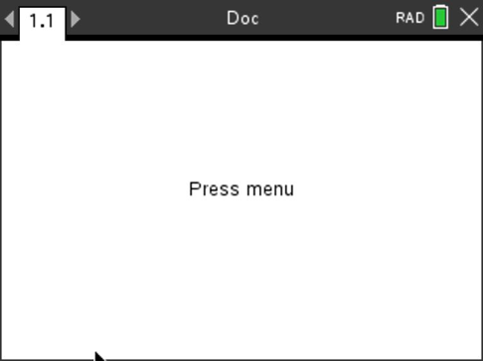
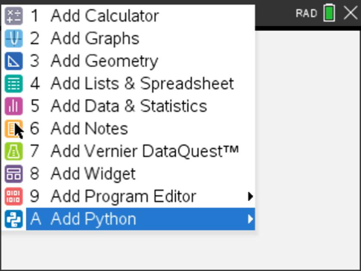
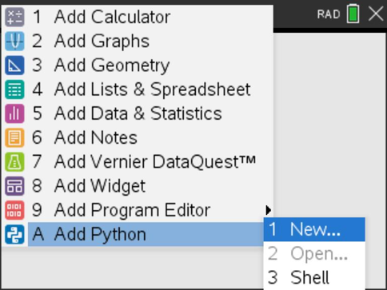
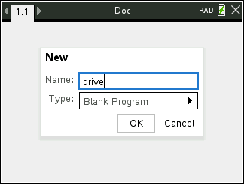
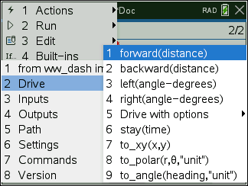
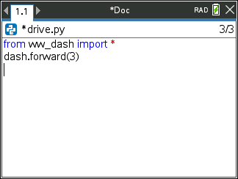
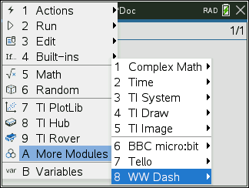
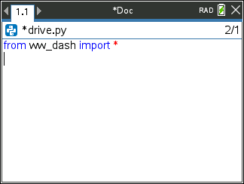
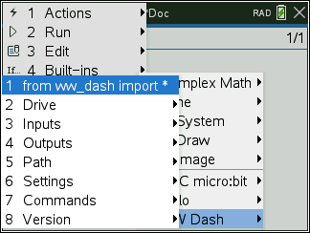
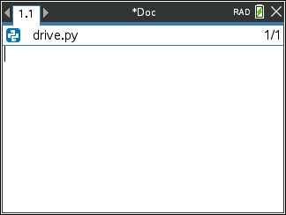
Creating a Dash Program
1
2
3
4
Enter your program name
and press [enter].
Press [menu] to bring up a menu
of applications to add to the page.
Press down arrow repeatedly then press [enter] or
press [A] to select Add Python.
Select 1: New by pressing [enter] or [1]
8
Note: You can also add a new page
to the document by pressing
[ctlr] [doc] +page.
6
7
5
Press [menu] then [A] More Modules then select WW Dash then [2] Drive [1] forward() to paste to the edit line. Type a value for units to drive. Right arrow to the end of the line and press [enter] to complete the statement.
A faster approach is to use [ctrl] [enter] from any place on a line to complete the statement and move the cursor to the beginning of the line below. Note: It is important that each statement begin on a new line.
Press [menu] then [A] More Modules then select WW Dash from the More Modules menu. Then select [1] from ww_dash import * (Note: The More Modules menu selections depend on the modules that you have added to your calculator.)
Importing the ww_dash module is required at the beginning of every Dash program.
You begin at a blank edit
screen.

Slide 11
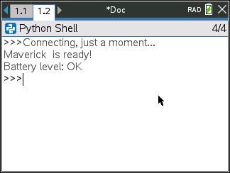
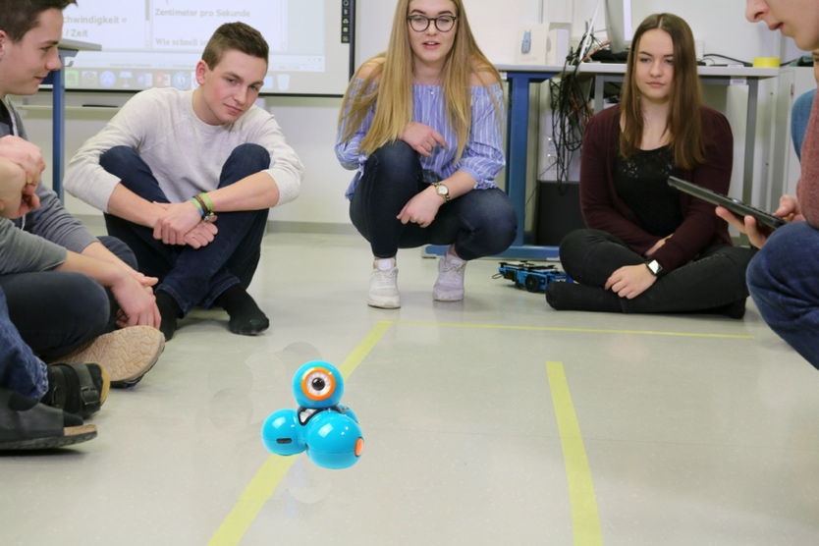
Running a Dash Program
1
2
Press [ctrl] [R] to run the program from a Python shell on the next page.
Note: [ctrl] [R] also checks syntax and stores program changes. [ctrl] [B] is another option for checking syntax and storing.
* before the program name indicates that changes have not been stored.
Before running the program
make sure that
Dash is switched on
Bluetooth Adapter is connected to the calculator
- Dash is on a flat surface ready to roll
Your program runs in a Python shell.
You can re-run the program from the shell by pressing [ctrl] [R] again.

Slide 12
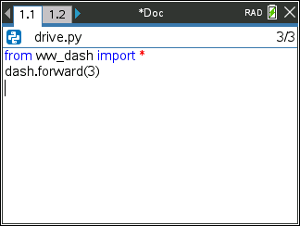
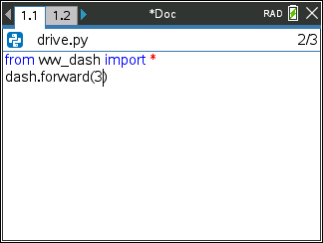
Editing a Dash Program
1
2
3
4
Press [ctrl] left to go back to your Python editor page.
Use the arrow keys to position the cursor to change the value of the forward distance.
Press [del] to backspace over the 3.
Type in a new value for distance, then [ctrl] [enter] to move to the next line.
5
6
Press [ctrl] [R] to run the program again from a Python shell on the next page.

Slide 13
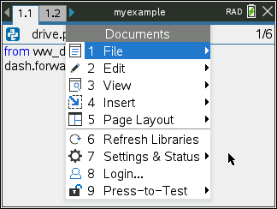
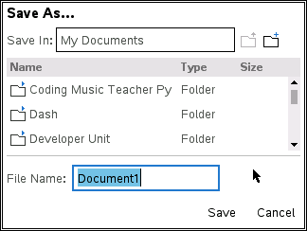
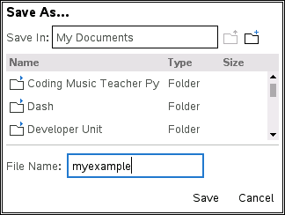
Saving a TI-Nspire document file
Folder where file will be saved.
1
2
3
4
Press [doc] then select 1 File
from the menu by pressing
[enter] or [1].
Select 4 Save or 5 Save As… from the menu.
Type in your file name using alpha and numeric characters.
Note: The name must begin with an alpha character.
Press [enter] to save the file to the
folder indicated above.
To change the folder press the
[UP] arrow key and then use
arrows and [enter] to select a
folder before pressing [enter] to
save the file.
Press [esc] to cancel the save
dialogue.
You can use [ctrl] [S] as a shortcut
to save the TI-Nspire document file.

Slide 14
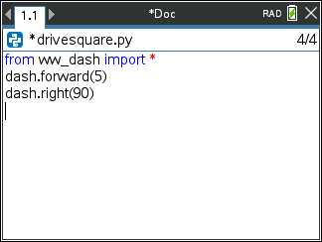
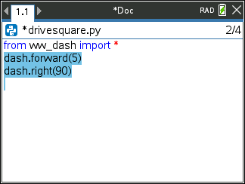
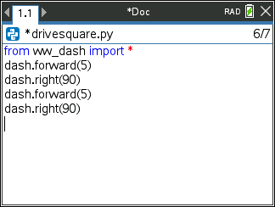
Copying and Pasting a Block of Code
1
2
3
4
Use arrow keys to move the cursor to the beginning of row below the section of code that you want to copy.
Press and hold [shift] then press UP arrow repeatedly to highlight the rows to be copied. Press [ctrl] [C] to copy the highlighted code.
Use arrow keys to move the cursor to the location that you want to paste from.
Press [ctrl] [V] to paste.
You can paste repeatedly.

Slide 15
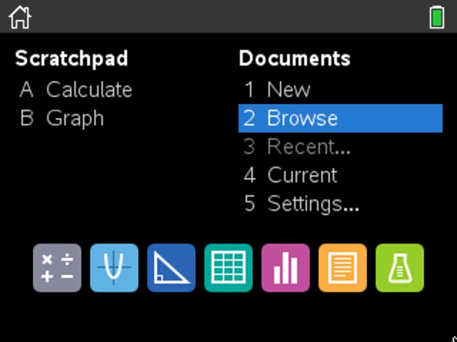
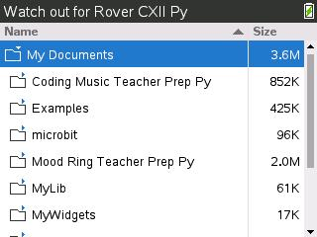
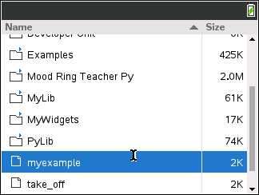
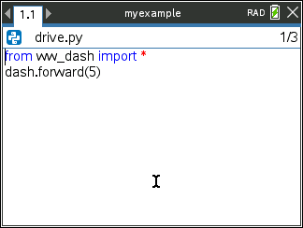
Opening an existing TI-Nspire document file
1
2
3
Use arrow keys and [enter] or
Press [2] to select 2 Browse files.
Use arrow keys and [enter] to select a folder and a file.
Note: Pressing the [home/on] key
repeatedly toggles between the home screen and the current document.
Press the [home/on] key to
display the home screen.

Slide 16
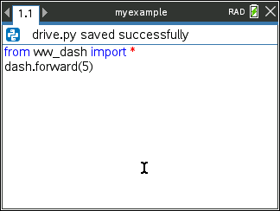
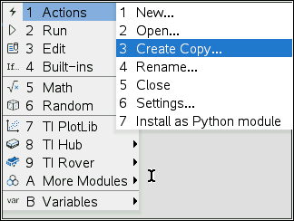
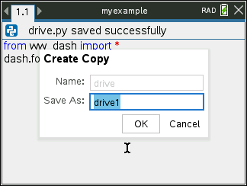
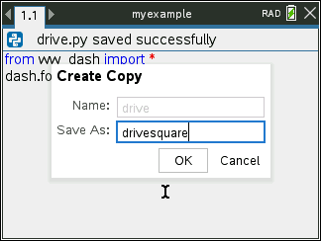
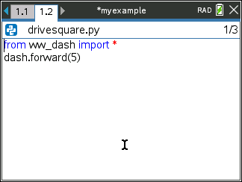
Copying a Python Program
1
2
3
Press [ctrl] [B] to compile and save your program.
Note: You will not be able to copy the program if you have made changes since using [ctrl] [R] or [ctrl] [B].
Press [menu] [1] Actions
[3] Create Copy…
Type in your new program name. Press [enter] to complete the dialogue.
The new program is inserted on the page after the original page, in this case page 1.2.

Slide 17
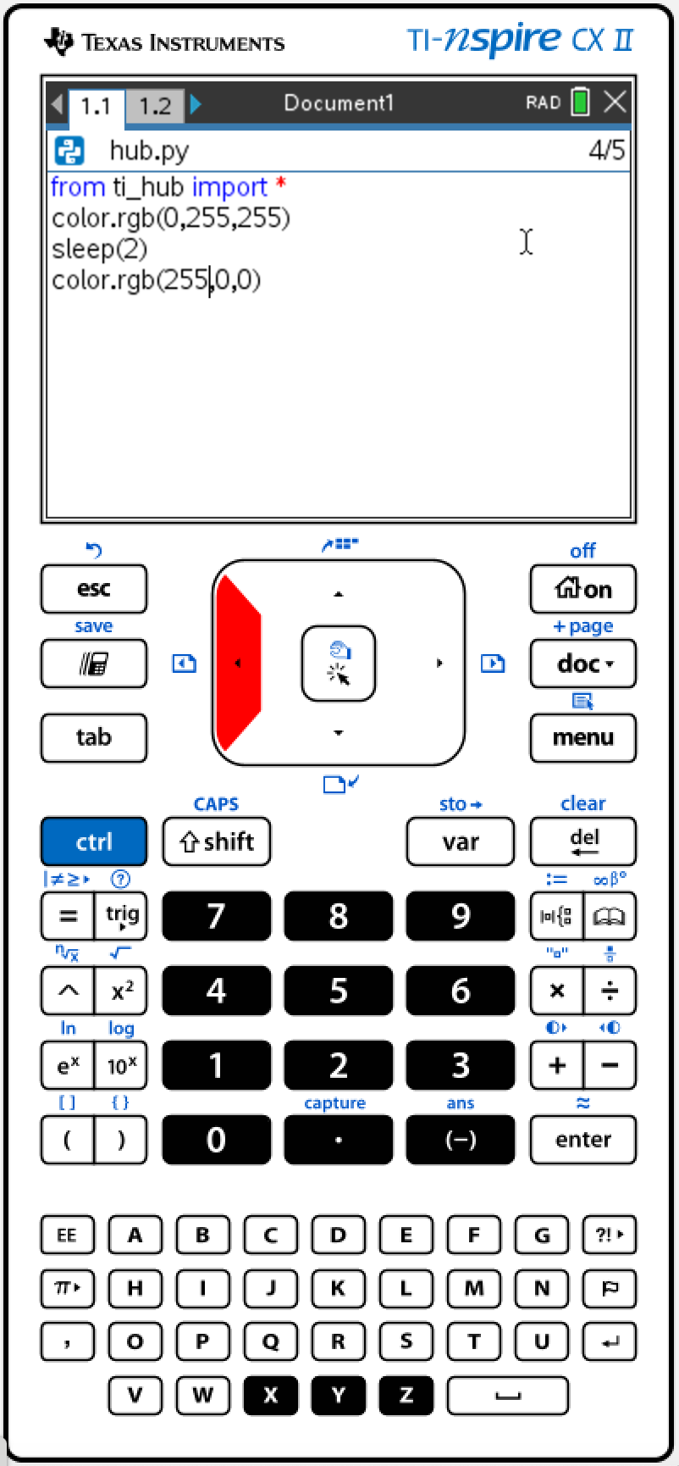
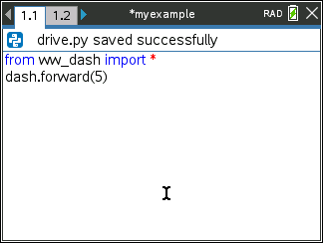
Entry and Edit Tips
Use number key shortcuts or arrow keys and [enter] to select from menus
Use [esc] to back out of a menu or a dialogue.
Use [enter] to complete a dialogue.
Use [tab] to move to the next input when entering a function
Use arrow keys to move the cursor around the screen
Use [del] as a destructive backspace
Use [ctrl] [enter] to complete a statement and move to the next line
Use [ctrl] [Z] to undo an action
Use [ctrl] [S] to save your file
Use [ctrl] [left arrow] and [ctrl] [right arrow] to move from page to page
Use [menu] to see options for the current application.

Slide 18
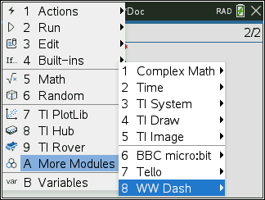
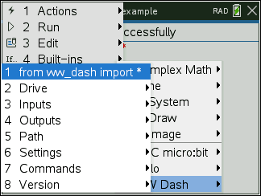
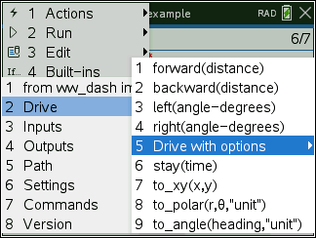
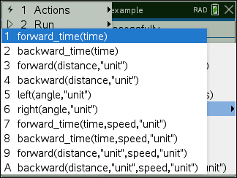
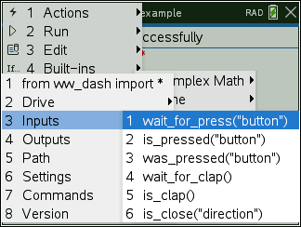
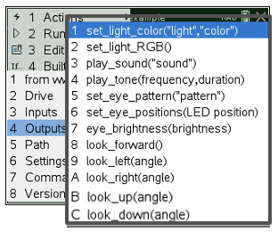
Dash Module Menus
Find from ww_dash import * on the A: More Modules WW Dash menu. Every Dash program must include a ww_dash import statement. This statement imports Dash Python functions.
Drive
Drive with options
Inputs
Outputs
Path
Settings
Commands
Version

Slide 19
MAKE IT MOVE!
Task: Discover how far Dash drives per unit.
Use differing values (1-20) to determine what 1 Dash unit is.
New Program:
Find from ww_dash import * on the A: More Modules WW Dash menu.
Find forward() and other drive functions on the WW Dash 2:Drive menu.
Press [menu] key to see Python Program Editor options.
Press [ctrl] [R] to run the program from a Python shell on the next page.
Use [ctrl] left arrow to move from the shell page back to the Python editor page.
Notes:
Explain import ti_rover module
Then demo how to import and how to enter the statements.
Give students time to explore with different distances to figure out.
Use [ctrl] left and [ctrl] right to move from page to page in the document.

Slide 20
Have Dash make a sound
Task: Have your Dash play a sound while driving.
Challenge Task: Have your Dash make a “Fire Siren” sound.
Edit Program:
Find dash.play_sound() on the A: More Modules WW Dash 4:Outputs menu. After you paste the function to the editor you will be prompted to select a sound from a drop-down menu.
To insert a blank line for the play_sound() functon move the cursor to the ww_dash import line and then press [ctrl] [enter]
Press [ctrl] [R] to run the program from a Python shell on the next page.
Use [ctrl] left arrow to move from the shell page back to the Python editor page.
Notes:
Explain import ti_rover module
Then demo how to import and how to enter the statements.
Give students time to explore with different distances to figure out.
Use [ctrl] left and [ctrl] right to move from page to page in the document.

Slide 21
Set the Dash color
Task: Set the color output of the
Red, Green, Blue (RGB) LED.
Each color takes a value
of (0-255).
Challenge Tasks:
Try to make Yellow or Cyan or Magenta.
Extra Challenge: Make your own color and give the color a fun name.
New Program:
Find dash.set_light_RGB() on the WW Dash 4:Outputs menu. You will be prompted for the lights to set and then the values of the red, green and blue components of the LED, 0 is off and 255 is maximum. Press [tab] to move from input to input. Finally, press [ctrl] [enter] to complete the statement and move to the next line.
Press [ctrl] [R] to run the program from a Python shell on the next page.
Use [ctrl] left arrow to move from the shell page back to the Python editor page.
Notes:
Explain import ti_rover module
Then demo how to import and how to enter the statements.
Give students time to explore with different distances to figure out.
Use [ctrl] left and [ctrl] right to move from page to page in the document.

Slide 22
Explore angles
New Program:
Task: Drive a square.
Challenge Task: Try to drive an equilateral triangle.
See the menu for the most common drive functions below.
The program above is a framework for driving a square.
Enter values for distance and turn angle.
Press [menu] key to see Python Program Editor options.
Press [ctrl] [R] to run the program from a Python shell on the next page.
Use [ctrl] left arrow to move from the shell page back to the Python editor page.
Notes:
Explain import ti_rover module
Then demo how to import and how to enter the statements.
Give time to explore.

Slide 23
Quick Math Reminders
Complementary Angles:
Sum to 90 degrees
Supplementary Angles:
Sum to 180 degrees

Slide 24
Quick Math Reminders
Exterior angles:
Interior Angles:

Slide 25
Logic Challenge
Task: Draw the figure shown large enough for Dash to drive.
Note: Try side lengths of 4 Dash units.
Write a program to have your Dash drive the figure without crossing any lines or going back over a line.
When your Rover on the drawing
Notes:
First challenge is to drive the shape without crossing any lines and without picking up the pen.

Slide 26
Logic Challenge
Marker version
Task: Drive the figure shown without crossing any lines or going back over a line and without picking up the pen.
Note: Try side lengths of 4 Dash units.
When you are ready, put the pen in and trace your path.
Note: For more information about marker holder 3D Print file see the earlier slide in this deck.
Notes:
First challenge is to drive the shape without crossing any lines and without picking up the pen.

Slide 27
Where can you go next with TI-Rover and Dash?
Drive an obstacle course
Drive a design
Draw artwork
Use a For loop
to draw polygons
Write your name
Navigate a map
Park your Rover

Slide 28
Quick Math Reminders
Pythagorean Theorem

Slide 29
Logic Challenge 2
Task: Draw the figure shown large enough for Dash to drive.
Write a program to have your Dash drive the figure without crossing any lines. or going back over a line.
The Math Module is needed for Square Root and other advanced functions.
Notes:
We will need to import the math library
First challenge is to drive the shape without crossing any lines and without picking up the pen.
Second will be to drive at least one segment in reverse direction.

Slide 30
Logic Challenge 2
Marker version
Task: Drive the figure shown without crossing any lines or going back over a line and without picking up the pen.
When you are ready, put the pen in and trace your path.
Note: For more information about marker holder 3D Print file see the earlier slide in this deck.
The Math Module is needed for Square Root and other advanced functions.
Notes:
We will need to import the math library
First challenge is to drive the shape without crossing any lines and without picking up the pen.
Second will be to drive at least one segment in reverse direction.

Slide 31
Logic Challenge 2 – example solution
3
2
4
5
6
1
7
9
8
10
Notes:
First challenge is to drive the shape without crossing any lines and without picking up the pen.
Second will be to drive at least one segment in reverse direction.

Slide 32
Logic Challenge 3
Task: Drive the figure shown without crossing any lines or going back over a line.
Now match the colors using the RGB LED. Don’t worry about using a marker.
The Math Module is needed for the Square Root Function.
Put the set_light_RGB statement before the drive statement that you want to match.
Note: The LED’s stay the same color until another set_light RGB statement is run.
Notes:
We will need to import the math library
First challenge is to drive the shape without crossing any lines and without picking up the pen.
Second will be to drive at least one segment in reverse direction.

Slide 33
Thank You
www.TIstemProjects.com
Contact stem-team@ti.com with questions

