Slide 1
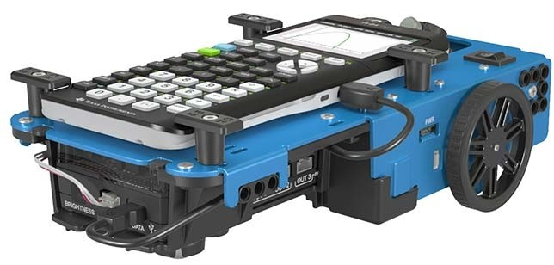
S
T
E
Math with the Rover

Slide 2
What is Math
Mathematics is the science that deals with the logic of shape, quantity and arrangement

Slide 3
What is Math
Mathematics is the science that deals with the logic of shape, quantity and arrangement
In school we teach our students to find algorithms for solving problems

Slide 4
What is Math
Mathematics is the science that deals with the logic of shape, quantity and arrangement
In school we teach our students to find algorithms for solving problems
Finding algorithms is what we also do in programming

Slide 5
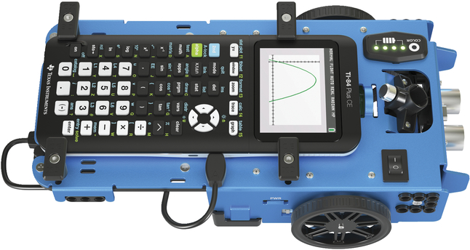
What is Math
Mathematics is the science that deals with the logic of shape, quantity and arrangement
In school we teach our students to find algorithms for solving problems
Finding algorithms is what we also do in programming
This is where the Rover comes in
This is where the Rover comes in

Slide 6
What do we do
⎼ Let the Rover draw shapes using different mathematical concepts

Slide 7
What do we do
⎼ Let the Rover draw shapes using different mathematical concepts
⎼ Let the Rover do some more complicated tasks

Slide 8
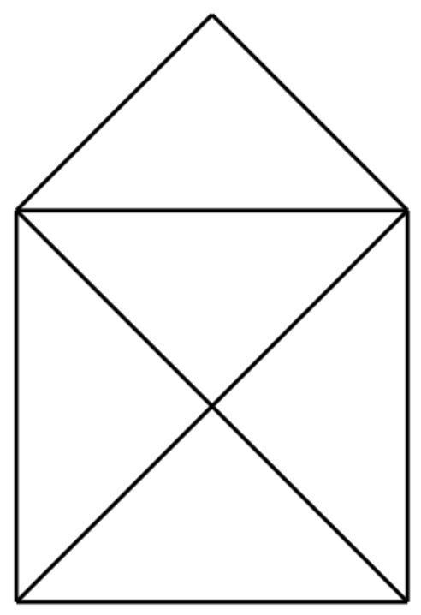
Shapes
Define shape()=
Prgm
Send "CONNECT RV"
Send "RV FORWARD … "
… = distance in dm
Send "RV RIGHT ... "
… = angle in degrees
Send "RV LEFT ... "
… = angle in degrees
EndPrgm

Slide 9
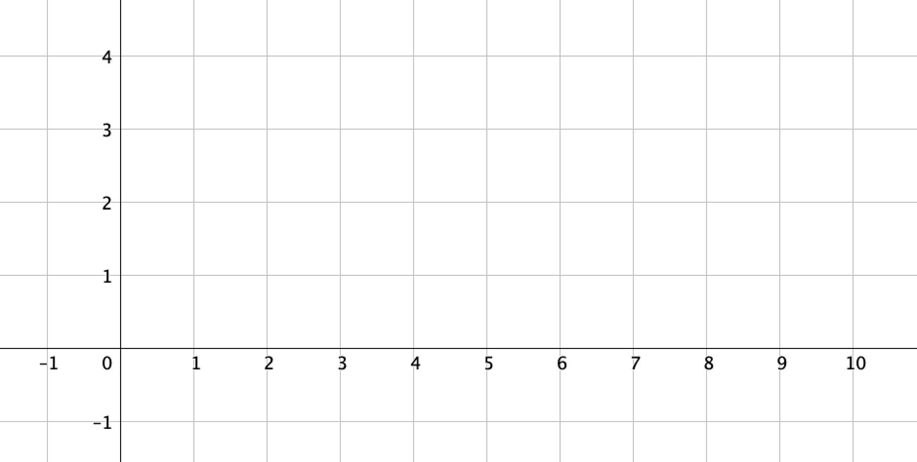
Using the grid
Send "CONNECT RV"
dm

Slide 10
Using the grid
Send "RV TO XY 8 3"
30 cm
80 cm

Slide 11
Using the grid

Slide 12
Using the grid

Slide 13
Using the grid

Slide 14
Using the grid

Slide 15
Using the grid
x = { 2 }
y = { 0 }

Slide 16
Using the grid
x = { 2 }
y = { 0 }

Slide 17
Using the grid
x = { 2 , 2 }
y = { 0 , 2 }

Slide 18
Using the grid
x = { 2 , 2 }
y = { 0 , 2 }

Slide 19
Using the grid
x = { 2 , 2 , 1 }
y = { 0 , 2 , 3 }

Slide 20
Using the grid
x = { 2 , 2 , 1 , 0 }
y = { 0 , 2 , 3 , 2 }

Slide 21
Using the grid
x = { 2 , 2 , 1 , 0 , 0 }
y = { 0 , 2 , 3 , 2 , 0 }

Slide 22
Using the grid
x = { 2 , 2 , 1 , 0 , 0 , 2 }
y = { 0 , 2 , 3 , 2 , 0 , 2 }

Slide 23
Using the grid
x = { 2 , 2 , 1 , 0 , 0 , 2 , 0 }
y = { 0 , 2 , 3 , 2 , 0 , 2 , 2 }

Slide 24
Using the grid
x = { 2 , 2 , 1 , 0 , 0 , 2 , 0 , 2 }
y = { 0 , 2 , 3 , 2 , 0 , 2 , 2 , 0 }

Slide 25
Using the grid
x = { 2 , 2 , 1 , 0 , 0 , 2 , 0 , 2 }
y = { 0 , 2 , 3 , 2 , 0 , 2 , 2 , 0 }

Slide 26
Using the grid
Define house()=
Prgm
x = { 2 , 2 , 1 , 0 , 0 , 2 , 0 , 2 }
Send "CONNECT RV"
y = { 0 , 2 , 3 , 2 , 0 , 2 , 2 , 0 }
EndPrgm

Slide 27
Using the grid
Define house()=
Prgm
Send "CONNECT RV"
x := {2, 2, 1, 0, 0, 2, 0, 2}
Defines the shape
y := {0, 2, 3, 2, 0, 2, 2, 0}
d:=dim(x)
Number of elements in the list
For i,1,d
Send "RV TO XY eval(x[i]) eval(y[i]) "
Tells the Rover to draw the shape
EndFor
EndPrgm

Slide 28
Using the grid
Define house()=
Prgm
Send "CONNECT RV"
x := {2, 2, 1, 0, 0, 2, 0, 2}
y := {0, 2, 3, 2, 0, 2, 2, 0}
d:=dim(x)
For i,1,d
Send "RV TO XY eval(x[i]) eval(y[i]) "
EndFor
eval() because we need the value of the variable and not it’s name
EndPrgm

Slide 29
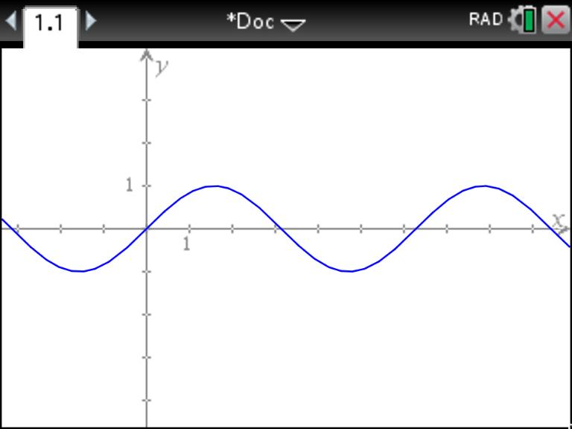

Functions
$$y=sin⁡(x)$$

Slide 30
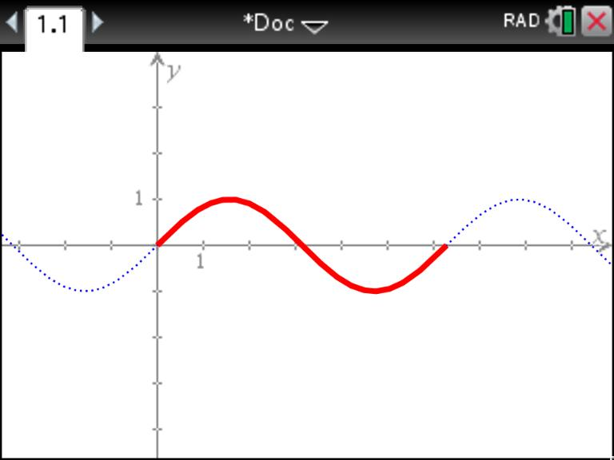



Functions
Define polygon()=
Prgm
Send "CONNECT RV"
For x, 0, $2π$
y := $sin⁡(x)$
Send "RV TO XY eval(x) eval(y) "
EndFor
EndPrgm
$$y=sin⁡(x)$$
$$0≤x≤2π$$

Slide 31

Functions
Define polygon()=
Prgm
Send "CONNECT RV"
For x, 0, $2π$, $\frac{2π}{12}$
Step size
y := $sin⁡(x)$
Send "RV TO XY eval(x) eval(y) "
EndFor
EndPrgm
$$y=sin⁡(x)$$
$$0≤x≤2π$$

Slide 32
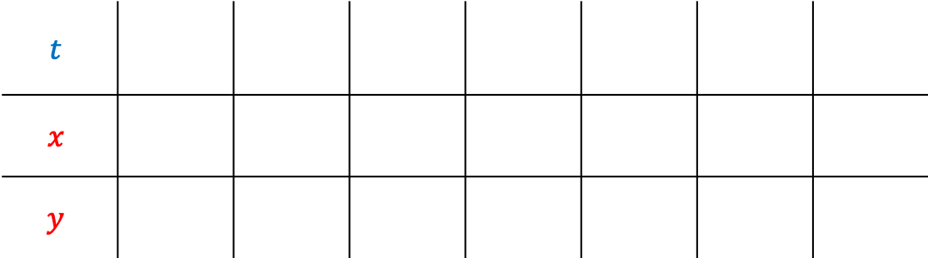
Parametric curves
$$t$$
$$x$$
$$y$$

Slide 33
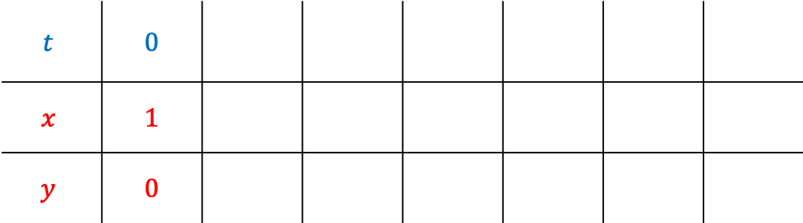
Parametric curves
$$t$$ | 0
$$x$$ | 1
$$y$$ | 0

Slide 34
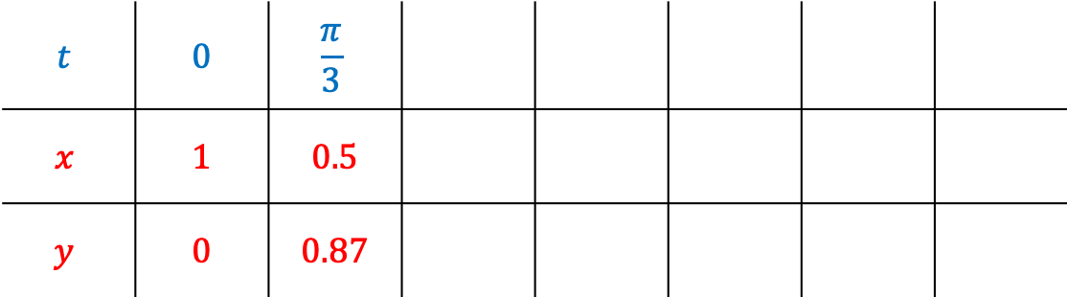
Parametric curves
$$t$$ | 0 | $$\frac{π}{3}$$
$$x$$ | 1 | 0.5
$$y$$ | 0 | 0.87

Slide 35
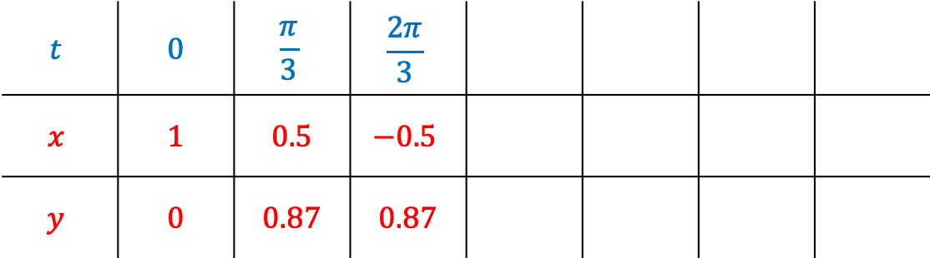
Parametric curves
$$t$$ | 0 | $$\frac{π}{3}$$ | $$\frac{2π}{3}$$
$$x$$ | 1 | 0.5 | $$−0.5$$
$$y$$ | 0 | 0.87 | 0.87

Slide 36
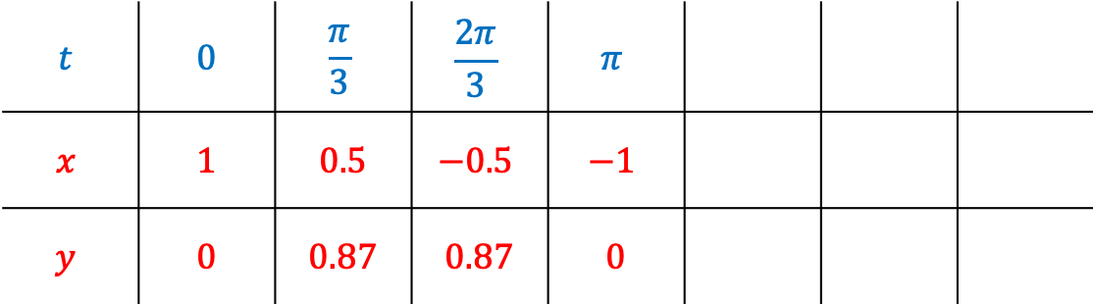
Parametric curves
$$t$$ | 0 | $$\frac{π}{3}$$ | $$\frac{2π}{3}$$ | $$π$$
$$x$$ | 1 | 0.5 | $$−0.5$$ | $$−1$$
$$y$$ | 0 | 0.87 | 0.87 | 0

Slide 37
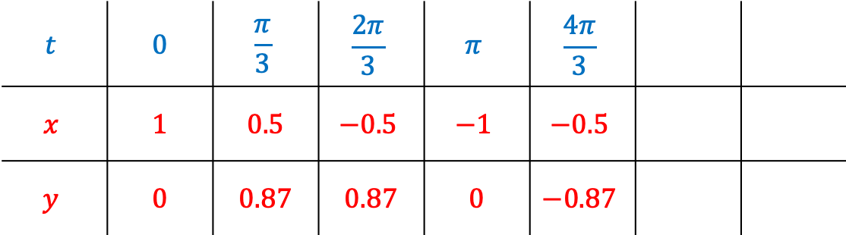
Parametric curves
$$t$$ | 0 | $$\frac{π}{3}$$ | $$\frac{2π}{3}$$ | $$π$$ | $$\frac{4π}{3}$$
$$x$$ | 1 | 0.5 | $$−0.5$$ | $$−1$$ | $$−0.5$$
$$y$$ | 0 | 0.87 | 0.87 | 0 | $$−0.87$$

Slide 38
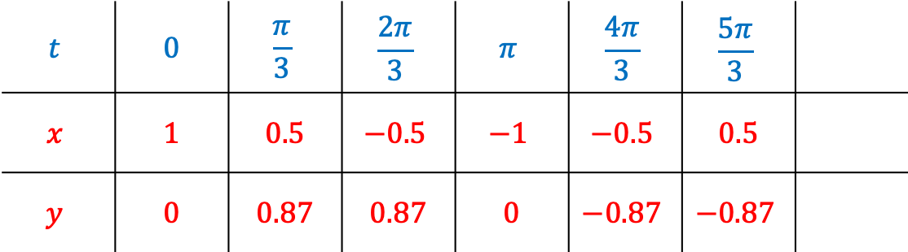
Parametric curves
$$t$$ | 0 | $$\frac{π}{3}$$ | $$\frac{2π}{3}$$ | $$π$$ | $$\frac{4π}{3}$$ | $$\frac{5π}{3}$$
$$x$$ | 1 | 0.5 | $$−0.5$$ | $$−1$$ | $$−0.5$$ | 0.5
$$y$$ | 0 | 0.87 | 0.87 | 0 | $$−0.87$$ | $$−0.87$$

Slide 39
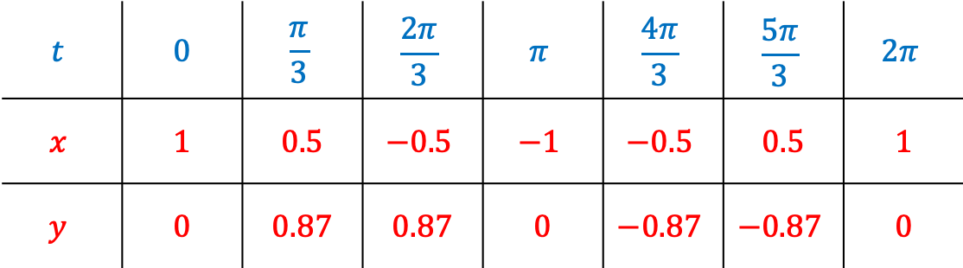
Parametric curves
$$t$$ | 0 | $$\frac{π}{3}$$ | $$\frac{2π}{3}$$ | $$π$$ | $$\frac{4π}{3}$$ | $$\frac{5π}{3}$$ | $$2π$$
$$x$$ | 1 | 0.5 | $$−0.5$$ | $$−1$$ | $$−0.5$$ | 0.5 | 1
$$y$$ | 0 | 0.87 | 0.87 | 0 | $$−0.87$$ | $$−0.87$$ | 0

Slide 40
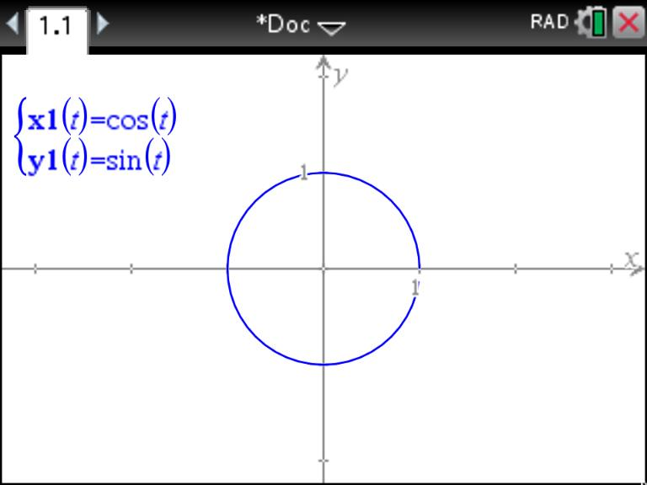
Parametric curves

Slide 41
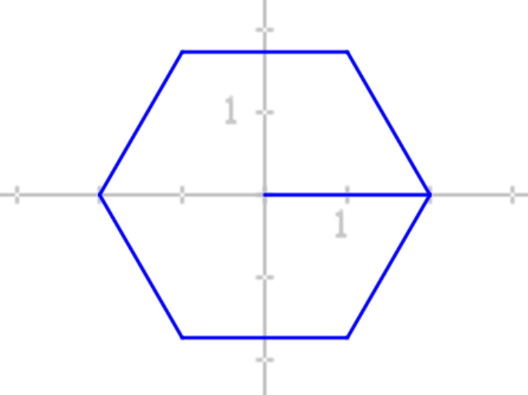



Parametric shapes and the Rover
Define polygon()=
Prgm
Send "CONNECT RV"
For t, 0, 2$π$, $\frac{2π}{6}$
x := 2$cos⁡(t)$
y := 2$sin⁡(t)$
Send "RV TO XY eval(x) eval(y) "
EndFor
EndPrgm

Slide 42
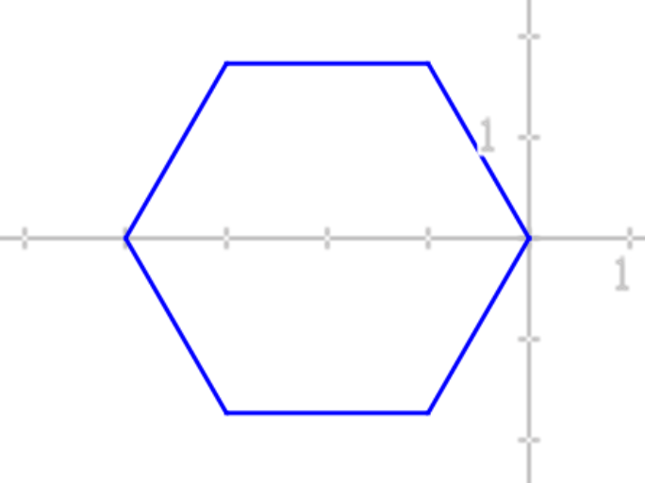
Parametric shapes and the Rover
Define polygon()=
Prgm
Send "CONNECT RV"
For t, 0, 2$π$, $\frac{2π}{6}$
x := 2$cos⁡(t)$
y := 2$sin⁡(t)$
Send "RV TO XY eval(x) eval(y) "
EndFor
EndPrgm

Slide 43

Parametric shapes and the Rover
Define polygon()=
Prgm
Send "CONNECT RV"
For t, 0, 2$π$, $\frac{2π}{6}$
x := 2$\cos\left(t\right)−2$
y := 2$sin⁡(t)$
Send "RV TO XY eval(x) eval(y) "
EndFor
EndPrgm

Slide 44
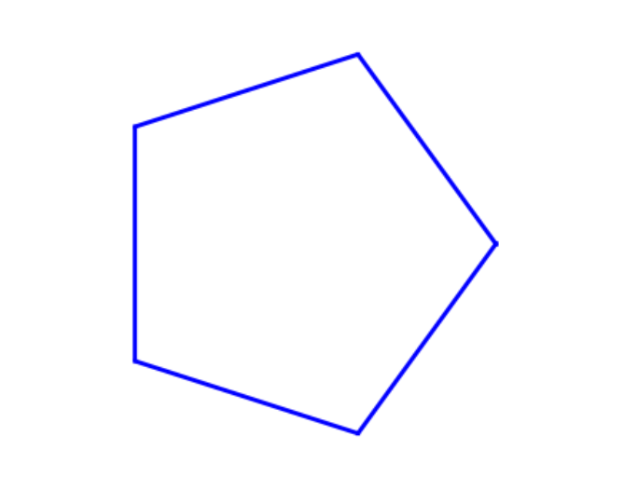
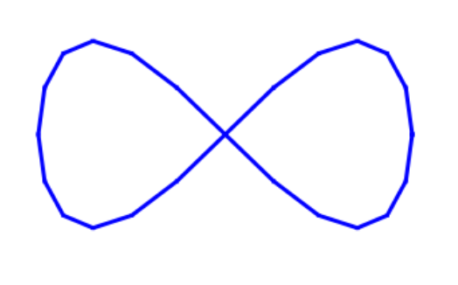
Parametric shapes and the Rover
Challenges:
Draw a pentagon
Draw a lemniscate

Slide 45
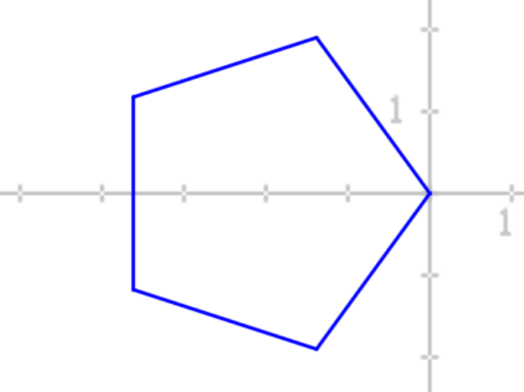

Parametric shapes and the Rover
Define polygon()=
Prgm
Send "CONNECT RV"
For t, 0, 2$π$, $\frac{2π}{5}$
x := 2$\cos\left(t\right)−2$
y := 2$sin⁡(t)$
Send "RV TO XY eval(x) eval(y) "
EndFor
EndPrgm

Slide 46
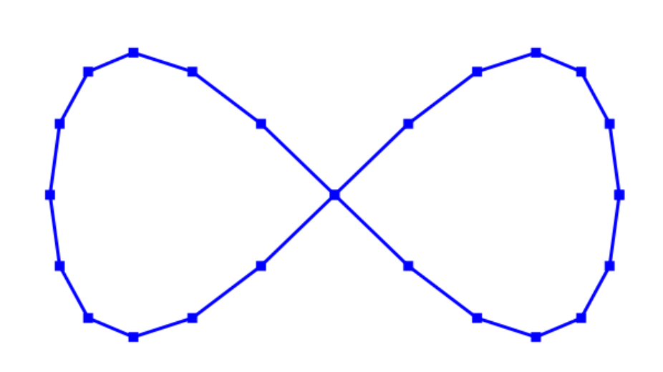


Parametric shapes and the Rover
Define polygon()=
Prgm
Send "CONNECT RV"
For t, 0, 2$π$, $\frac{2π}{24}$
x := 2$\cos\left(t\right)−2$
y := 2$sin⁡(2t)$
Send "RV TO XY eval(x) eval(y) "
EndFor
EndPrgm

Slide 47




Polar coordinates
$$(r,θ)$$
r = 3 dm
$$r$$
θ = 60$°$
Send " RV TO POLAR 3 60 "
$$θ$$

Slide 48
Polar coordinates
$$(r,θ)$$
r = 3 dm
$$r$$
θ = 1.05 radians
Send " RV TO POLAR 3 1.05 RADIANS "
$$θ$$

Slide 49
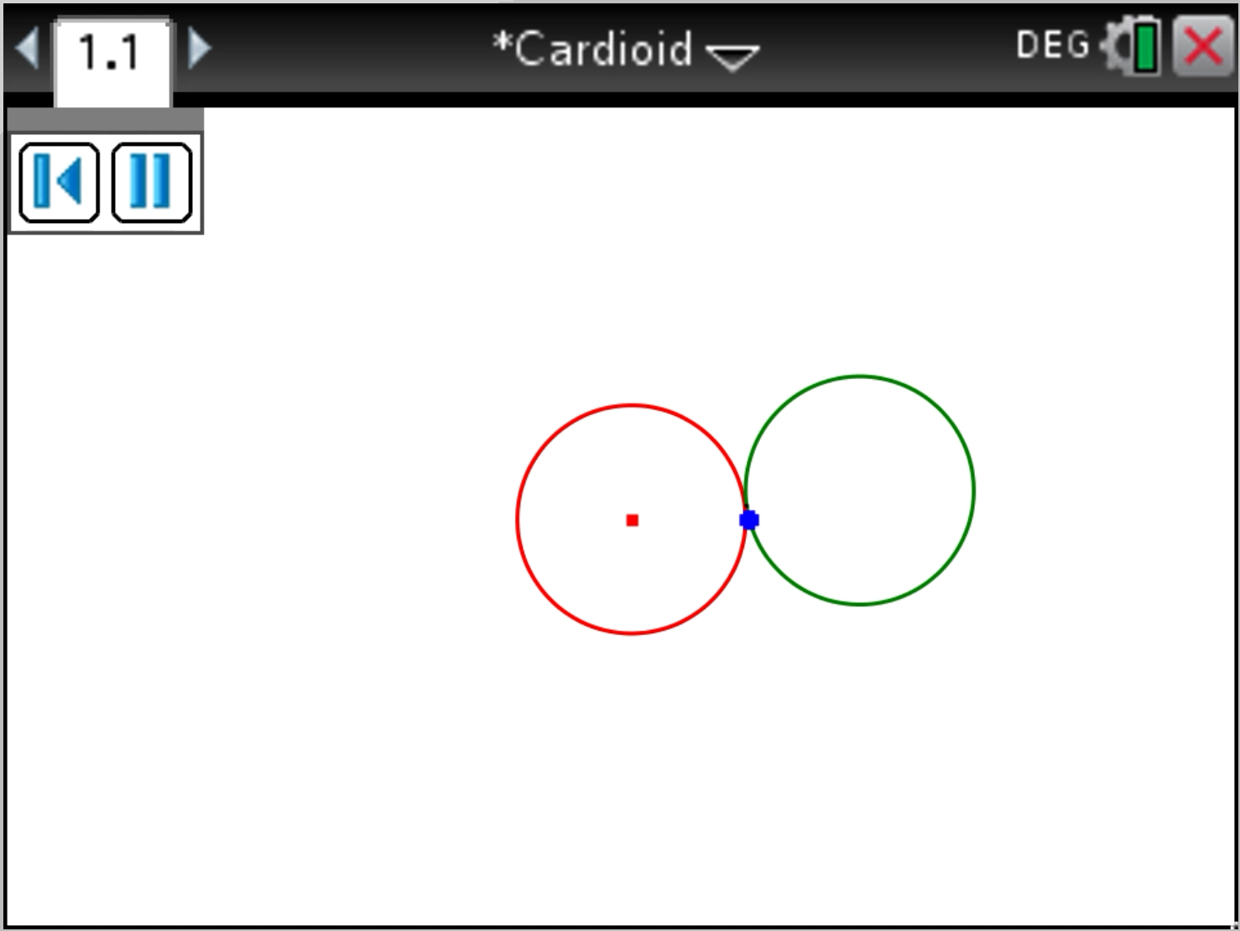
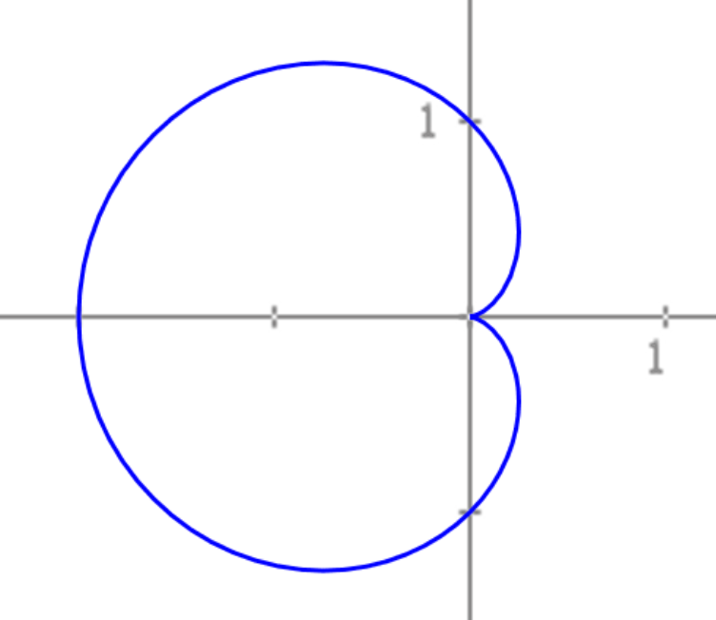


The Cardioid
$$r=1−cos⁡(θ)$$
$$0≤θ≤2π$$

Slide 50


The Cardioid
Define cardioid()=
Prgm
Send "CONNECT RV"
For i, 0, 2$π$, $\frac{2π}{24}$
r := $1−cos⁡(i)$
Send "RV TO POLAR eval(r) eval(i) RADIANS "
EndFor
$$r=1−cos⁡(θ)$$
EndPrgm
$$0≤θ≤2π$$

Slide 51
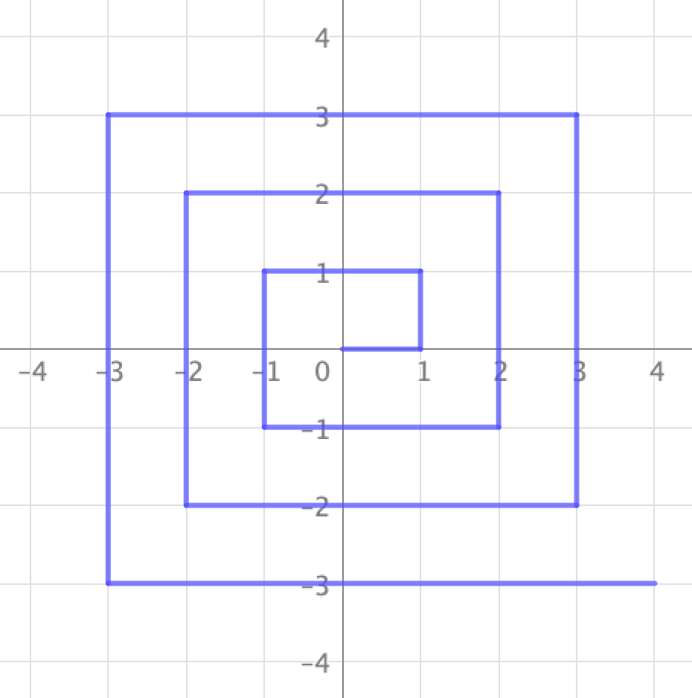
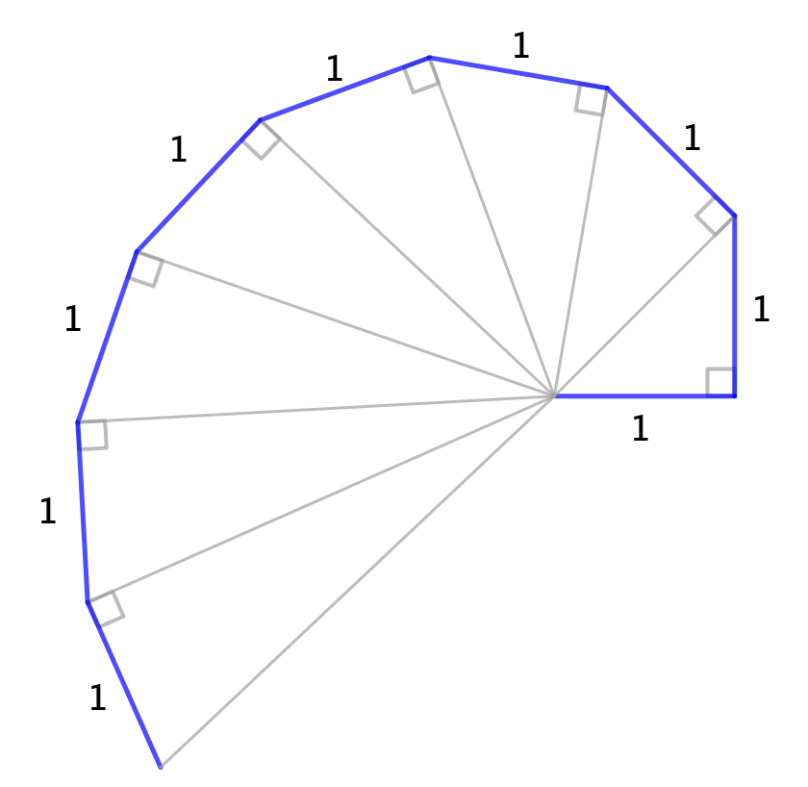
Spirals

Slide 52
Spirals

Slide 53
Spirals
Define spiral()=
Prgm
Send "CONNECT RV"
For i,1,7
Send "RV FORWARD eval(i)"
Send "RV LEFT 90"
Send "RV FORWARD eval(i)"
Send "RV LEFT 90"
EndFor
EndPrgm

Slide 54
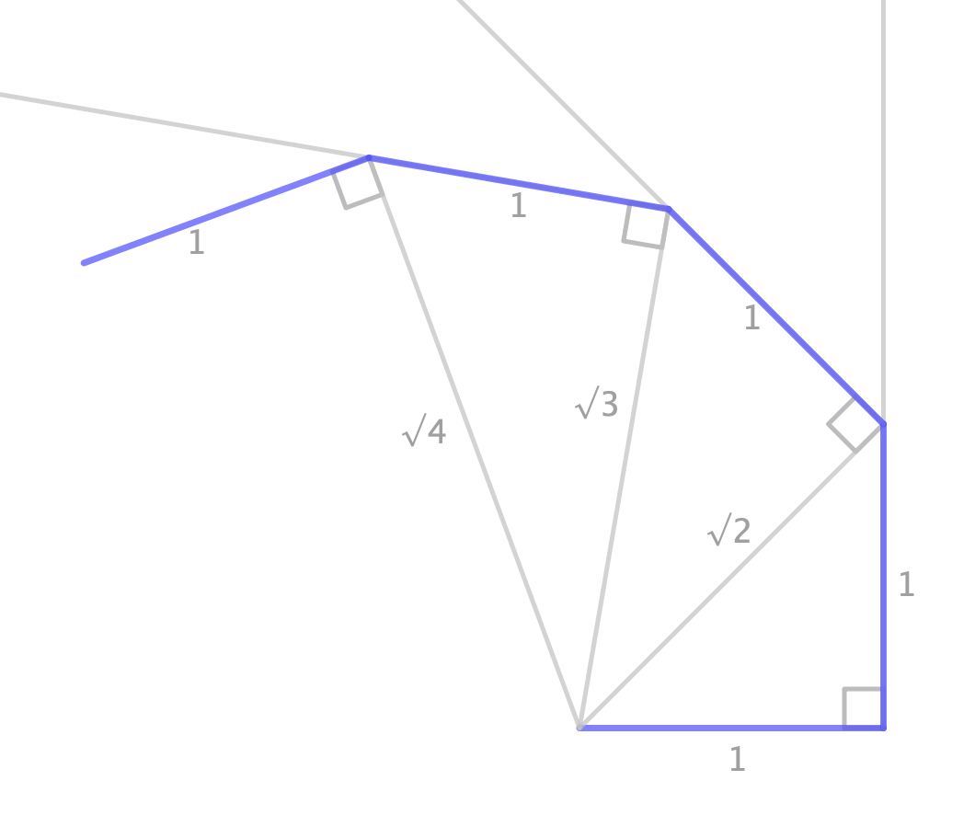
Pythagorean spiral

Slide 55
Pythagorean spiral
C
A
B

Slide 56
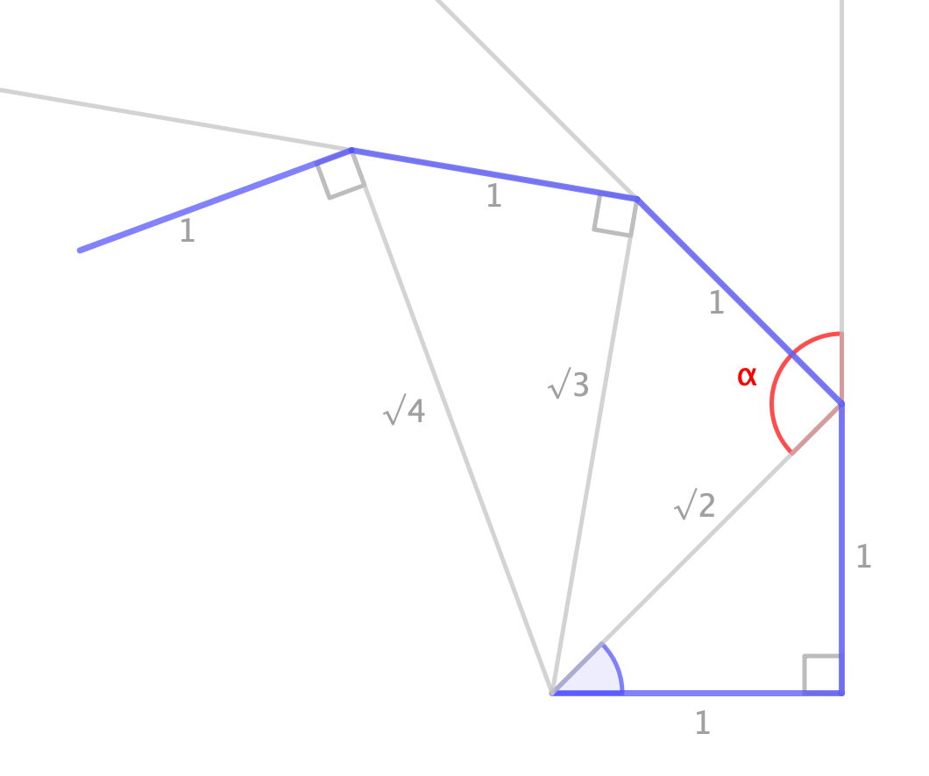
Pythagorean spiral
Theorem:
An exterior angle of a triangle is equal to the sum of the opposite interior angles
C
A
B

Slide 57
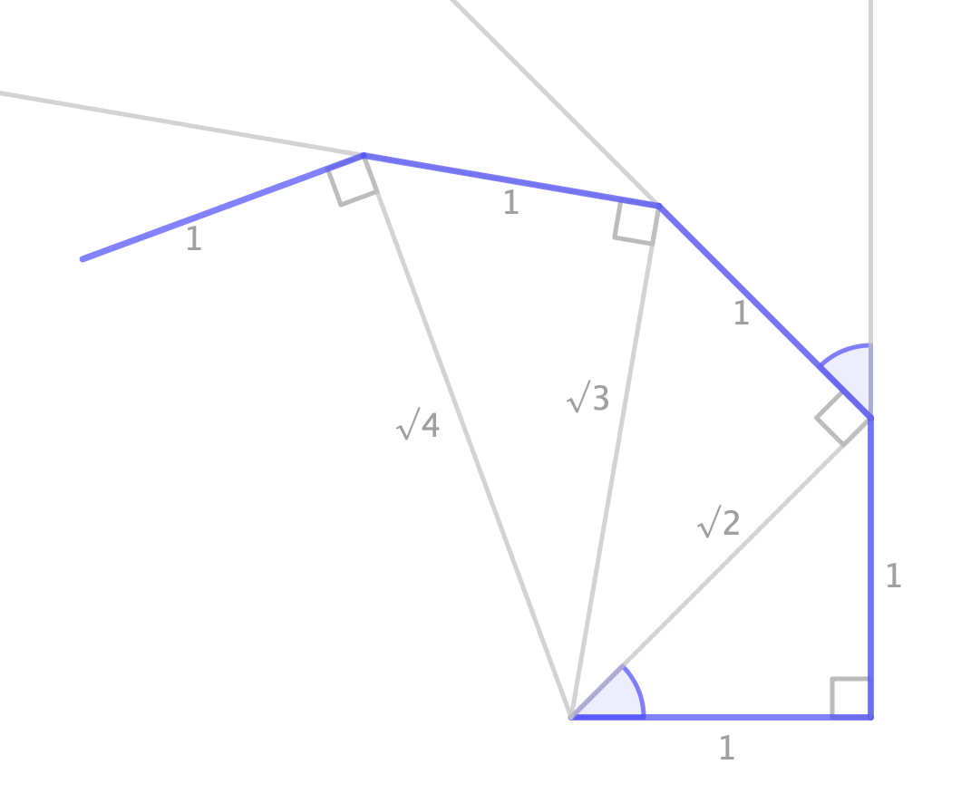
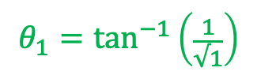

Pythagorean spiral
$$θ_{1}=\tan^{−1}\left(\frac{1}{√1}\right)$$
$$θ1$$
C
A
B

Slide 58
Pythagorean spiral
$$θ_{1}=\tan^{−1}\left(\frac{1}{√1}\right)$$
D
C
A

Slide 59
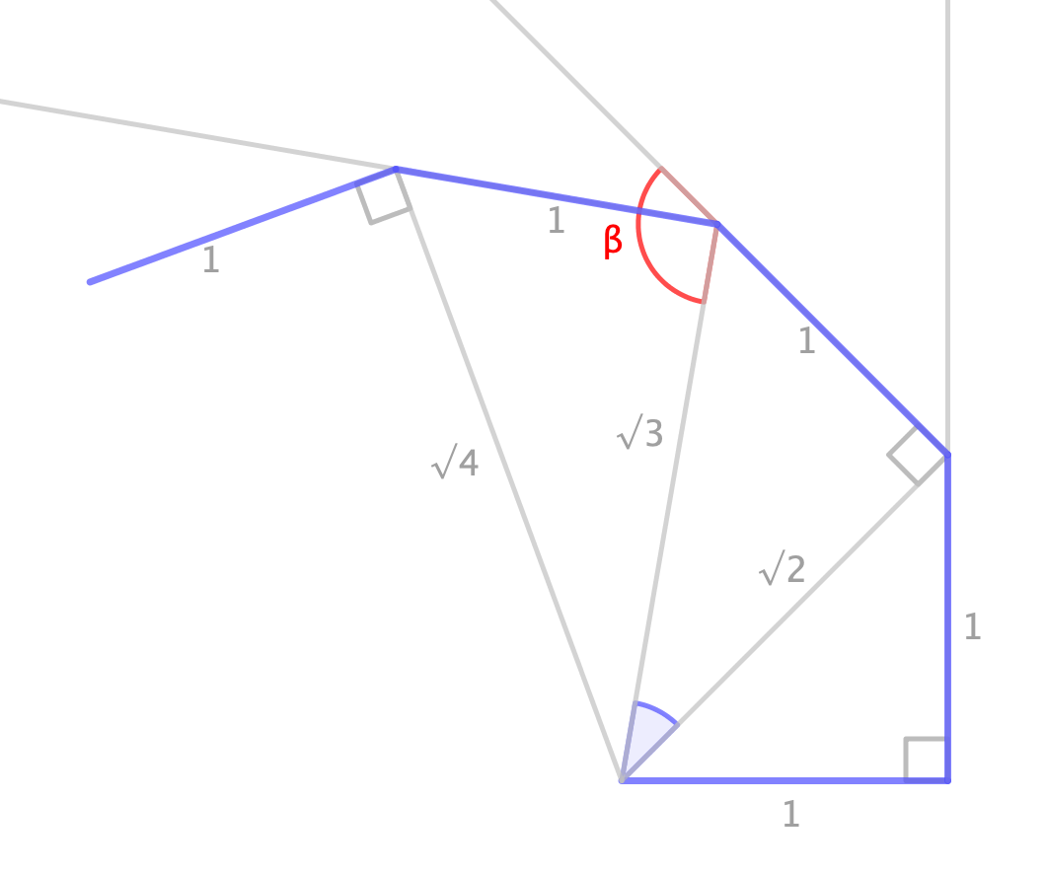
Pythagorean spiral
$$θ_{1}=\tan^{−1}\left(\frac{1}{√1}\right)$$
D
C
A

Slide 60
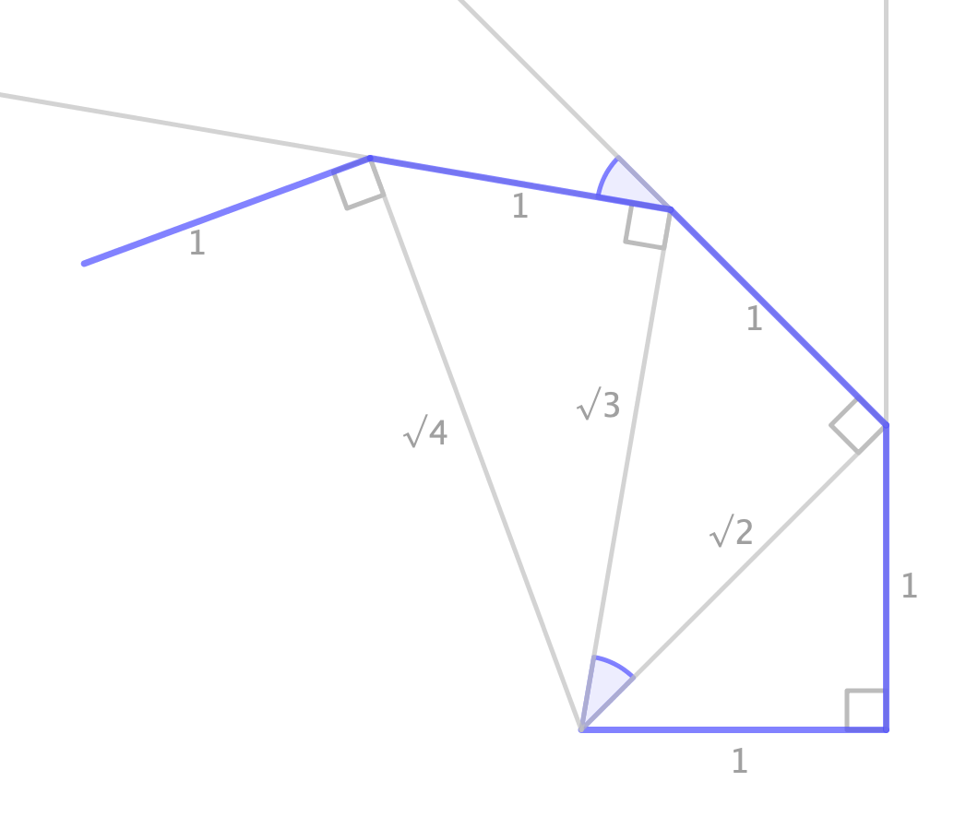
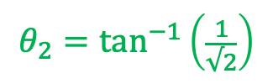

Pythagorean spiral
$$θ_{1}=\tan^{−1}\left(\frac{1}{√1}\right)$$
$$θ2$$
D
$$θ_{2}=\tan^{−1}\left(\frac{1}{√2}\right)$$
C
A

Slide 61
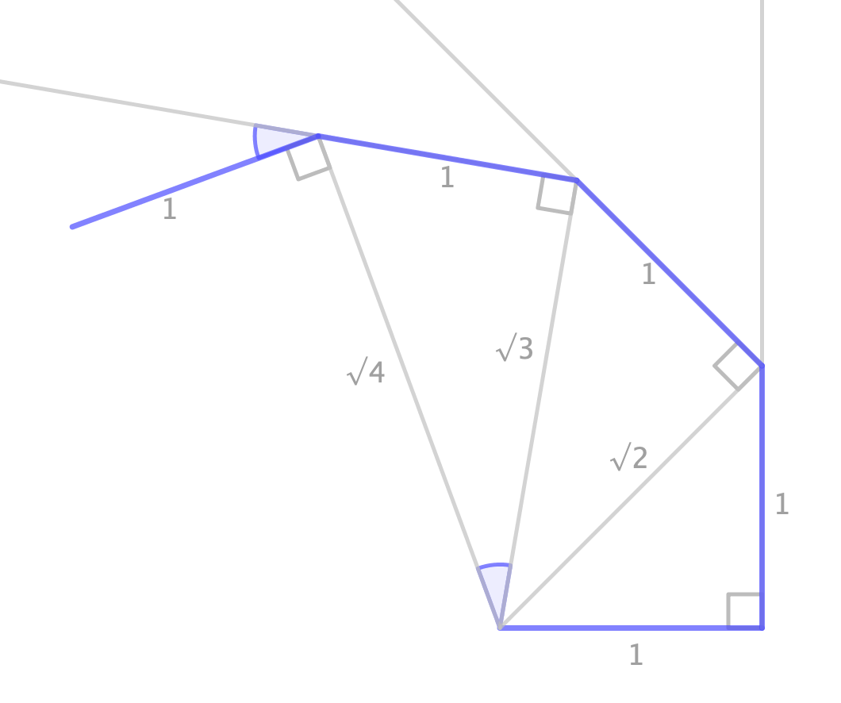
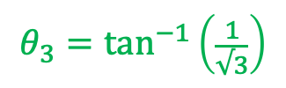

Pythagorean spiral
$$θ_{1}=\tan^{−1}\left(\frac{1}{√1}\right)$$
$$θ3$$
$$θ_{2}=\tan^{−1}\left(\frac{1}{√2}\right)$$
$$θ_{3}=\tan^{−1}\left(\frac{1}{√3}\right)$$
…

Slide 62
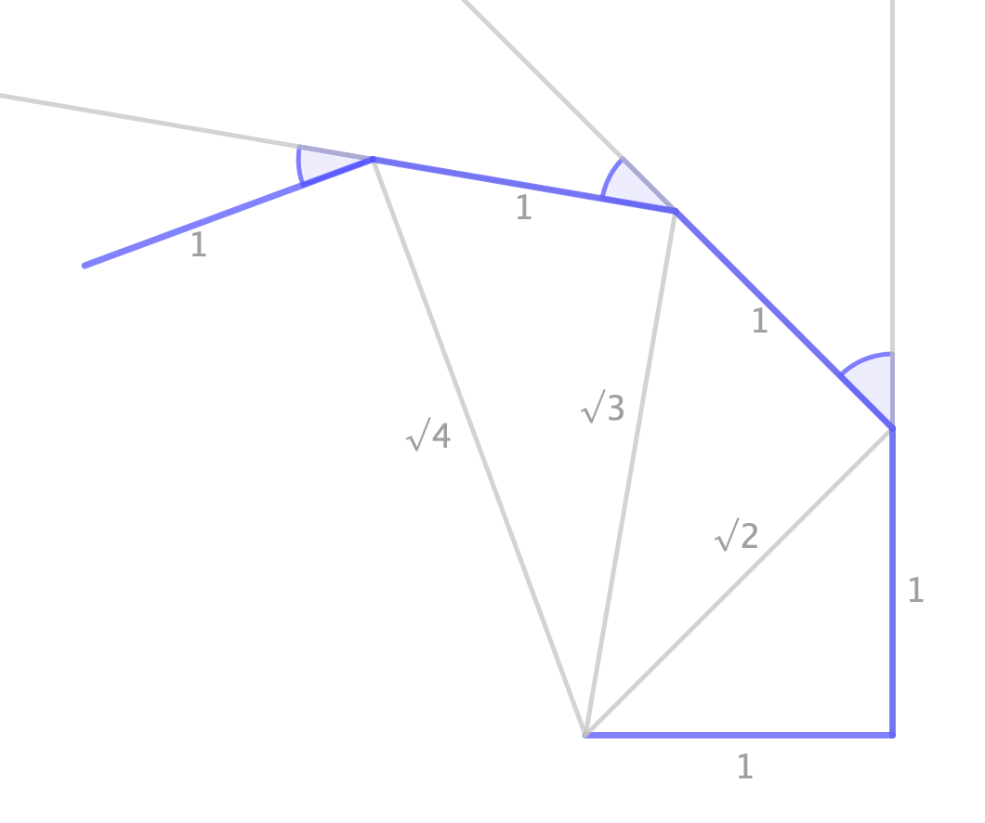



Pythagorean spiral
$$θ3$$
$$θ2$$
$$θ1$$

Slide 63





Pythagorean spiral
Define spiral()=
Prgm
Send "CONNECT RV"
$$θ2$$
$$θ3$$
Send "RV FORWARD 1"
Send "RV LEFT 90"
$$θ1$$
Send "RV FORWARD 1"
For i,1,3
$$h:=\tan^{−1}\left(\frac{1}{\sqrt{i}}\right)$$
Send "RV LEFT eval($h$) RADIANS "
Send "RV FORWARD 1"
EndFor
EndPrgm

Slide 64


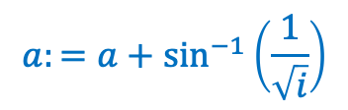
Pythagorean spiral (with polar coordinates)
Define spiral()=
Prgm
Send "CONNECT RV"
Send "RV FORWARD 1"
a:=0
For i,2,4
$$r:=\sqrt{i}$$
$$a:=a+\sin^{−1}\left(\frac{1}{\sqrt{i}}\right)$$
Send "RV TO POLAR eval($r$) eval($a$) RADIANS "
EndFor
EndPrgm

Slide 65
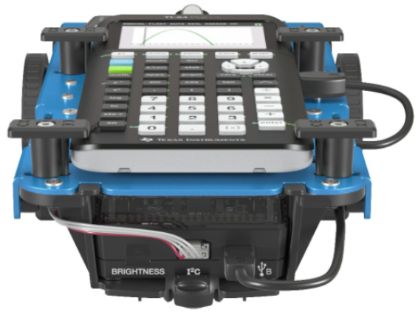
Thank you
Peter Vaandrager peter@tab63a.nl
Bert Wikkerink b.wikkerink@gmail.com

