Slide 1
Computational Thinking and Coding in the Classroom
Sharing Inspiration 2021 – September 16
Alexandre Gomes, T3 Europe, T3-APM Portugal

Slide 2
STEM projects as a vehicle for integrating
Computational Thinking into the curriculum
Sharing Inspiration 2021 – September 16
Alexandre Gomes, T3 Europe, T3-APM Portugal

Slide 3
CONTENTS
Computational Thinking (CT) and educational agenda: some European and Portuguese examples.
STEM projects examples with TI-Nspire ecosystem.
1
2

Slide 4
1
Computational Thinking(CT) and educational agenda: some European and Portuguese examples

Slide 5
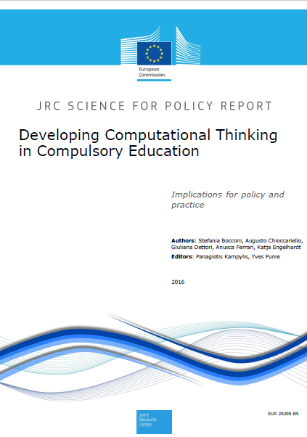
1
Computational Thinking and educational agenda
.
https://publications.jrc.ec.europa.eu/repository/bitstream/JRC104188/jrc104188_computhinkreport.pdf

Slide 6
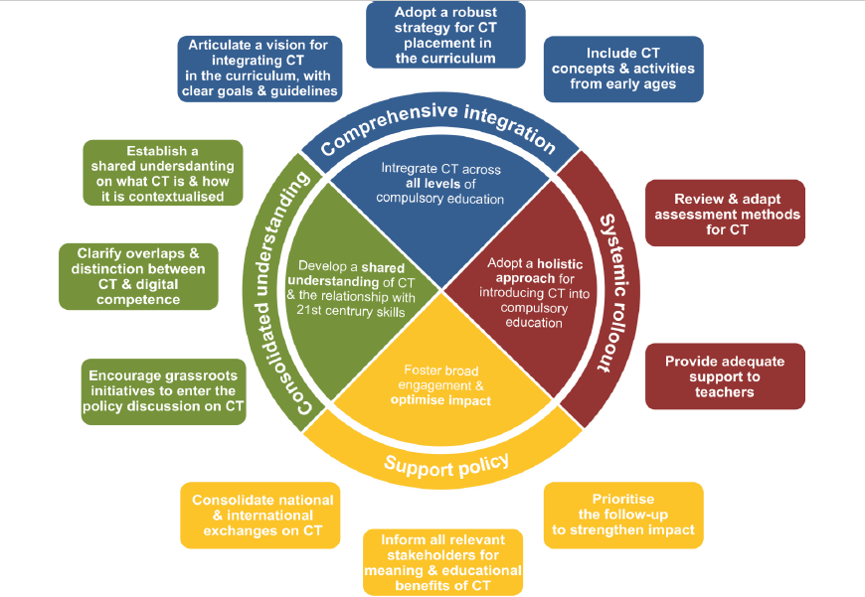
1
Computational Thinking and educational agenda
Bocconi, S., Chioccariello, A., Dettori, G., Ferrari, A., Engelhardt, K. (2016). Developing computational thinking in compulsory education – Implications for policy and practice; p. 8.

Slide 7
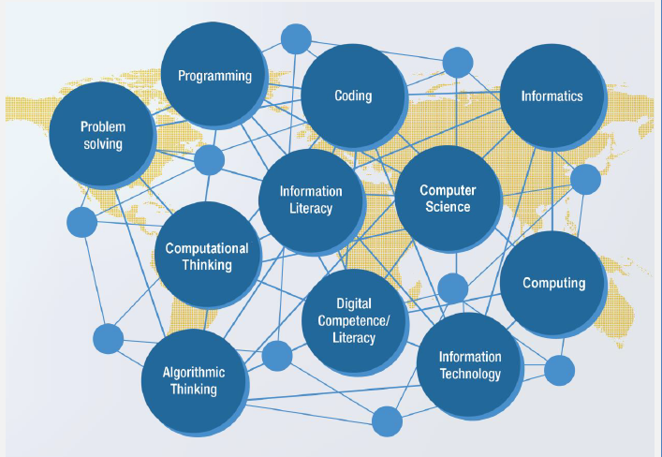
1
Computational Thinking and educational agenda
Bocconi, S., Chioccariello, A., Dettori, G., Ferrari, A., Engelhardt, K. (2016). Developing computational thinking in compulsory education – Implications for policy and practice; p. 22.

Slide 8
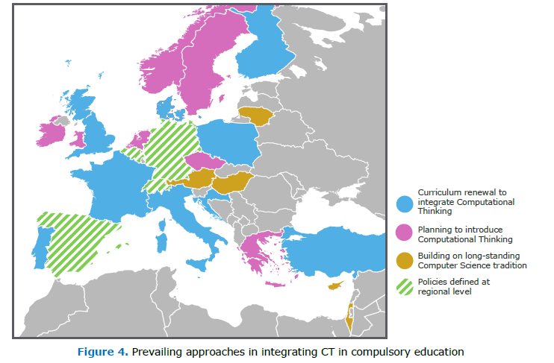
1
Computational Thinking and educational agenda
Bocconi, S., Chioccariello, A., Dettori, G., Ferrari, A., Engelhardt, K. (2016). Developing computational thinking in compulsory education – Implications for policy and practice; p. 27.

Slide 9
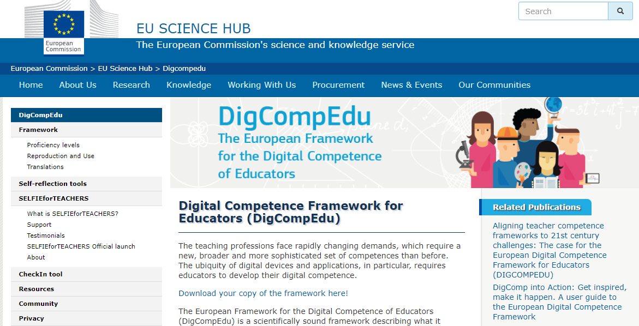
1
Computational Thinking and educational agenda
https://ec.europa.eu/jrc/en/digcompedu

Slide 10
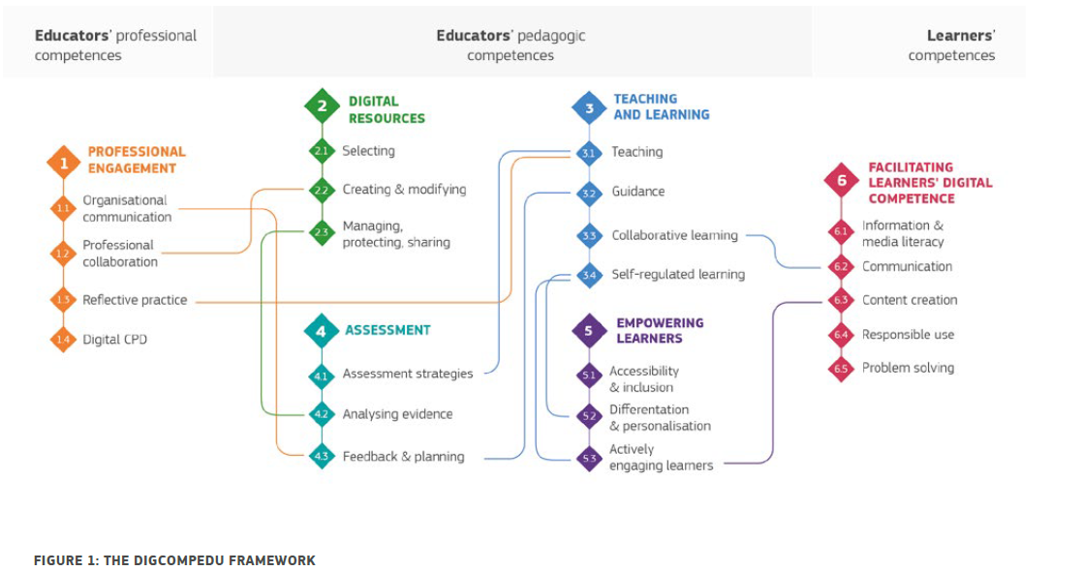
1
Computational Thinking and educational agenda
Punie, Y., editor(s), Redecker, C. (2017). European Framework for the Digital Competence of Educators: DigCompEdu , EUR 28775 EN, Publications Office of the European Union, Luxembourg, p. 8

Slide 11
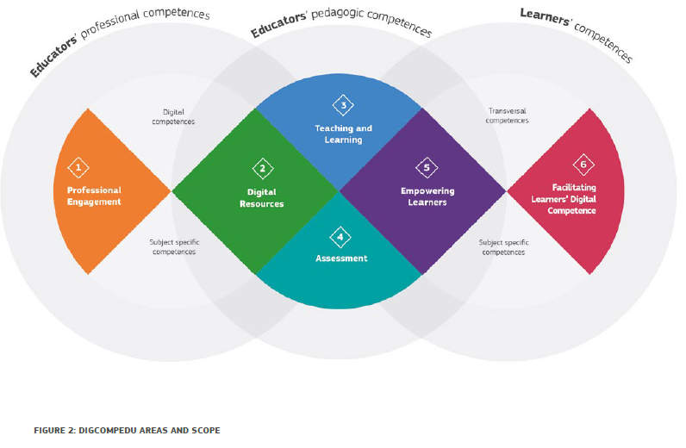
1
Computational Thinking and educational agenda
Punie, Y., editor(s), Redecker, C. (2017). European Framework for the Digital Competence of Educators: DigCompEdu , EUR 28775 EN, Publications Office of the European Union, Luxembourg, p. 16.

Slide 12

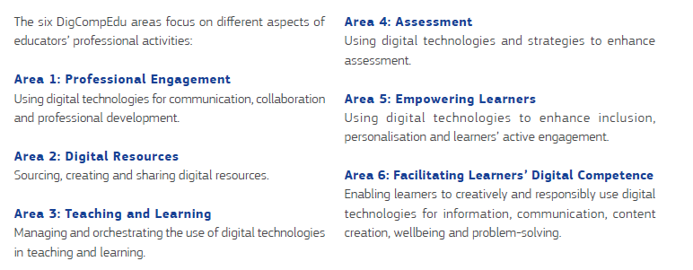
1
Computational Thinking and educational agenda
Punie, Y., editor(s), Redecker, C. (2017). European Framework for the Digital Competence of Educators: DigCompEdu , EUR 28775 EN, Publications Office of the European Union, Luxembourg, p. 16

Slide 13
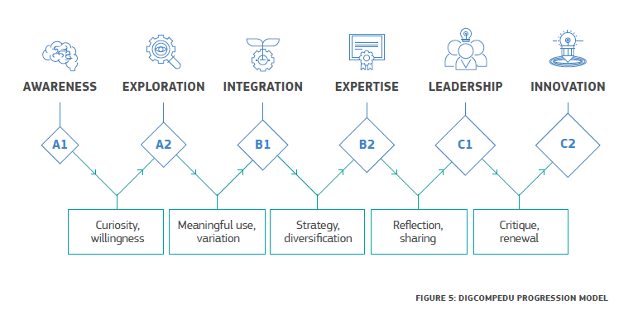
1
Computational Thinking and educational agenda
Punie, Y., editor(s), Redecker, C. (2017). European Framework for the Digital Competence of Educators: DigCompEdu , EUR 28775 EN, Publications Office of the European Union, Luxembourg, p. 29.

Slide 14
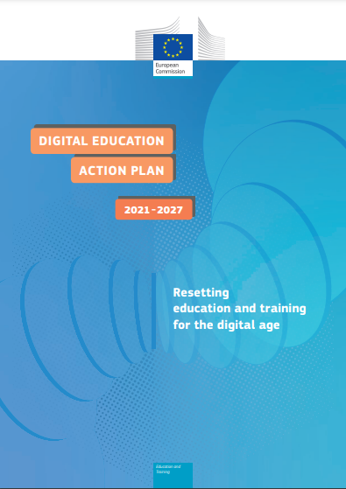
1
Computational Thinking and educational agenda
“The STEAM approach for learning and teaching links STEM and other fields of study. It promotes cross-cutting, ‘transversal’ skills such as digital skills, critical thinking, problem-solving, management, and entrepreneurship. It also promotes cooperation with non-academic partners and responds to economic, environmental, political and social challenges. STEAM encourages the blending of knowledge that is required in the real world and natural curiosity”
https://ec.europa.eu/education/sites/default/files/document-library-docs/deap-communication-sept2020_en.pdf

Slide 15

1
Computational Thinking and educational agenda

Slide 16
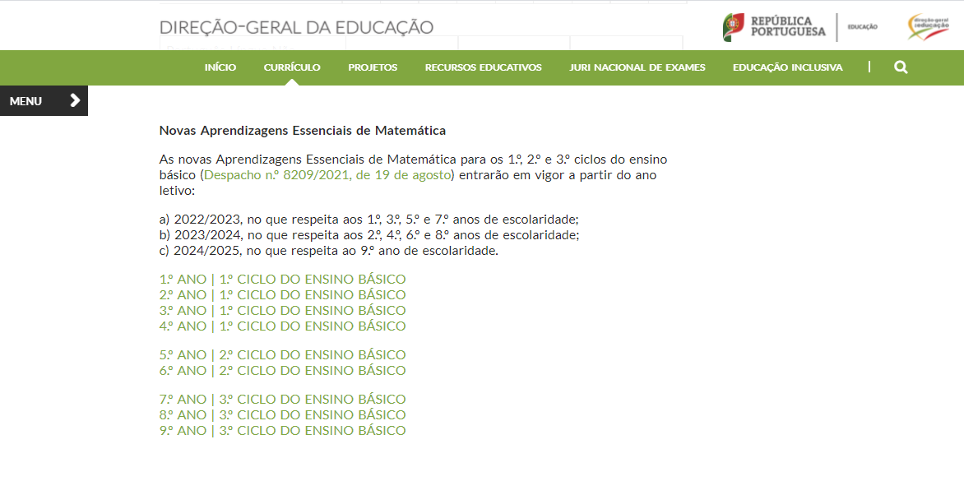
1
Computational Thinking and educational agenda
http://www.dge.mec.pt/aprendizagens-essenciais-ensino-basico

Slide 17


1
Computational Thinking and educational agenda
Develop and mobilize computational thinking, a capacity that has come to assume relevance in the curriculum of Mathematics of several countries. Computational thinking presupposes the development, in an integrated manner, of practices such as abstraction, the decomposition, pattern recognition, analysis and definition of algorithms, and the development of debugging and optimization of processes. These practices are essential in mathematical activity and provide students with tools that allow to solve problems, in particular related to programming.

Slide 18
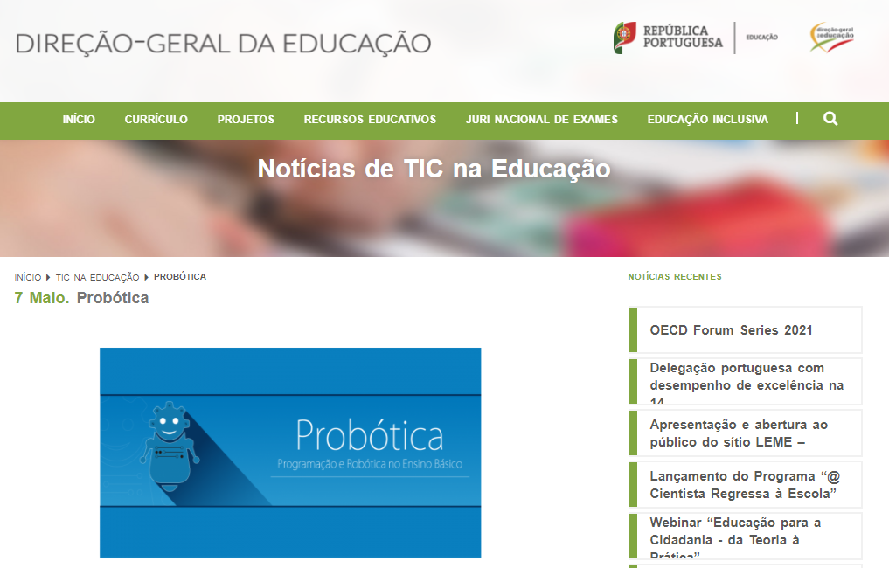
1
Computational Thinking and educational agenda
https://www.dge.mec.pt/noticias/tic-na-educacao/probotica

Slide 19

1
Computational Thinking and educational agenda
“The articulation of knowledge from the various disciplines or subject areas should be put into practice by carrying out projects or solving problems that allow students to see programming and robotics not as an end in themselves, but as transversal tools that promote learning of diverse knowledge. Thus, it is important that the teacher promotes articulation with other teachers in the class (from the class or from the school), prioritizing areas where they can develop projects in an articulated and contextualized manner”.
https://www.dge.mec.pt/noticias/tic-na-educacao/probotica

Slide 20
2
STEM projects examples with TI-Nspire ecosystem.

Slide 21

2
Vacuum Cleaner Project: step by step
Connection test – move forward
Wall outline
Step detection
Dirt detection
Obstacle detection
Virtual barrier
Full algorithm implementation

Slide 22
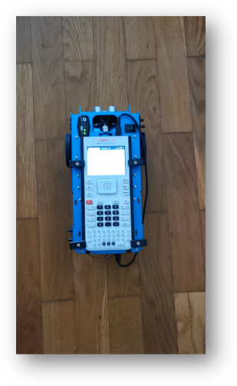
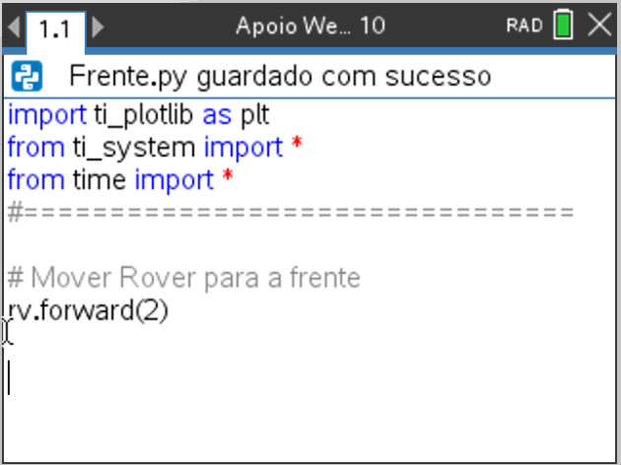
Connection test – move forward
2

Slide 23
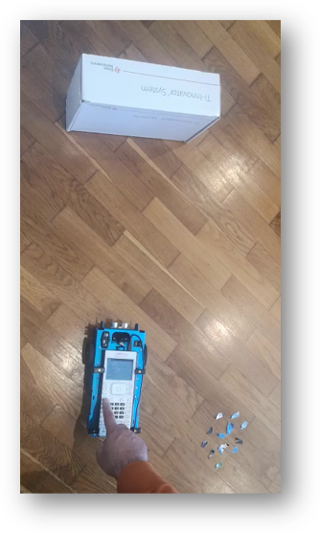
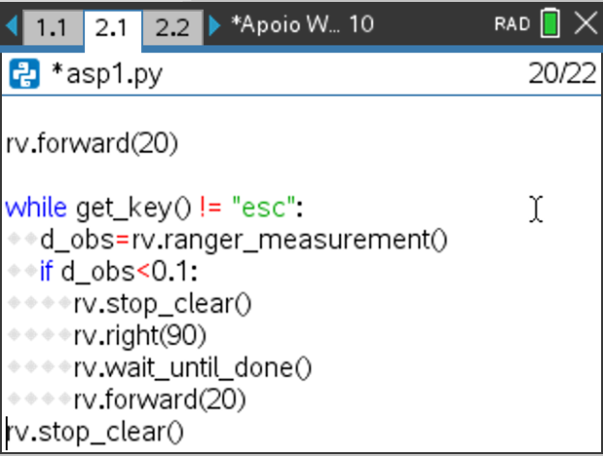
Obstacle detection
2

Slide 24
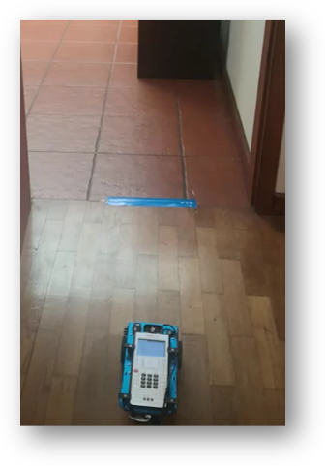
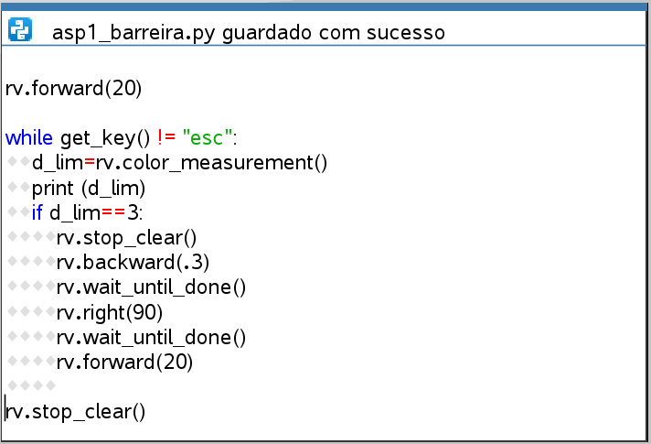
Virtual barrier
2

Slide 25
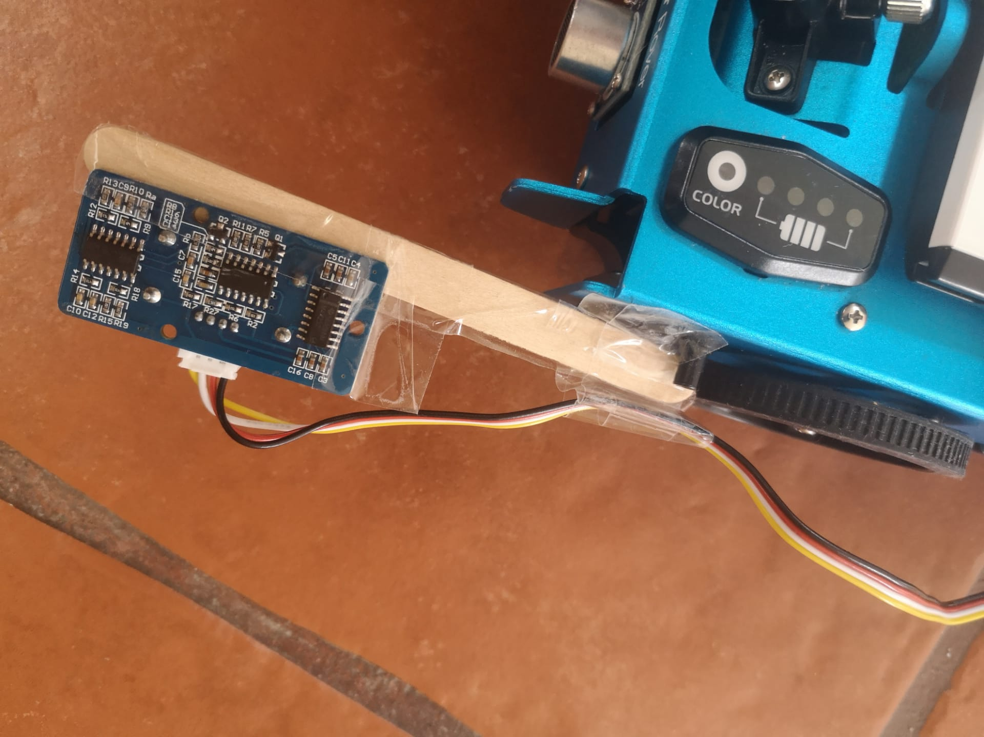
Step detection
2

Slide 26
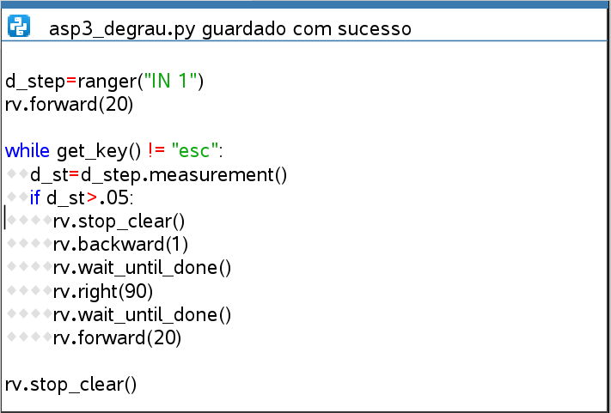
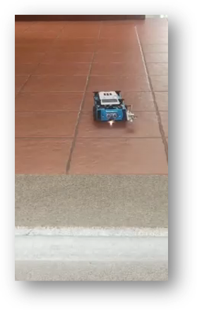
Step detection
2

Slide 27
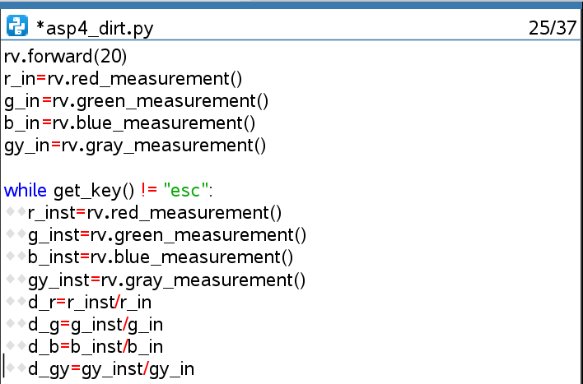
Dirt detection
2

Slide 28
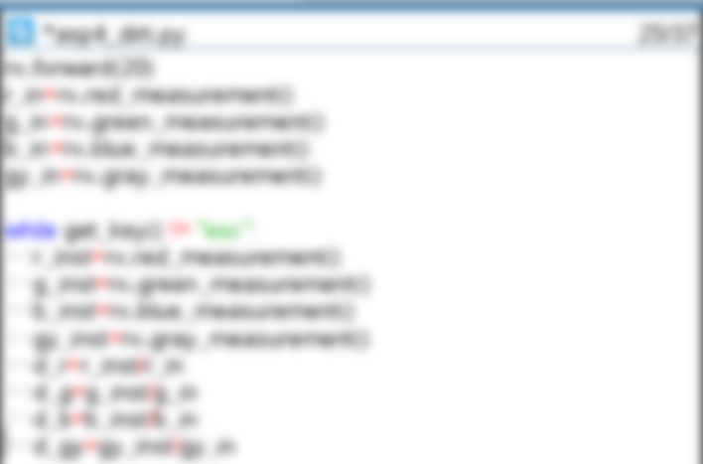
Dirt detection
2

Slide 29
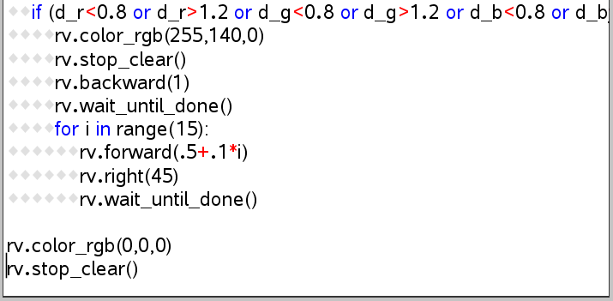
Dirt detection
2

Slide 30
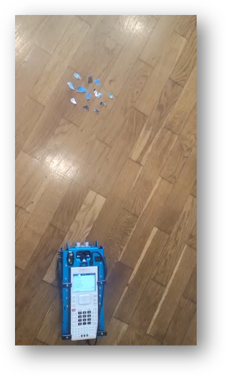

Dirt detection
2

Slide 31
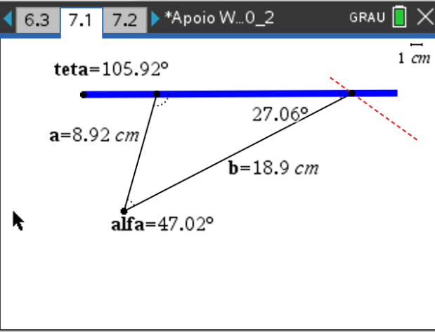
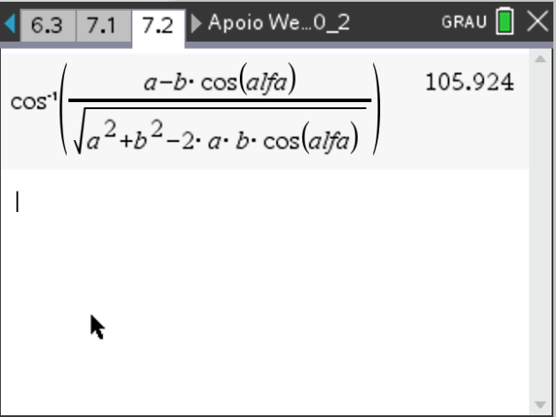
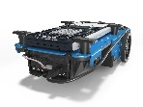
Wall outline– law of cosines
2

Slide 32
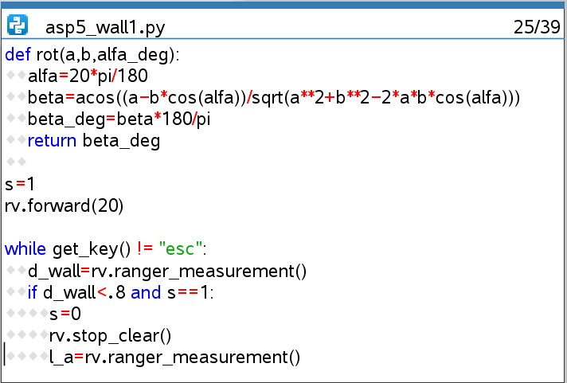
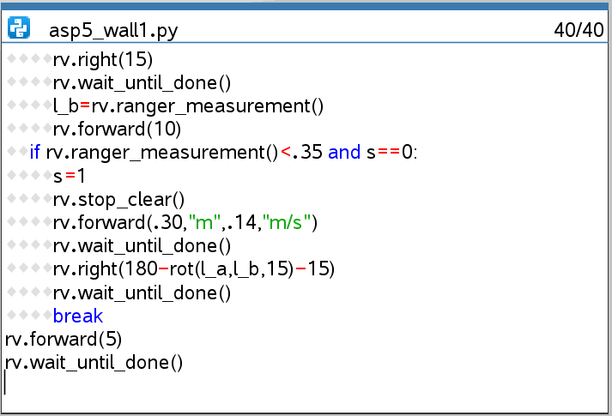
Wall outline– law of cosines
2

Slide 33
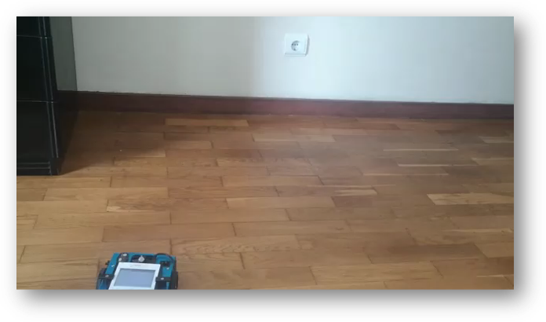
Wall outline– law of cosines
2

Slide 34
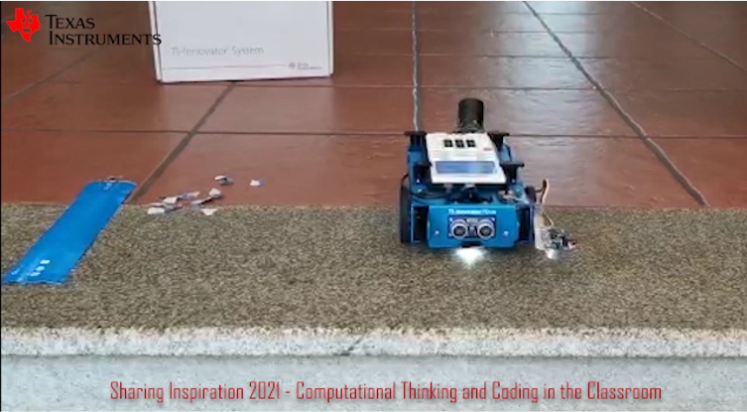
Full algorithm implementation
2

Slide 35
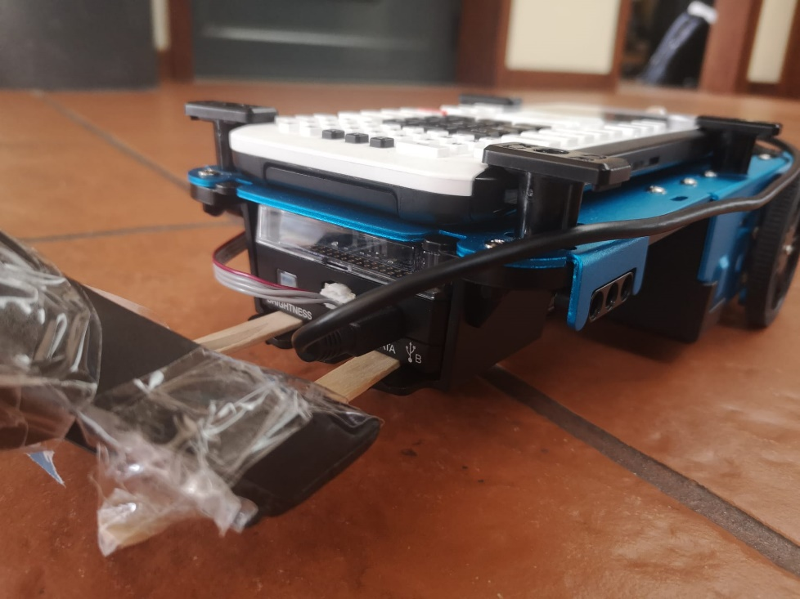
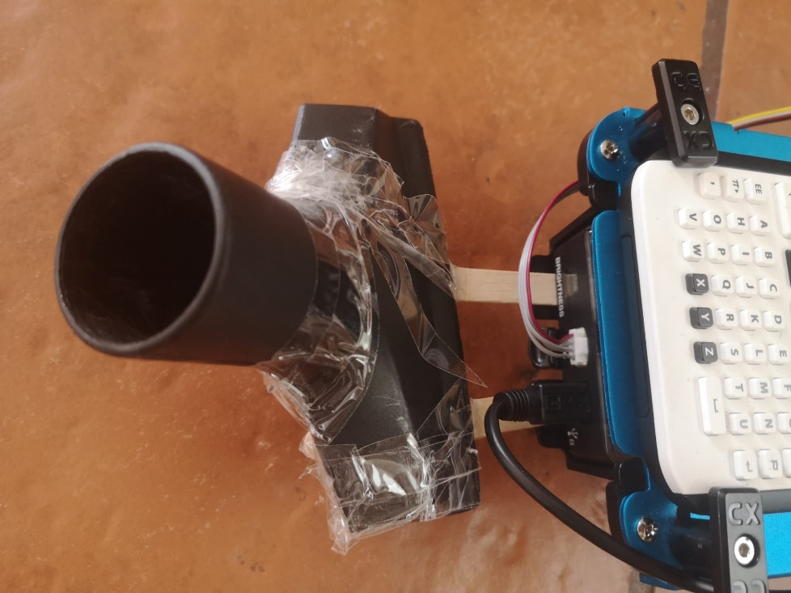
2
General layout

Slide 36

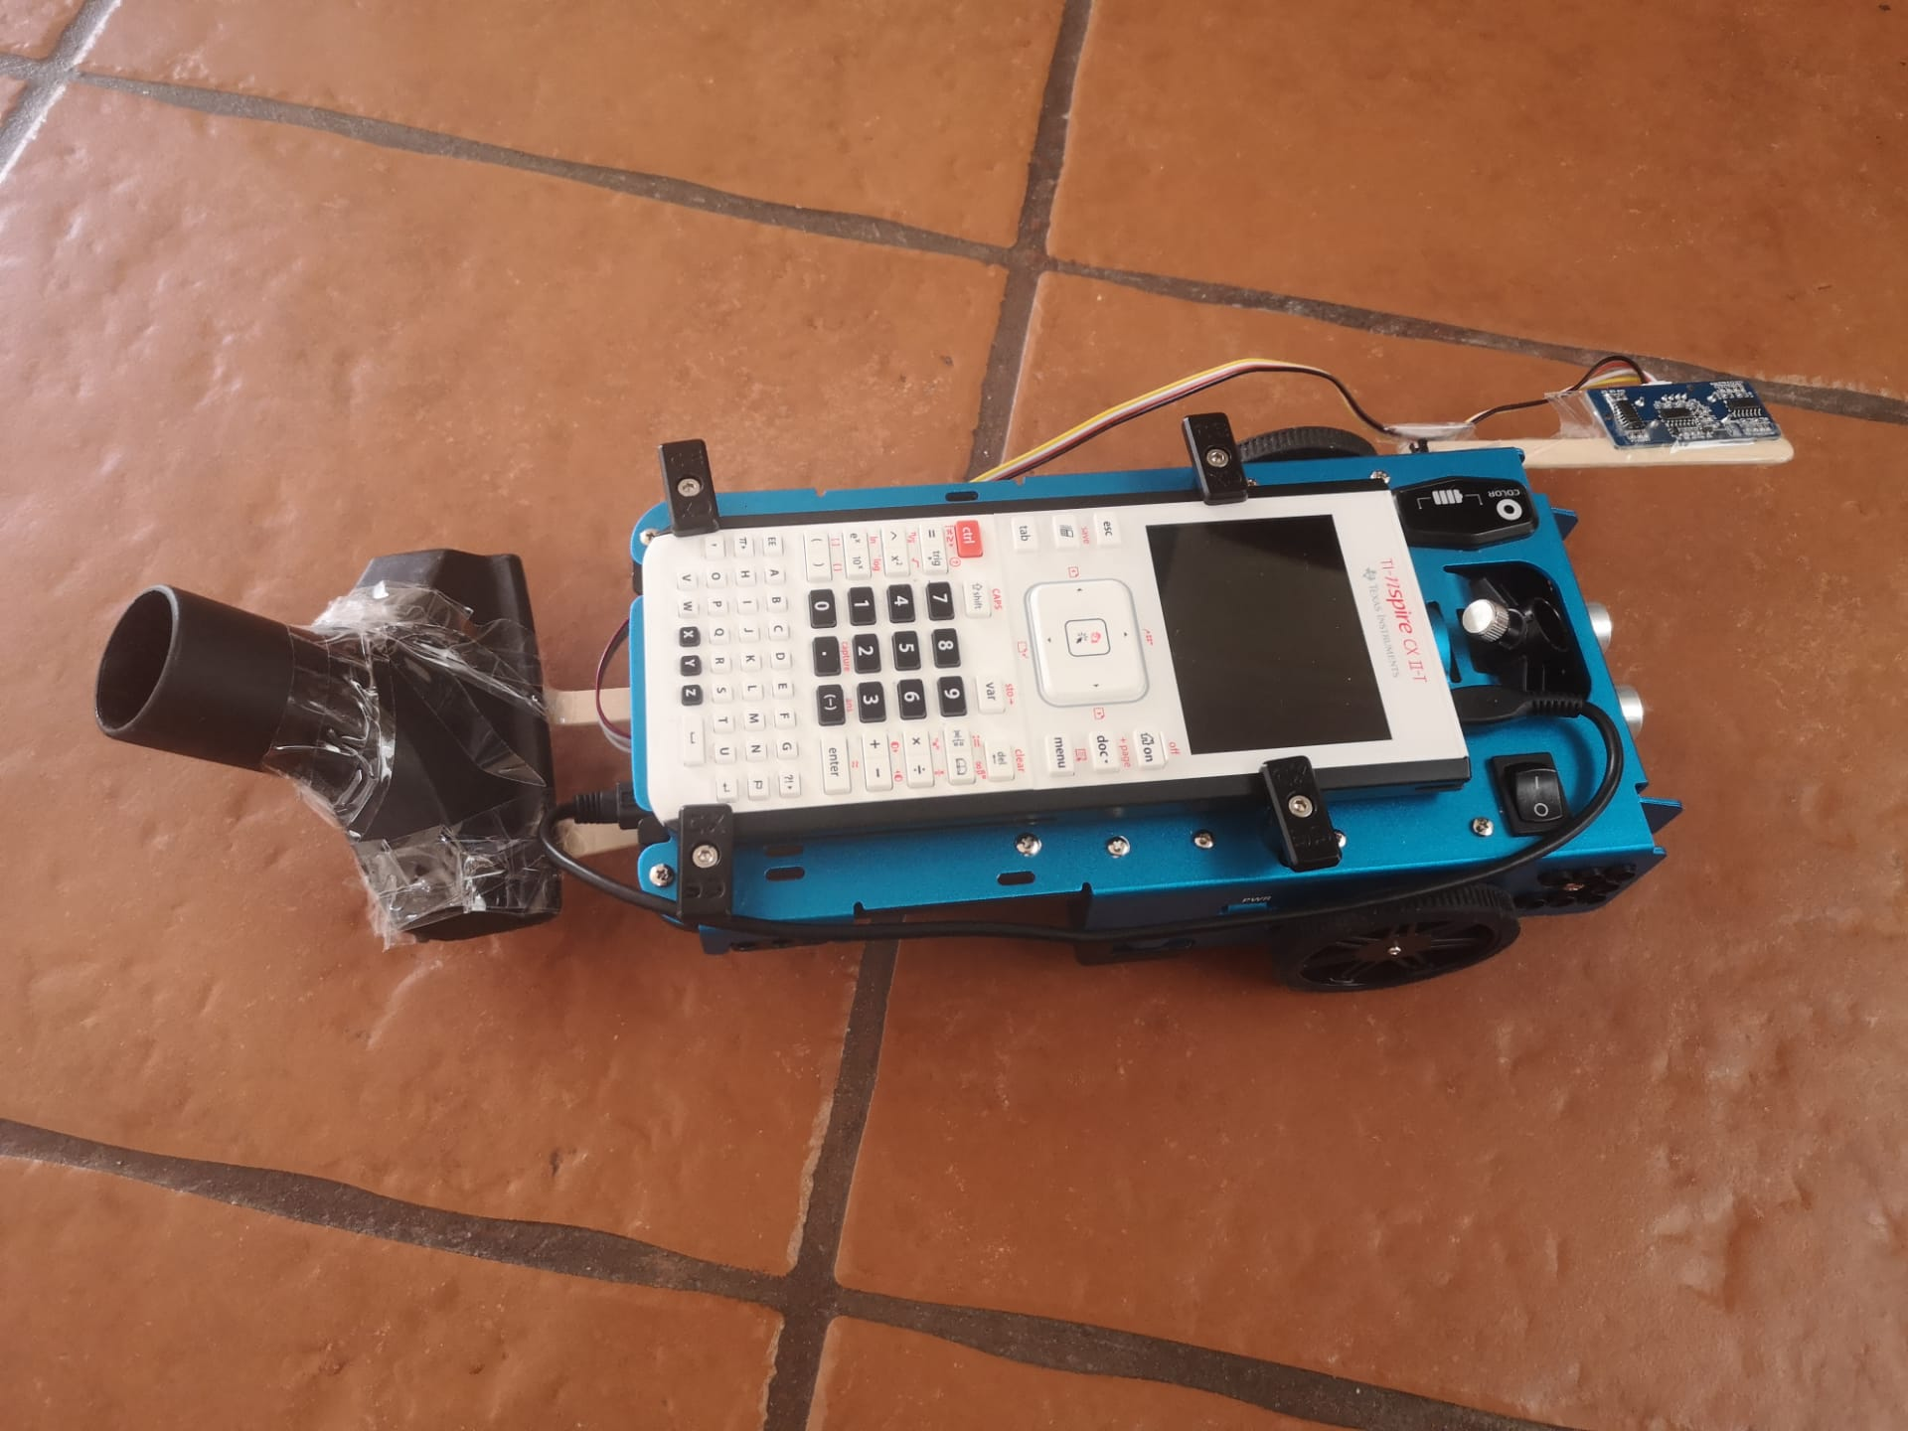

2
General layout

Slide 37
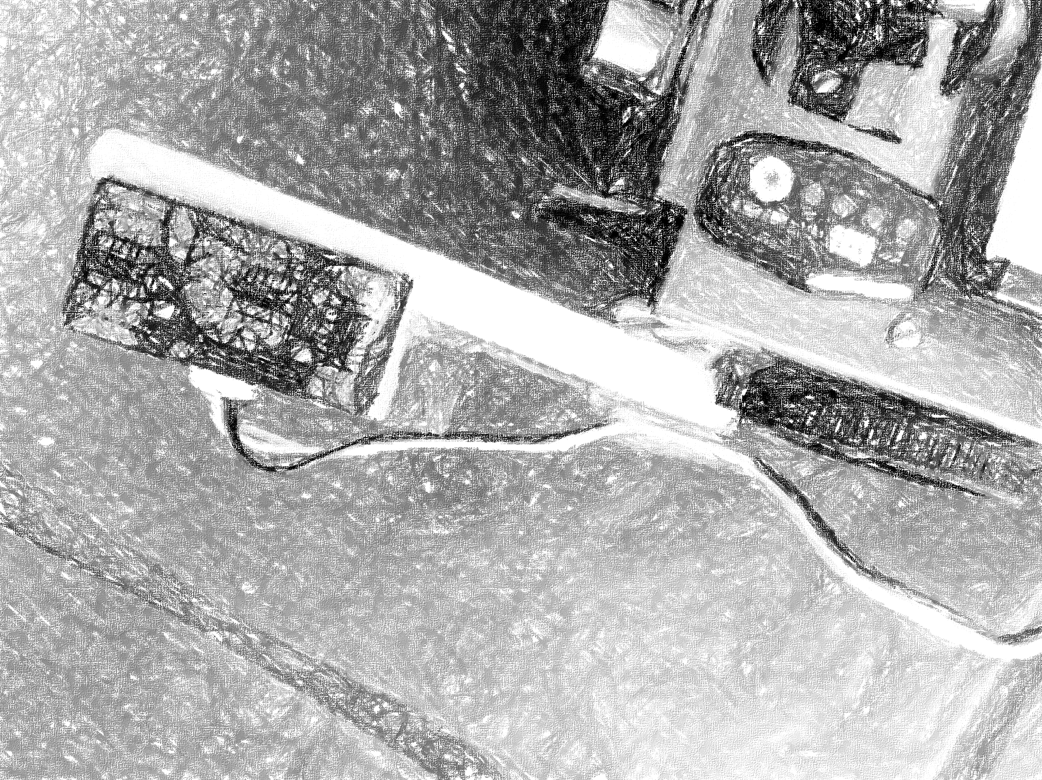
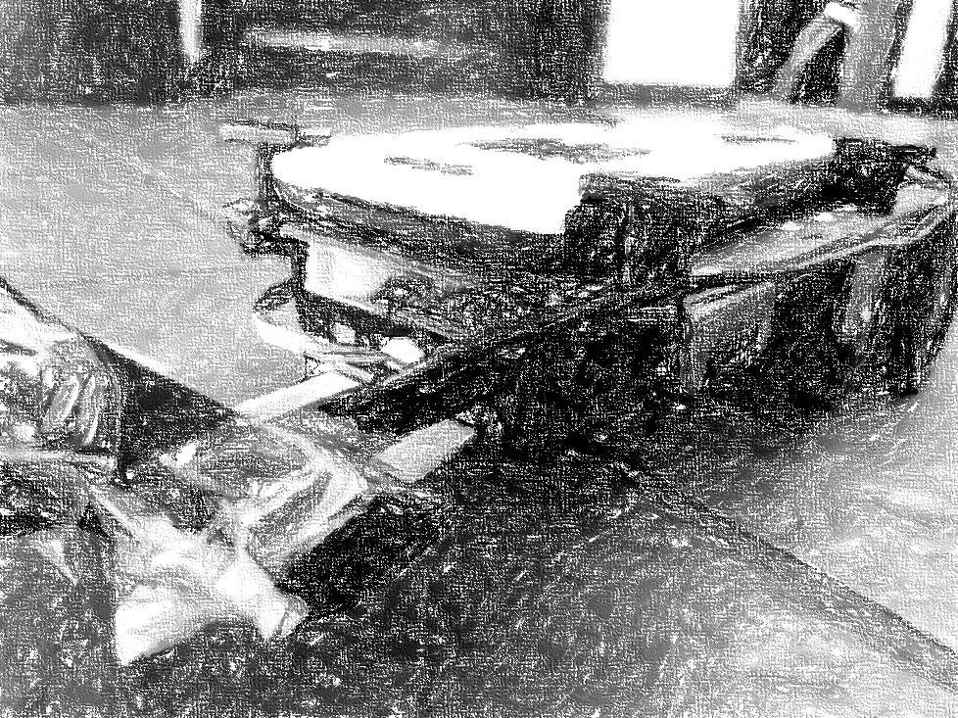
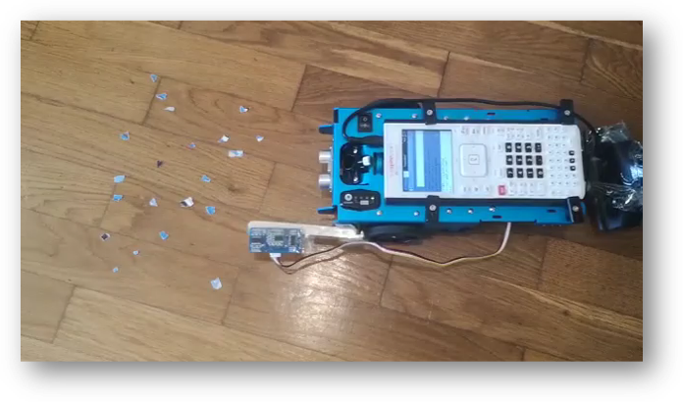
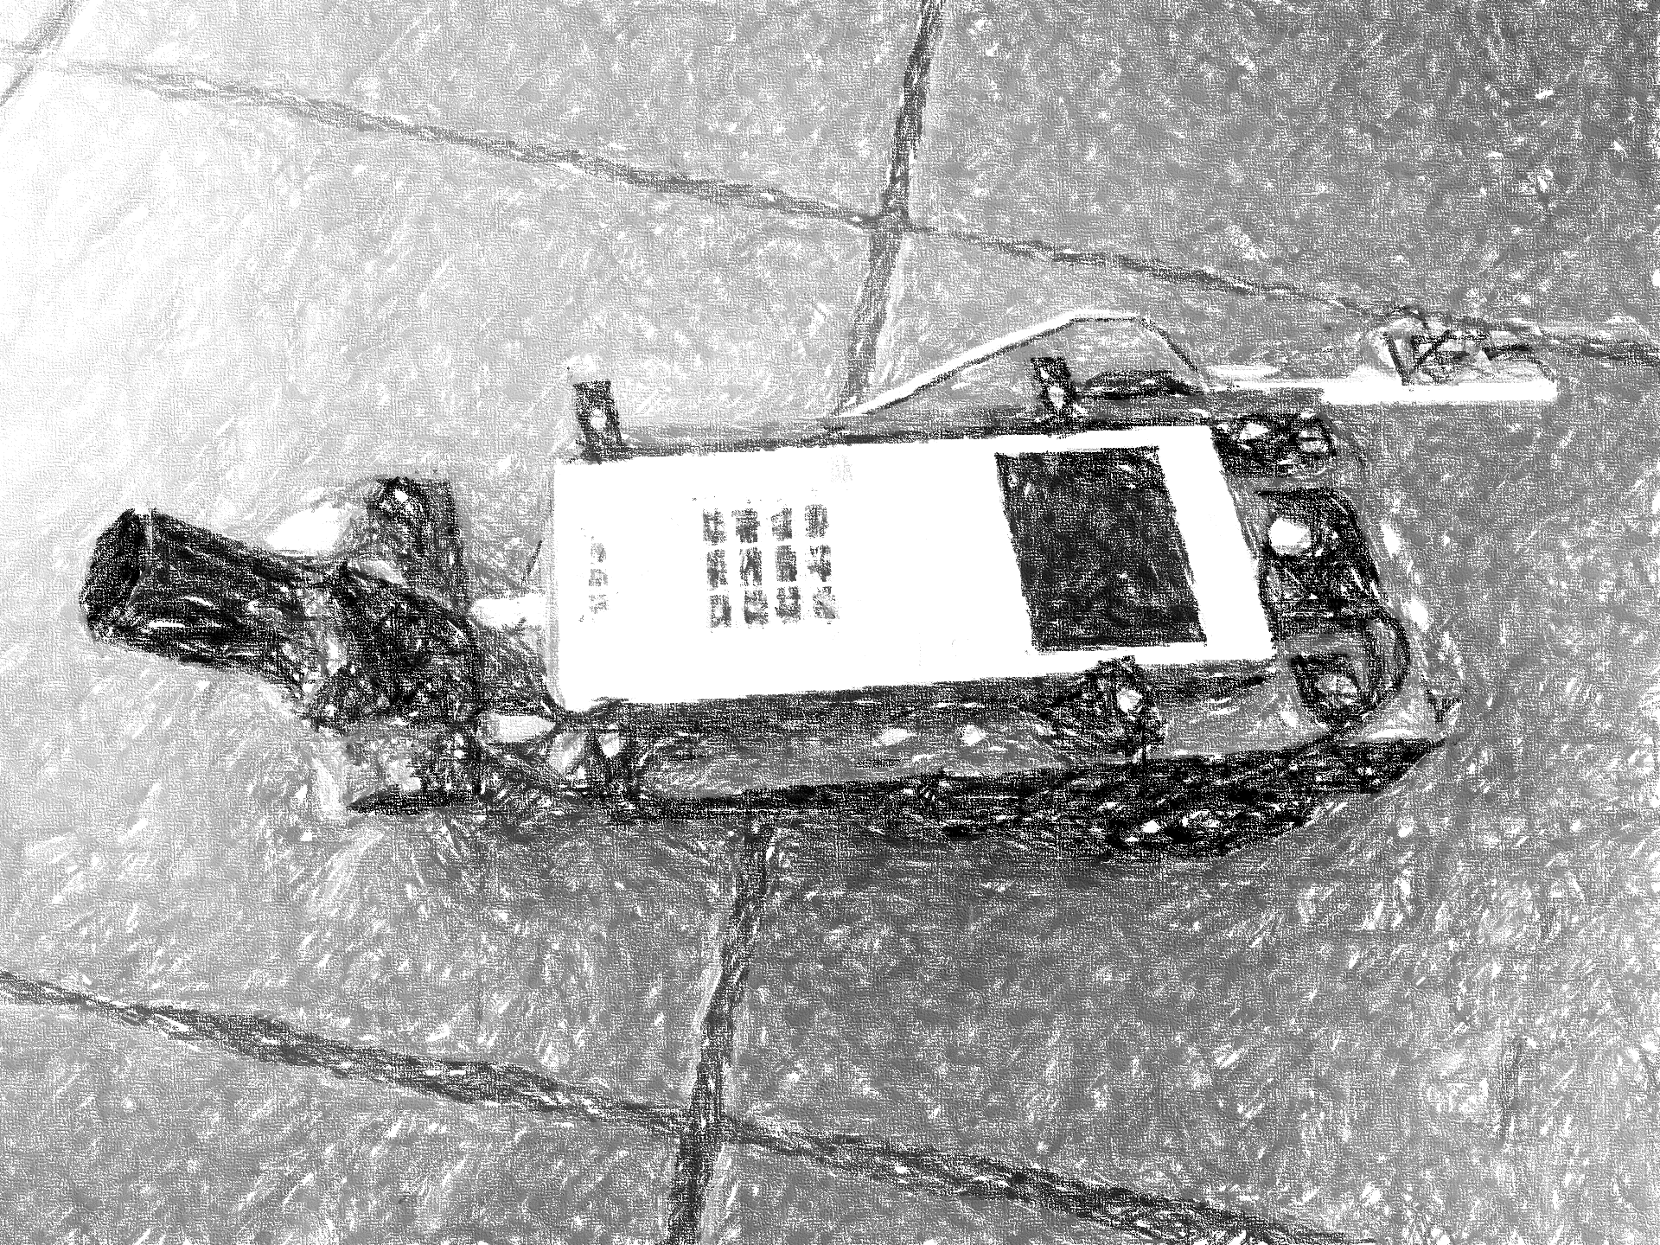
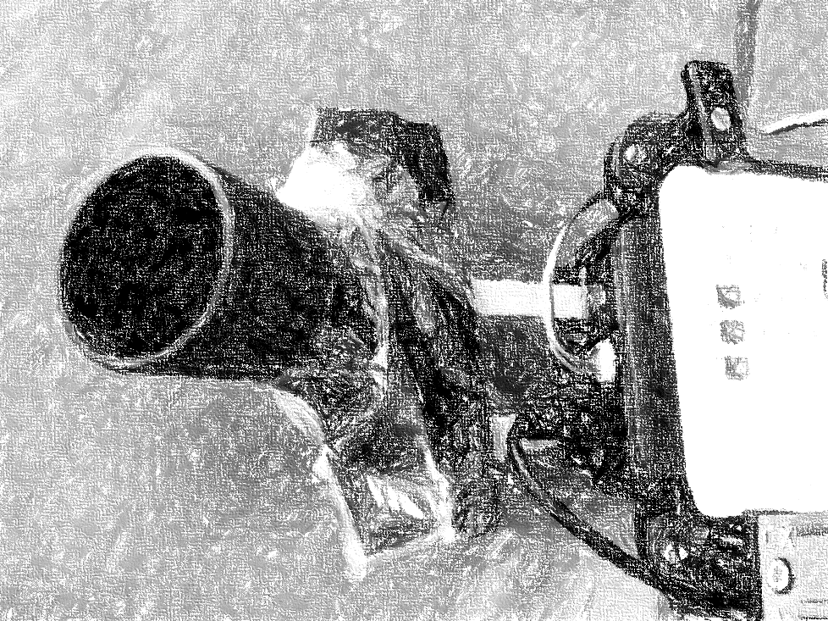
2
Real cleaning

Slide 38
2
Parking Project: step by step
Connection test – move forward
Parking Sensor
Logistic Function
Parallel Parking
Search and park
Perpendicular Parking

Slide 39
Connection test – move forward
2

Slide 40
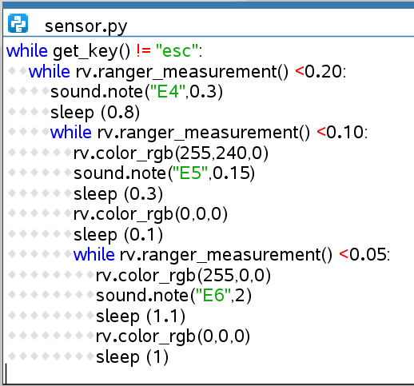
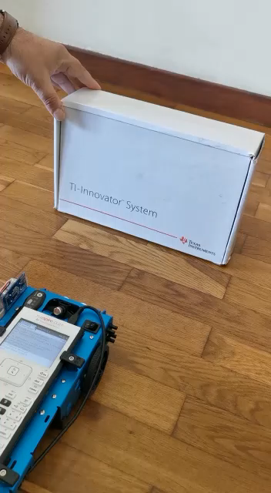
Parking Sensor
2

Slide 41
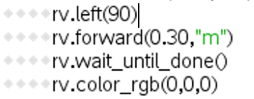
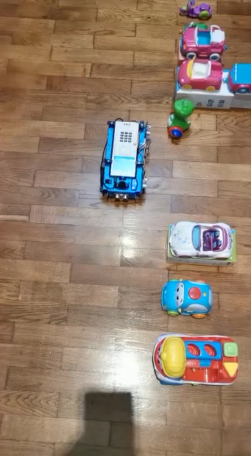

Perpendicular parking
2

Slide 42
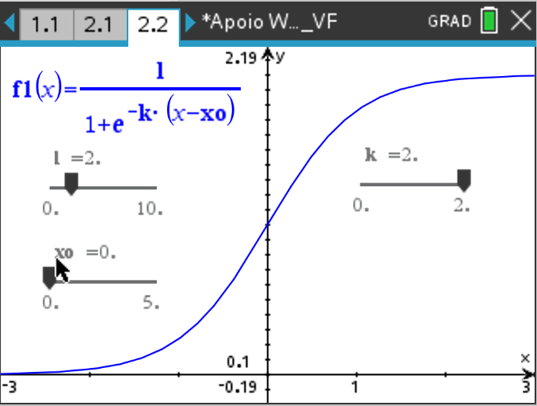
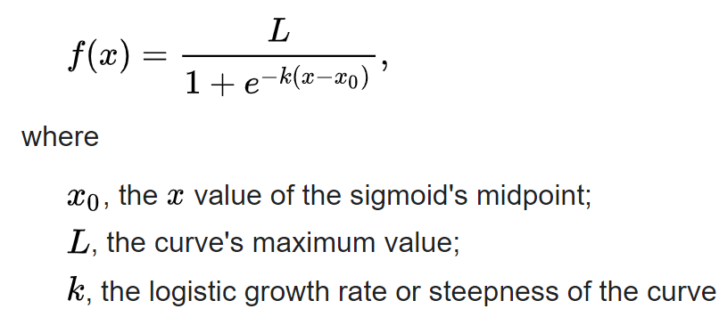
2
Logistic function

Slide 43
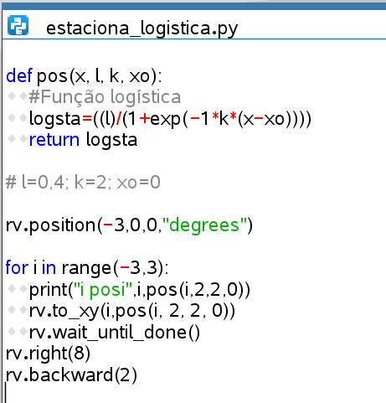
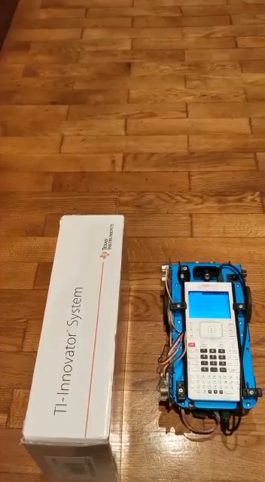
Logistic function parking
2

Slide 44
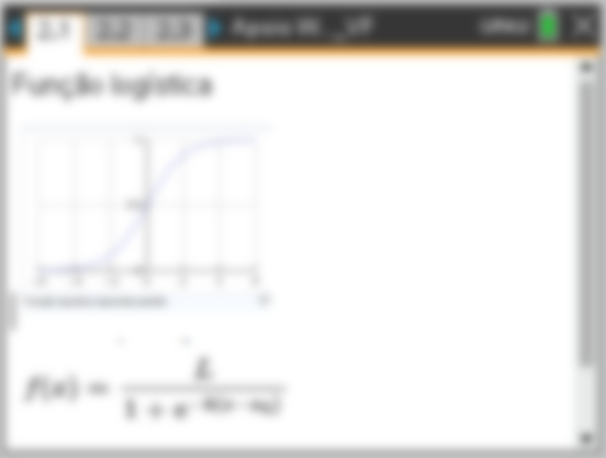
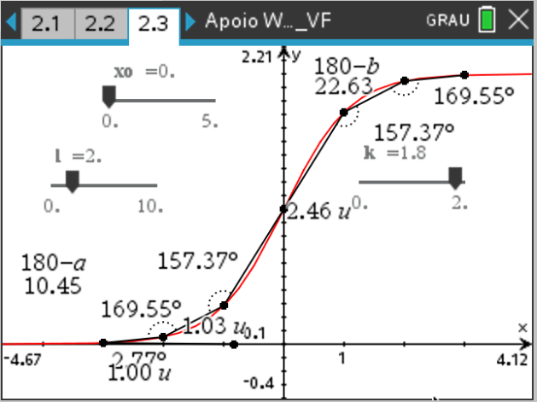

Logistic function study
2

Slide 45


Logistic function study
2

Slide 46

Search for parking spot
2

Slide 47


Search for parking spot
2

Slide 48






Search for parking spot - perpendicular
2
Depth (> 0.30m)
Depth

Slide 49




Search for parking spot - parallel
2
Depth (> 0.15 m)
Gap (0.10 m)

Slide 50

2
Search for parking spot

Slide 51

2
Full algorithm implementation

Slide 52

STEM projects as a vehicle for integrating
Computational Thinking into the curriculum
Sharing Inspiration 2021 – September 16
Alexandre Gomes, T3 Europe, T3-APM Portugal
alexandre.gomes@aeoj.org

