Slide 1
Garbage in the Classroom
Cathy Baars
Start at 17:00 uur

Slide 2
Content
Idea
Subjects from curriculum
Pedagogy
During lockdown
At school
How
Examples
“Movie”
Pictures made by M.Goulmy and C. Baars

Slide 3
Idea
Students doing a larger project
Sustainability / milieu
Programming
Orientation at future career
Scrum finalization
Garbage project:
Garbage van
Separating plastic
Separating metal
Cleaning glass
Garbage press

Slide 4
Subjects covered:
Technical automation
Technical design
Design cycle
Use of internet for information
Sustainability, climate and environment
Communicating about physics
Orientation on study and career
Modelling, computational thinking and programming
Technical skills in using apparatus
General use of computer for science
My target:
Use of physics in a project that is larger and extending my classroom.

Slide 5
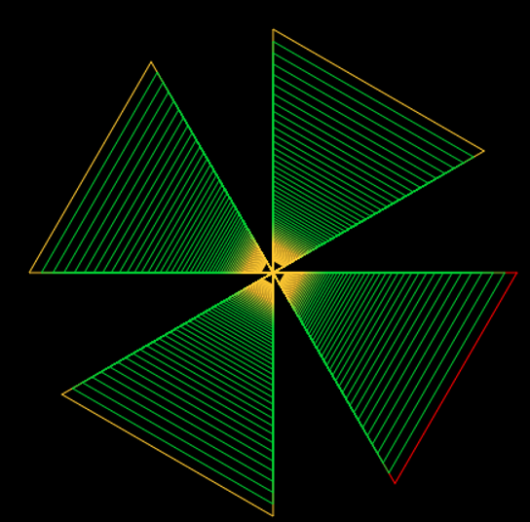
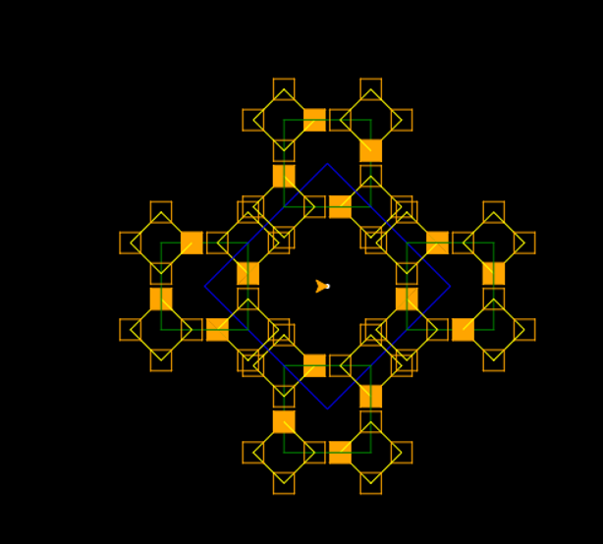
Pedagogy during lockdown
Target: Programming motors that respond on sensors
But:
During lockdown students didn’t have access to materials
Learning how to program art in python
No python on calculator at that time
Repl-it
Zoom with chat
Debugging programs together → very valuable

Slide 6
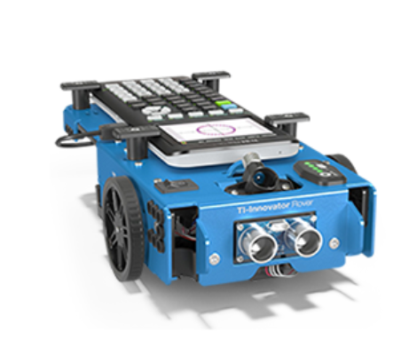
Pedagogy: at school (1)
Only 20 minute lesson per week at school
Turtle vs rover→ Works the same!
turtle.forward(10)
rv.forward(10)
Programs made for art worked also with the rover
The same program can be used for more than 1 purpose.

Slide 7
Pedagogy: at school (2)→ Scrum

Slide 8
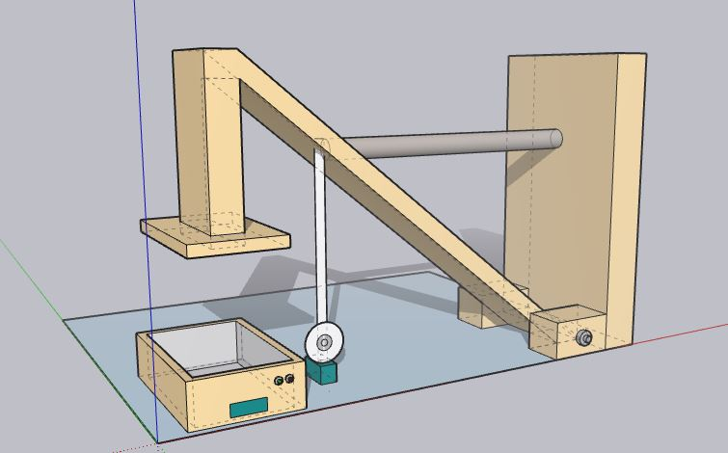
How: Scrum with sprints
Sprint 1: Background information and requirements of product→Poster
Sprint 2: partial solutions and refined requirements of product→Video
Sprint 3: Working product
Time: Sprint 1 and 2 one week, sprint 3 two weeks
Scoring with rubrics
Retro and review

Slide 9
Making groups: Quality chart
Qualities | Skills | Interaction
Creative | Good in building | Keeping the spirit up
Ambitious | Good in problem solving | Activating people
Independent | Good in programming | Taking the lead
Reliable | Good in tinkering | Helping people
Responsible | Good in planning
Positive | Good in technic
Determent

Slide 10
How: Used materials
Ti-Nspire with python (pre-release)
Innovator hub
Sensors + motors
Battery packs.
K’nex
….

Slide 11
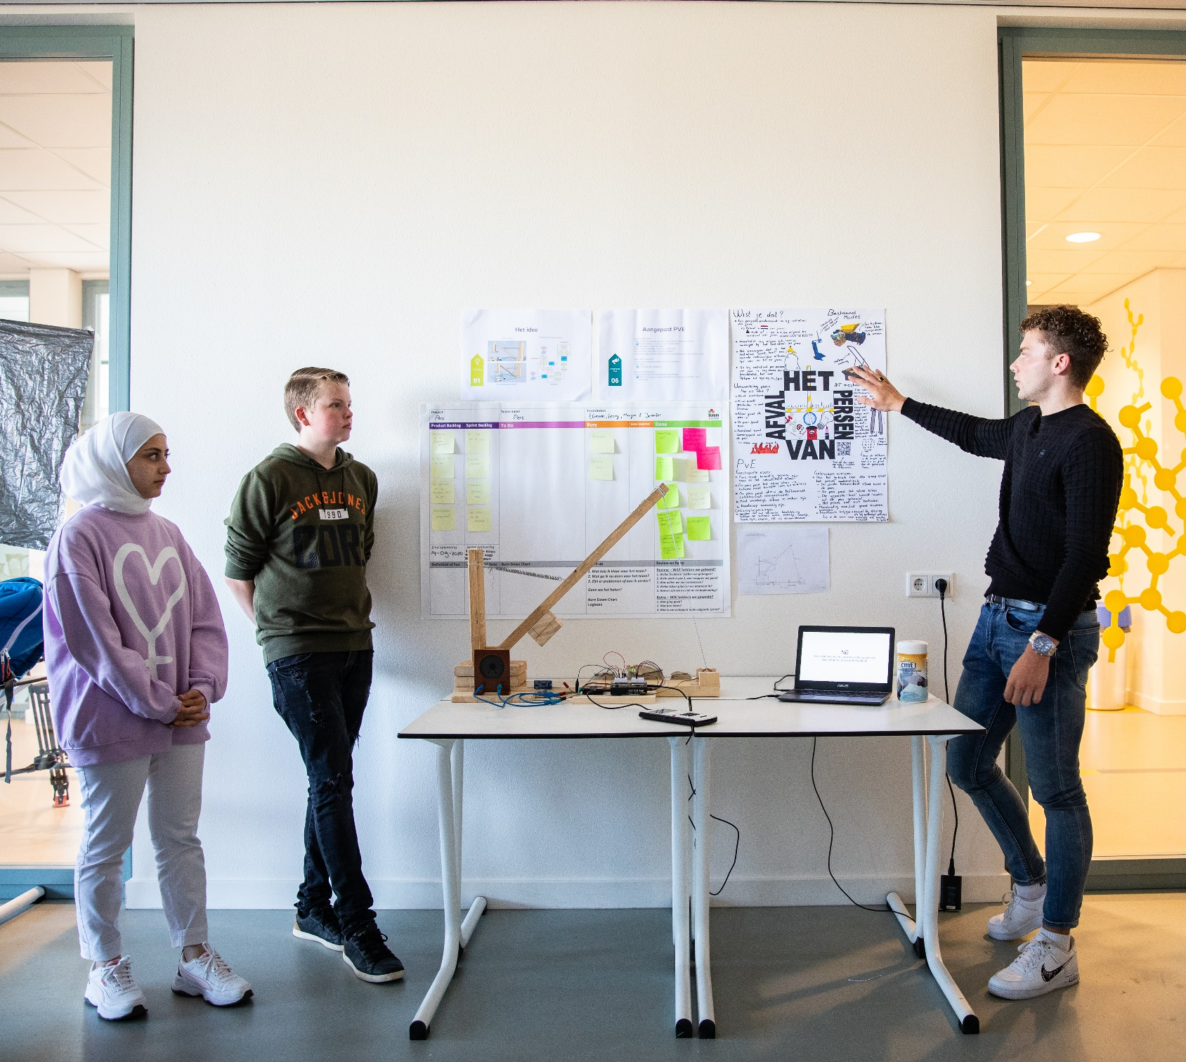
Garbage press

Slide 12
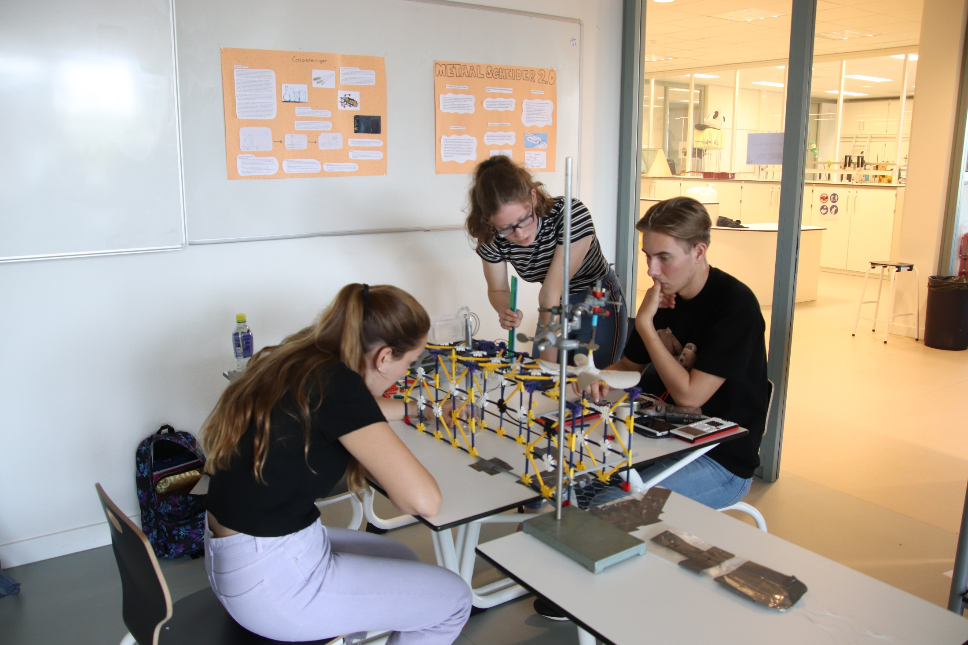
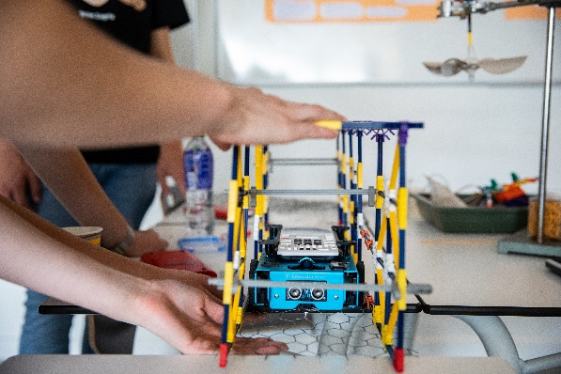
Cleaning glas

Slide 13
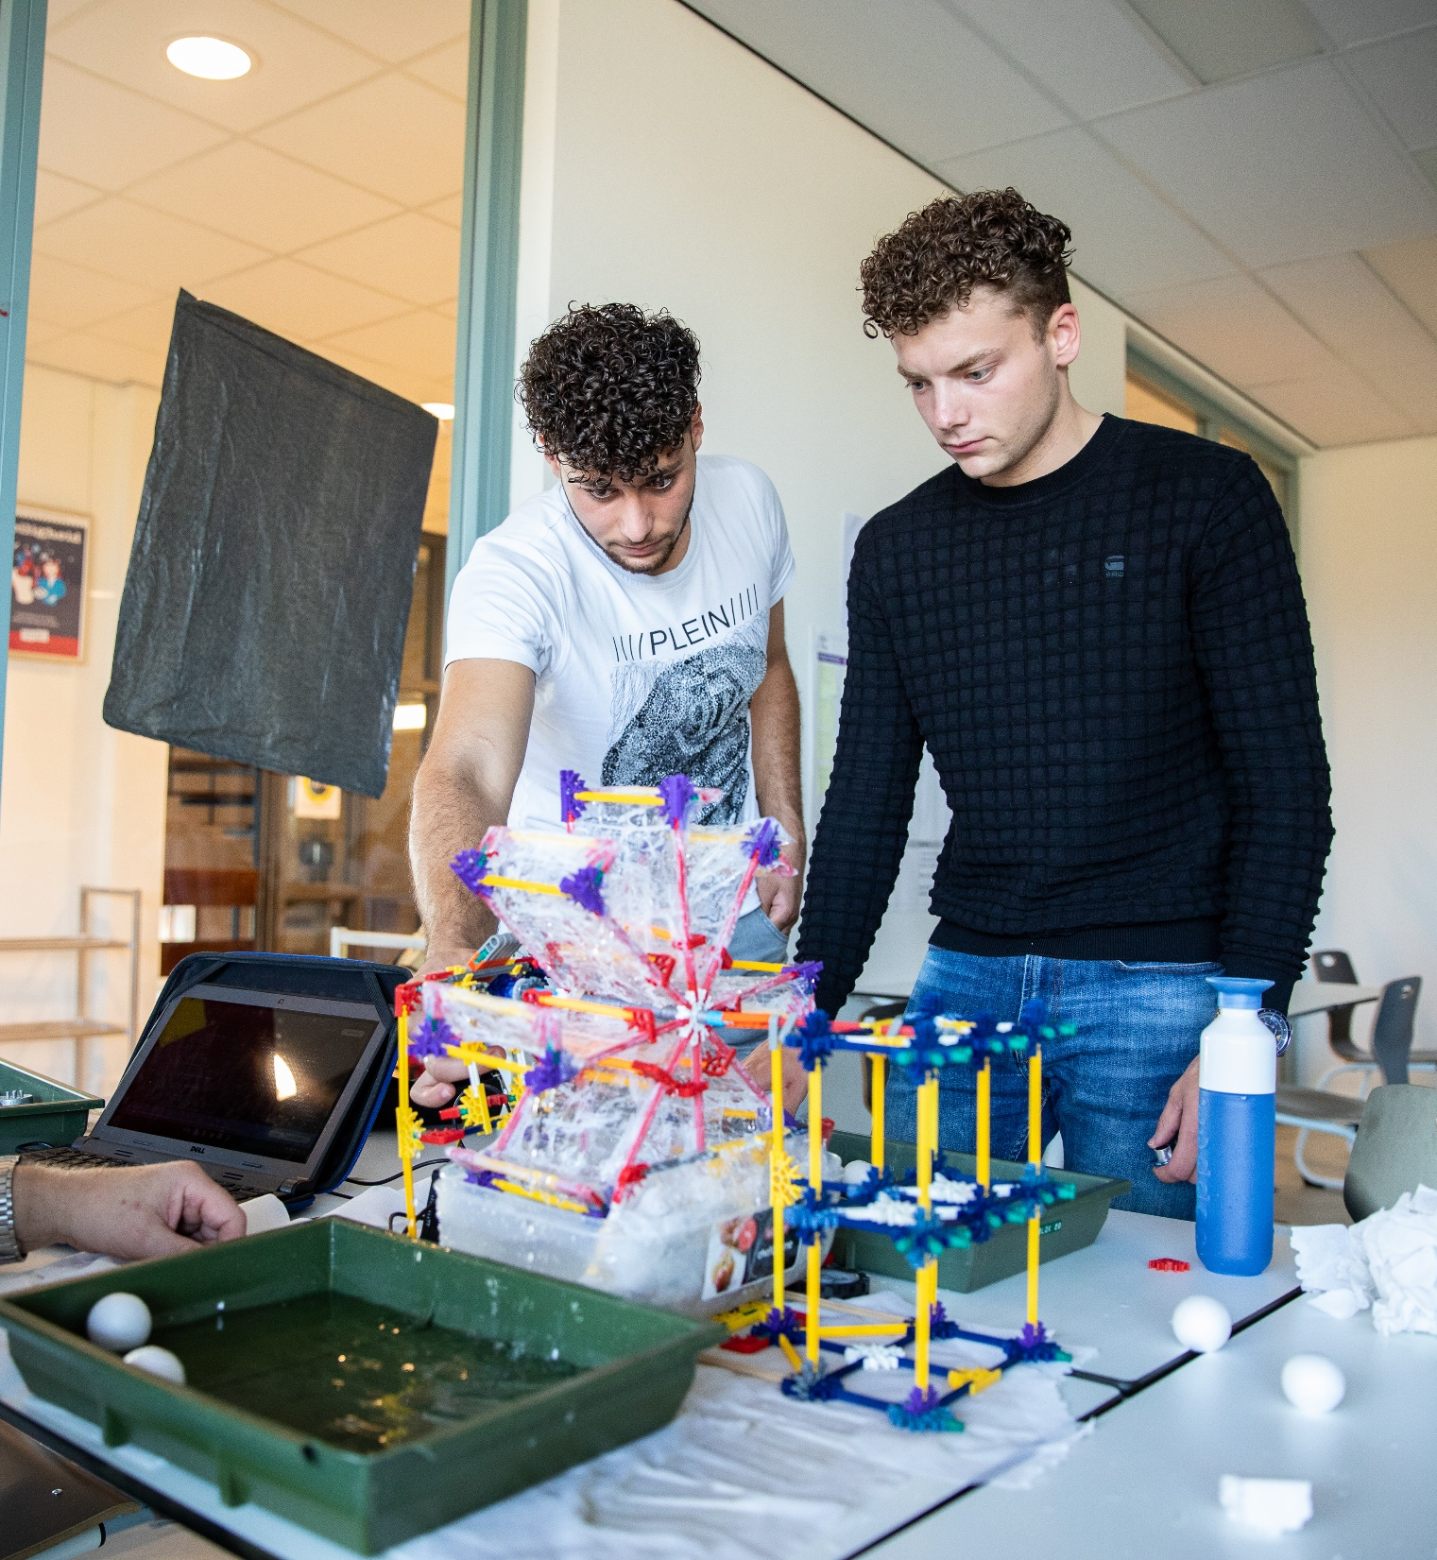
Separating Plastic

Slide 14
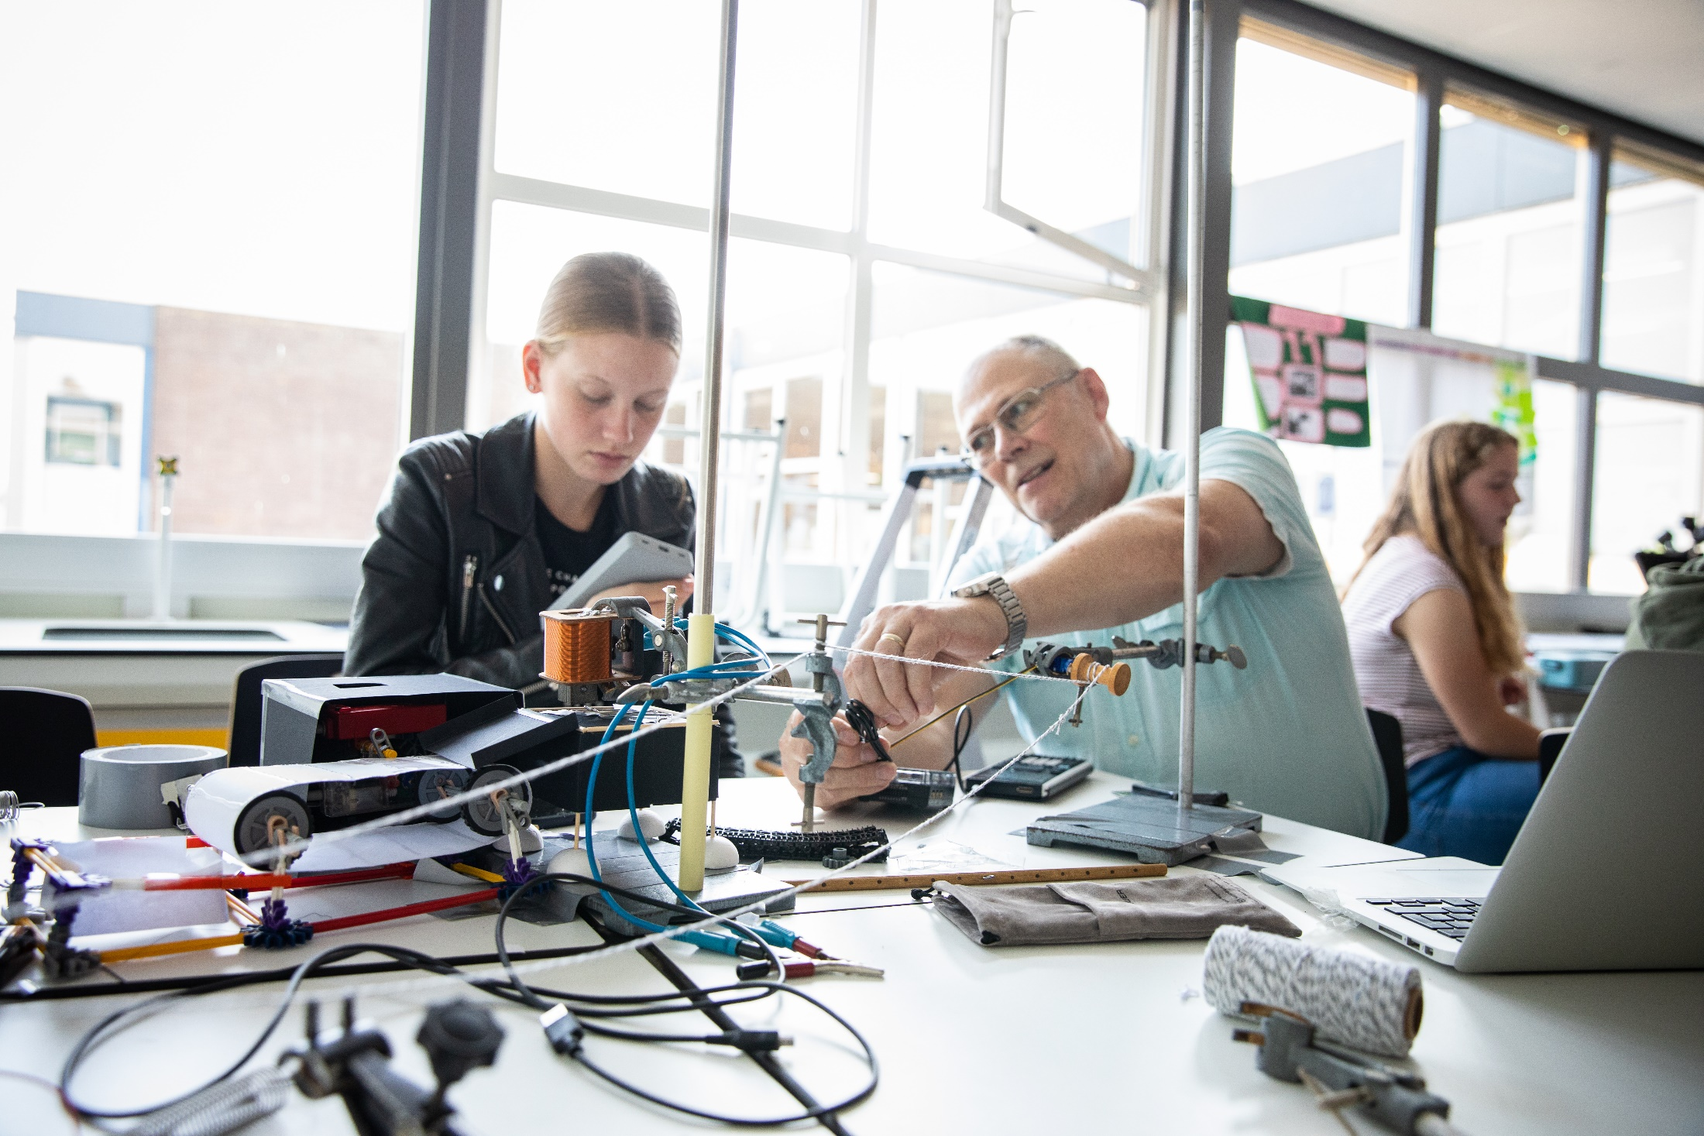
Separating Metal

Slide 15
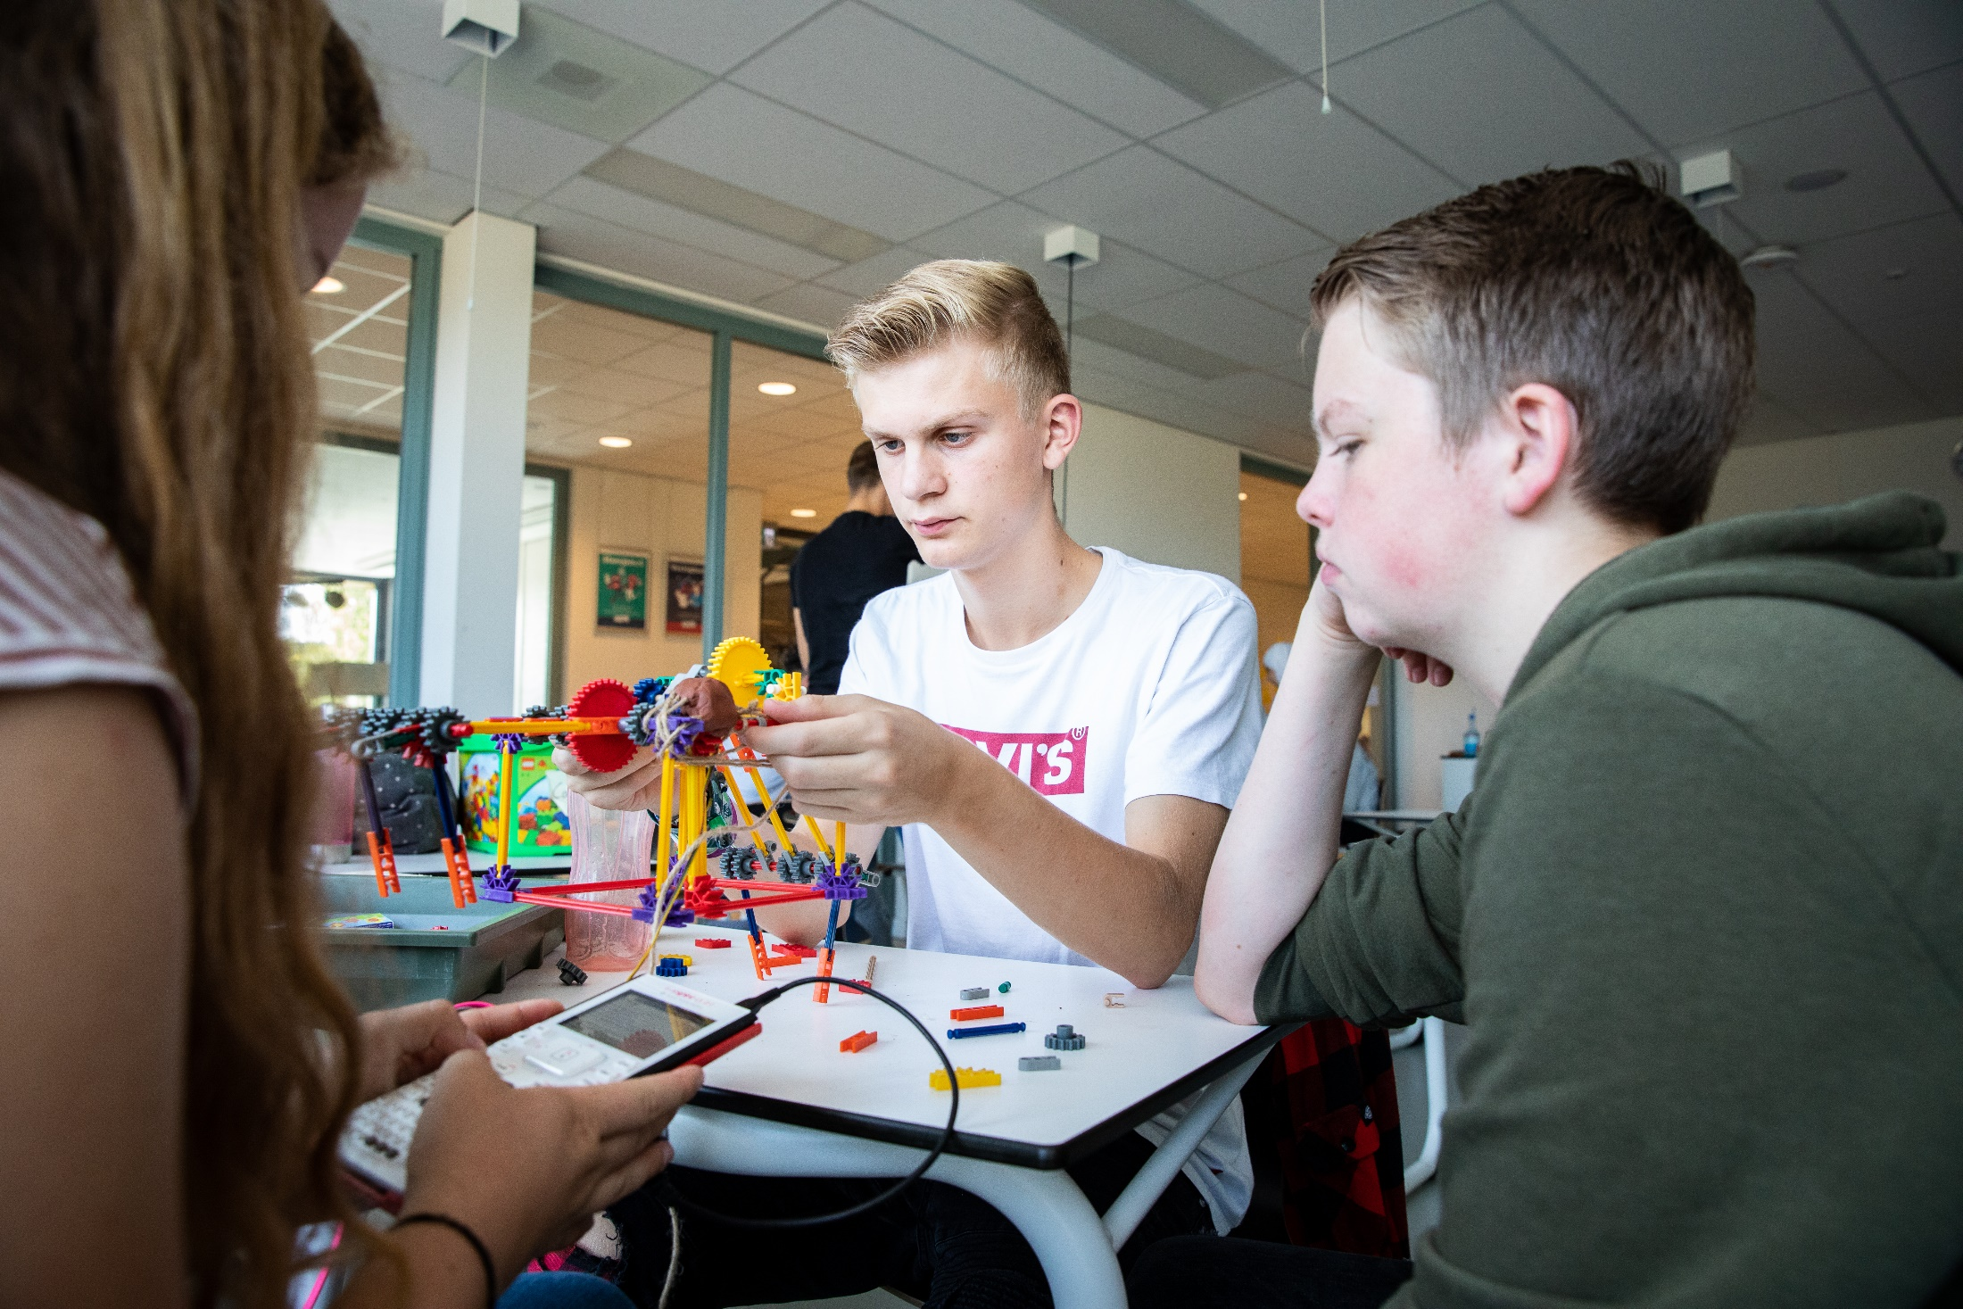
Garbage van

Slide 16
Short video about project
Video: https://www.youtube.com/watch?v=XGJ7GGlNBoI
Notes:
https://www.youtube.com/watch?v=XGJ7GGlNBoI Engelse versie

Slide 17
More information
For more information: Cathy.Baars@quicknet.nl
T3Nederland.nl
T3Europa.eu
Notes:
https://youtu.be/8GK-yFpeavs Nederlandse versie

