Slide 1
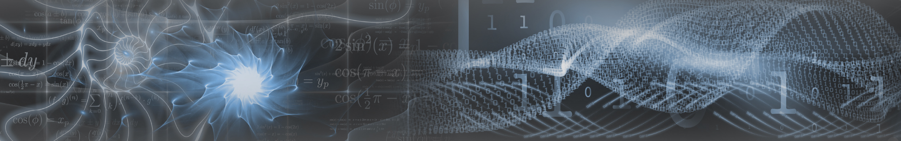

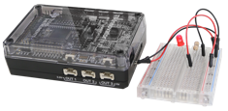
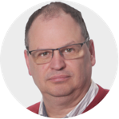


Physical Computing
with Python in the classroom
k-stulens@ti.com
cbaars@martinuscollege.nl
www.t3nederland.nl
www.wil-destem.nl
www.t3europe.eu

Slide 2
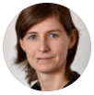
Physical Computing …
Physical computing covers the design and realization of
interactive objects and installations and allows students to
develop concrete, tangible products of the real world, which arise from the students’ imagination – Przybylla, 2014.

Slide 3

Physical Computing …
Physical computing covers the design and realization of
interactive objects and installations and allows students to
develop concrete, tangible products of the real world, which arise from the students’ imagination – Przybylla, 2014.
Physical computing involves interactive systems that can sense and respond to the world around them.
Physical computing is a framework for understanding human beings' relationship to the digital world.
In practice physical computing often describes design or DIY - do it yourself - projects that use sensors and microcontrollers to translate analog input to a software system and/or control hardware.

Slide 4

Physical Computing …
Physical computing covers the design and realization of
interactive objects and installations and allows students to
develop concrete, tangible products of the real world, which arise from the students’ imagination – Przybylla, 2014.
Physical computing involves interactive systems that can sense and respond to the world around them.
Physical computing is a framework for understanding human beings' relationship to the digital world.
In practice physical computing often describes design or DIY - do it yourself - projects that use sensors and microcontrollers to translate analog input to a software system and/or control hardware.
Physical computing means interacting with real-world objects by programming: programming an LED to flash, reading environmental data from a sensor, …
Applications like these are all around us, from traffic signals to driverless cars.
Behind these applications are algorithms and programs that govern their behaviour. Physical computing is combining hardware and software in order to create something useful / productive or simply just for fun.

Slide 5
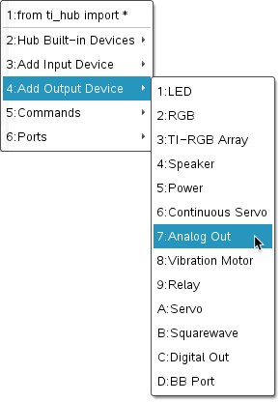
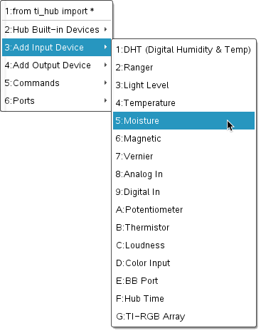
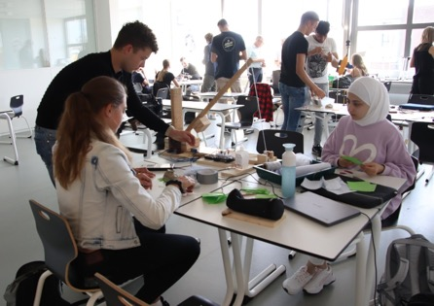
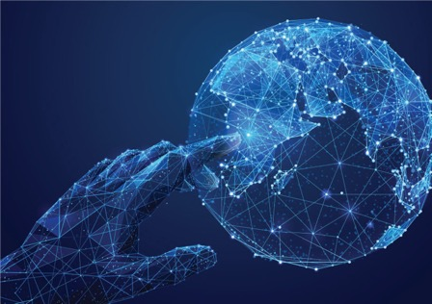




Physical Computing …
in the classroom
output
input
TI HUB Python Module
TI-Innovator Hub
$$⇔$$
$$⇔$$
$$⇔$$
Classroom
TI-Nspire CX Technology
TI-84 Plus CE-T python edition
Physical Environment
BBC micro:bit
TI Technology: www.education.ti.com > Select your country
TI Educational Content: www.t3europe.eu

Slide 6
Physical Computing …
in the classroom
environment
system
actuators
sensors
outputs
processing
inputs
TI-Innovator Hub
$$⇔$$
$$⇔$$
$$⇔$$
Classroom
TI-Nspire CX Technology
TI-84 Plus CE-T python edition
Physical Environment
BBC micro:bit
TI Technology: www.education.ti.com > Select your country
TI Educational Content: www.t3europe.eu

Slide 7
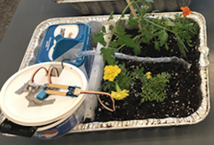
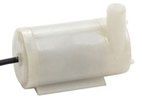

Physical Computing …
in the classroom
Smart Irrigation System
environment
system
actuators
sensors
outputs
processing
inputs
Moisture sensor
www.tistemprojects.com
resources.t3europe.eu
Water Pump
TI-Innovator Hub
$$⇔$$
$$⇔$$
$$⇔$$
Classroom
TI-Nspire CX Technology
TI-84 Plus CE-T python edition
Physical Environment
BBC micro:bit
TI Technology: www.education.ti.com > Select your country
TI Educational Content: www.t3europe.eu

Slide 8
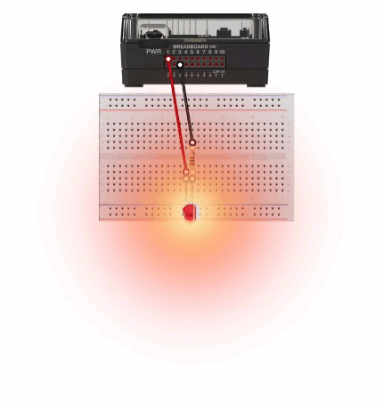
Physical Computing …
Basics – Actuators
Flashing LED
Sound
from ti_hub import *
flash=led("BB1")
for i in range(5):
♦♦flash.on()
♦♦sleep(1)
♦♦flash.off()
♦♦sleep(1)

Slide 9
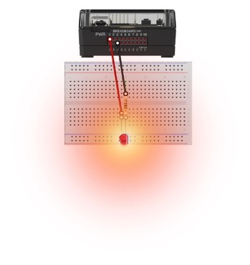
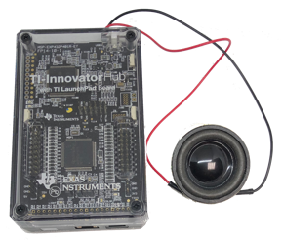

Physical Computing …
Basics – Actuators
Flashing LED
Sound
from ti_hub import *
flash=led("BB1")
for i in range(5):
♦♦flash.on()
♦♦sleep(1)
♦♦flash.off()
♦♦sleep(1)
from ti_hub import *
sound=speaker("BB1")
for i in range(5):
♦♦sound.tone(500,1)
♦♦sleep(1)
♦♦sound.tone(375,1)
♦♦sleep(1)

Slide 10
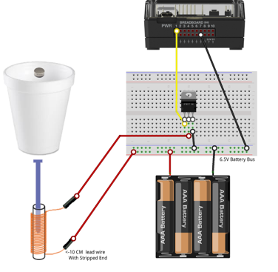
Physical Computing …
Basics – Actuators
Flashing LED
Sound
from ti_hub import *
flash=led("BB1")
for i in range(5):
♦♦flash.on()
♦♦sleep(1)
♦♦flash.off()
♦♦sleep(1)
from ti_hub import *
sound=speaker("BB1")
for i in range(5):
♦♦sound.tone(500,1)
♦♦sleep(1)
♦♦sound.tone(375,1)
♦♦sleep(1)

Slide 11
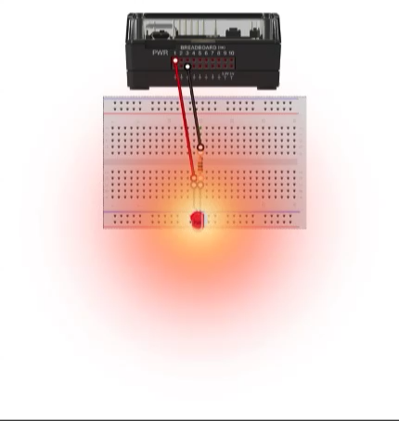
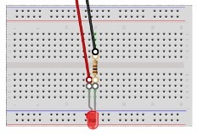

Physical Computing …
Basics – Actuators
Alarm
Flashing LED
from ti_hub import *
flash=led("BB1")
sound=speaker("BB2")
for i in range(5):
♦♦flash.on()
♦♦sound.tone(500,1)
♦♦sleep(1)
♦♦flash.off()
♦♦sound.tone(375,1)
♦♦sleep(1)
Sound
from ti_hub import *
flash=led("BB1")
for i in range(5):
♦♦flash.on()
♦♦sleep(1)
♦♦flash.off()
♦♦sleep(1)
from ti_hub import *
sound=speaker("BB2")
for i in range(5):
♦♦sound.tone(500,1)
♦♦sleep(1)
♦♦sound.tone(375,1)
♦♦sleep(1)

Slide 12
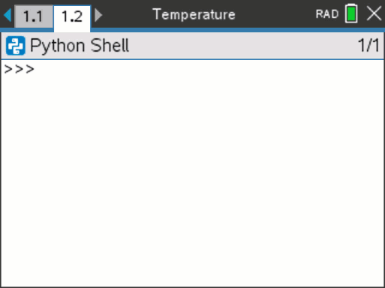
Physical Computing …
Basics – Sensors
Temperature
from ti_hub import *
from ti_system import *
temp=temperature("IN 1")
while get_key() != "esc":
♦♦t=temp.measurement()
♦♦print("Temperature =",t)
♦♦sleep(0.5)
♦♦get_key()

Slide 13
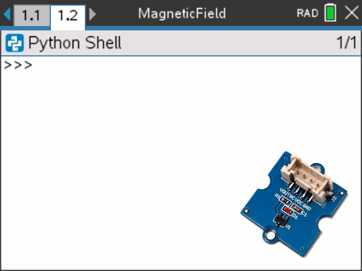
Physical Computing …
Basics – Sensors
Magnetic Field
from ti_hub import *
from ti_system import *
mag=magnetic("IN 3")
while get_key() != "esc":
♦♦m=mag.measurement()
♦♦print("Hallsensor = {}".format(int(m)))
♦♦if m<100:
♦♦♦♦print("Magnet detected")
♦♦else:
♦♦♦♦print("Magnet not detected”)
♦♦sleep(1)
♦♦get_key()
Temperature
from ti_hub import *
from ti_system import *
temp=temperature("IN 1")
while get_key() != "esc":
♦♦t=temp.measurement()
♦♦print("Temperature =",t)
♦♦sleep(0.5)
♦♦get_key()

Slide 14
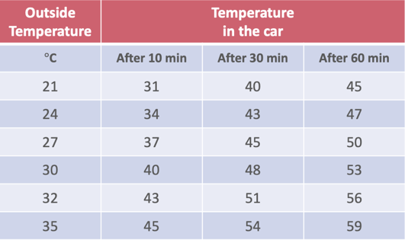
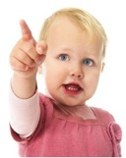
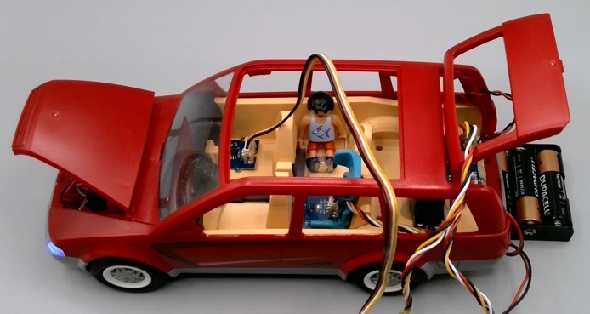
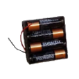
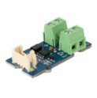
Physical Computing …
Heat Car Alarm
Don’t let us in the car!
from ti_hub import *
from ti_draw import *
flash=led("BB1")
sound=speaker("BB 2")
temp=temperature("IN 1")
mag=magnetic("IN 3")

Slide 15
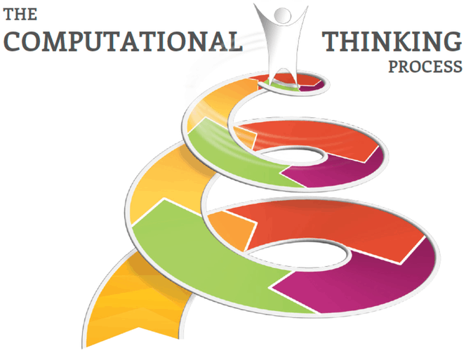
Physical Computing …
Heat Car Alarm
Don’t let us in the car!
from ti_hub import *
from ti_draw import *
flash=led("BB1")
sound=speaker("BB 2")
temp=temperature("IN 1")
mag=magnetic("IN 3")
Structure
Translate
Process
Control

Slide 16
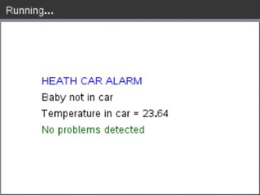
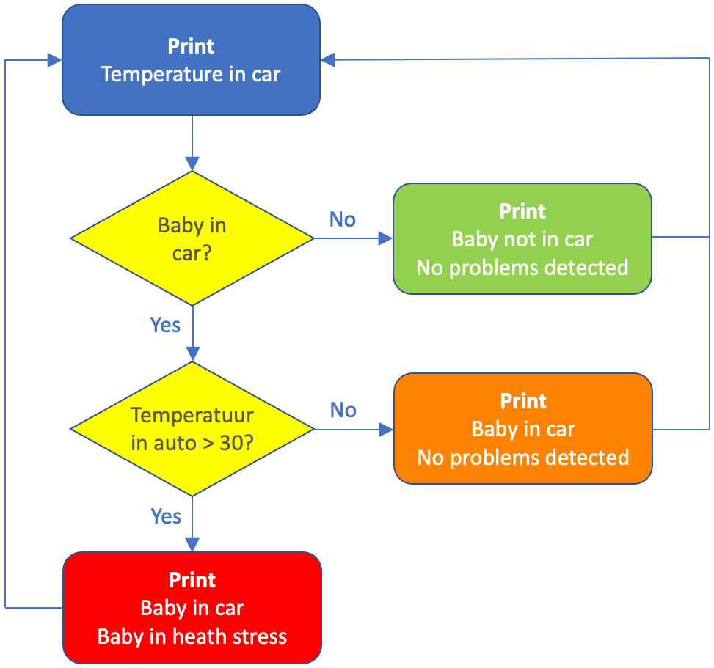
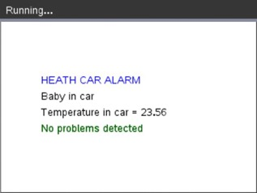

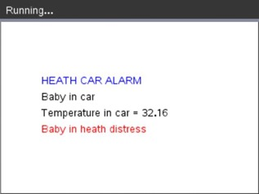
Physical Computing …
Heat Car Alarm
Structure
Translate
Process
Control
Don’t let us in the car!
from ti_hub import *
from ti_draw import *
flash=led("BB1")
sound=speaker("BB 2")
temp=temperature("IN 1")
mag=magnetic("IN 3")

Slide 17
Physical Computing …
Heat Car Alarm
Structure
Translate
Process
Control
♦♦set_color(0,0,255)
♦♦draw_text(50,80,"HEAT CAR ALARM”)
♦♦set_color(0,0,0)
♦♦draw_text(50,120,"Temperature in car = {}".format(t))
♦♦if m > 100:
♦♦♦♦draw_text(50,100,"Baby not in car")
♦♦♦♦set_color(0,100,0)
♦♦♦♦draw_text(50,140,"No problems detected")
♦♦else:
♦♦♦♦draw_text(50,100,"Baby in car")
♦♦♦♦if t > 30:
♦♦♦♦♦♦set_color(255,0,0)
♦♦♦♦♦♦draw_text(50,140,"Baby in heath distress")
♦♦♦♦♦♦flash.blink(10,1)
♦♦♦♦♦♦sound.tone(440,1)
♦♦♦♦♦♦sleep(0.5)
♦♦♦♦♦♦sound.tone(880,0.5)
♦♦♦♦♦♦sleep(0.5)
♦♦♦♦else:
♦♦♦♦♦♦set_color(0,100,0)
♦♦♦♦♦♦draw_text(50,140,"No problems detected")
♦♦paint_buffer()
♦♦sleep(1)
Don’t let us in the car!
from ti_hub import *
from ti_draw import *
flash=led("BB1")
sound=speaker("BB 2")
temp=temperature("IN 1")
mag=magnetic("IN 3")
use_buffer()
while get_key() != "esc":
♦♦clear()
♦♦t=round(temp.measurement(),2)
♦♦m=mag.measurement()

Slide 18
Physical Computing …
Heat Car Alarm
Structure
Translate
Process
Control
♦♦set_color(0,0,255)
♦♦draw_text(50,80,"HEAT CAR ALARM")
♦♦set_color(0,0,0)
♦♦draw_text(50,120,"Temperature in car = {}".format(t))
♦♦if m > 100:
♦♦♦♦draw_text(50,100,"Baby not in car")
♦♦♦♦set_color(0,100,0)
♦♦♦♦draw_text(50,140,"No problems detected")
♦♦else:
♦♦♦♦draw_text(50,100,"Baby in car")
♦♦♦♦if t > 30:
♦♦♦♦♦♦set_color(255,0,0)
♦♦♦♦♦♦draw_text(50,140,"Baby in heath distress")
♦♦♦♦♦♦flash.blink(10,1)
♦♦♦♦♦♦sound.tone(440,1)
♦♦♦♦♦♦sleep(0.5)
♦♦♦♦♦♦sound.tone(880,0.5)
♦♦♦♦♦♦sleep(0.5)
♦♦♦♦else:
♦♦♦♦♦♦set_color(0,100,0)
♦♦♦♦♦♦draw_text(50,140,"No problems detected")
♦♦paint_buffer()
♦♦sleep(1)
Don’t let us in the car!
from ti_hub import *
from ti_draw import *
flash=led("BB1")
sound=speaker("BB 2")
temp=temperature("IN 1")
mag=magnetic("IN 3")
use_buffer()
while get_key() != "esc":
♦♦clear()
♦♦t=round(temp.measurement(),2)
♦♦m=mag.measurement()

Slide 19
Physical Computing …
Heat Car Alarm
Structure
Translate
Process
Control
♦♦set_color(0,0,255)
♦♦draw_text(50,80,"HEAT CAR ALARM”)
♦♦set_color(0,0,0)
♦♦draw_text(50,120,"Temperature in car = {}".format(t))
♦♦if m > 100:
♦♦♦♦draw_text(50,100,"Baby not in car")
♦♦♦♦set_color(0,100,0)
♦♦♦♦draw_text(50,140,"No problems detected")
♦♦else:
♦♦♦♦draw_text(50,100,"Baby in car")
♦♦♦♦if t > 30:
♦♦♦♦♦♦set_color(255,0,0)
♦♦♦♦♦♦draw_text(50,140,"Baby in heat distress")
♦♦♦♦♦♦flash.blink(10,1)
♦♦♦♦♦♦sound.tone(440,1)
♦♦♦♦♦♦sleep(0.5)
♦♦♦♦♦♦sound.tone(880,0.5)
♦♦♦♦♦♦sleep(0.5)
♦♦♦♦else:
♦♦♦♦♦♦set_color(0,100,0)
♦♦♦♦♦♦draw_text(50,140,"No problems detected")
♦♦paint_buffer()
♦♦sleep(1)
Don’t let us in the car!
from ti_hub import *
from ti_draw import *
flash=led("BB1")
sound=speaker("BB 2")
temp=temperature("IN 1")
mag=magnetic("IN 3")
use_buffer()
while get_key() != "esc":
♦♦clear()
♦♦t=round(temp.measurement(),2)
♦♦m=mag.measurement()

Slide 20
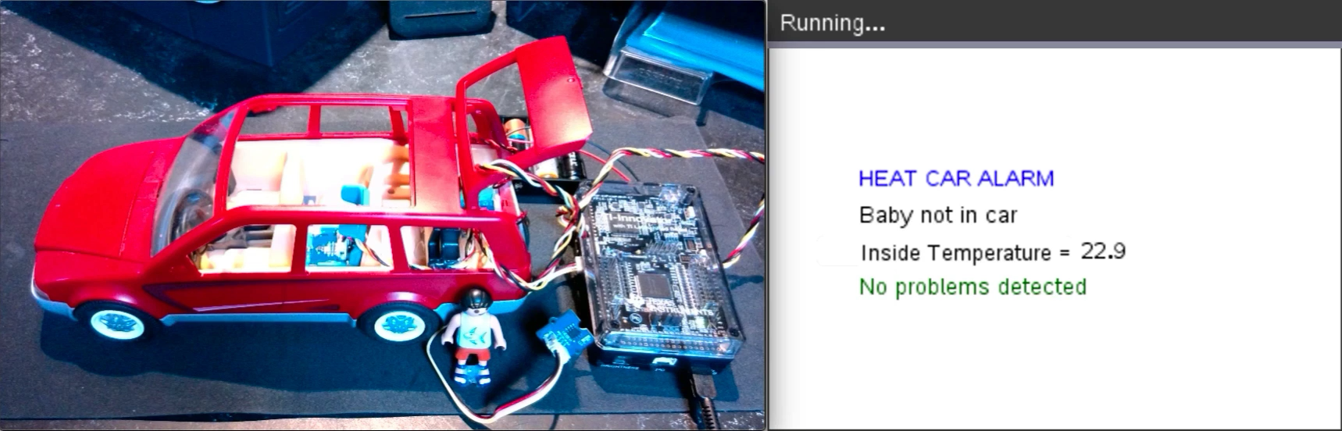
Physical Computing …
Heath Car Alarm
Structure
Translate
Process
Control
Don’t let us in the car!

Slide 21


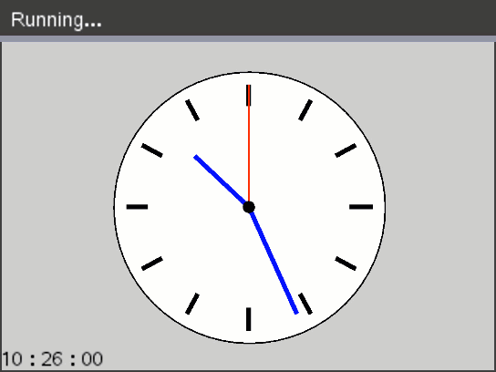

Physical Computing …
Uniform Linear Motion
from time import *
from ti_system import *
import ti_rover as rv
d0=rv.ranger_measurement()
t0=clock()
dis=[] ; t=[]
rv.forward(100)
while d > 0.1:
♦♦d=rv.ranger_measurement()
♦♦dis.append(d)
♦♦t.append(clock())
rv.stop()
store_list("distance",dis) ; store_list("time",t)
store_value("t0",t0) ; store_value("d0",d0)
+ data manipulation
10 cm

Slide 22
Physical Computing …
Uniform Linear Motion
from time import *
from ti_system import *
import ti_rover as rv
d0=rv.ranger_measurement()
t0=clock()
dis=[] ; t=[]
rv.forward(100)
while d > 0.1:
♦♦d=rv.ranger_measurement()
♦♦dis.append(d)
♦♦t.append(clock())
rv.stop()
store_list("distance",dis) ; store_list("time",t)
store_value("t0",t0) ; store_value("d0",d0)
+ data manipulation
10 cm

Slide 23

Physical Computation
in the classroom
Teaching is more than the dissemination of content
Teaching should cultivate curiosity and inquiry
Teaching should spark student imagination and creativity
Students
deserve it!
Some skills become more important because technology requires it
Some skills become less important because technology replaces it
Some skills becomes possible because technology allows it
based on Bert Waits – 2000
Co-founder Teachers Teaching with Technology™

